Slide 1


Demonstration of the QGIS-plugin
^{Online Webinar|15.12.2025}
^{Cristiano Guidi}
interreg-baltic.eu/project/APRIORA

Slide 2


APRIORA plugin
What does the end-user receive?
URO
SYKE
EPOELY
FIMEA
UBA
QGIS plugin
LIAE
LVGMC
GUT
HKR

Slide 3

APRIORA plugin
Main features
Integrated into existing workflows, no need for additional software
Freely available, not something you need to buy
Flexible and adaptable, allows adjustments during piloting and beyond
Comes with a detailed user manual (under writing)
Generates risk maps for each substance selected
    Status quo: baseline risk with no mitigation
    Mitigation scenarios: updated maps showing concentrations and risk levels after measures are applied

Slide 4
APRIORA plugin
Why QGIS?
Free and open-source GIS software
Easy to create digital maps and visualize geographical data
Already familiar to our target group (users working with spatial data)
Goal
Make risk assessment easy to implement in every catchment
Test mitigation scenarios a priori to support decision-making process
Provide practical support for regional and local authorities, and sectoral agencies
Integrate as much flexibility as possible to adapt to users’ needs and keep up with changing legislation

Slide 5




APRIORA plugin
Overview – what does the tool contain?
Plugin
Flow
API*
Flow estimation model
API estimation
Conduct Risk Assessment
Mitigation scenarios
Potential further applications/substances…
A – Monitoring
B3 – Flow estimation
calibration
validation
B1 – Consumption estimation
calibration
validation
Subcatchment yearly flow
B4 – Accumulation in environment
B2 – WWTP emission loads
API concentration
Legend:
Process
Intermediate output
Output
C – Risk Assessment
B6 – Mitigation measures
no
Risk maps
yes
*API = Active Pharmaceutical Ingredients

Slide 6
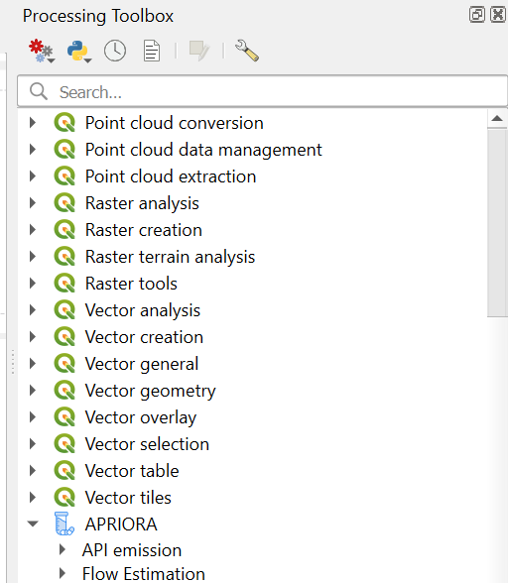
APRIORA plugin
First look
It will be available in the official QGIS repository by May 2026. Right now, it is stored in a local repository and ready to be downloaded
After the installation, you can find it in the Processing Toolbox
Two subgroups: API emission and Flow Estimation
Set of tools from Flow Estimation are not necessary
if you already have regionalized flow data

Slide 7
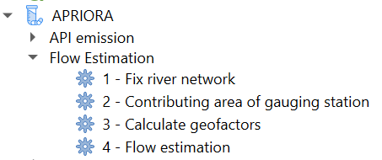
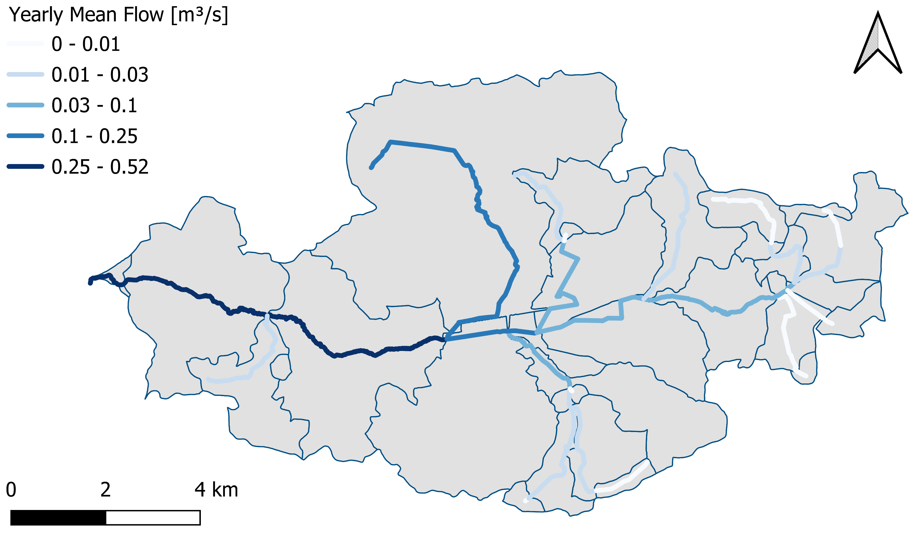
APRIORA plugin
1 – 4 Flow Estimation group
This set of tools is calculating the yearly mean flow and yearly mean low flow for each subcatchment within a catchment. The output is a river level shapefile containing the flow information.

Slide 8
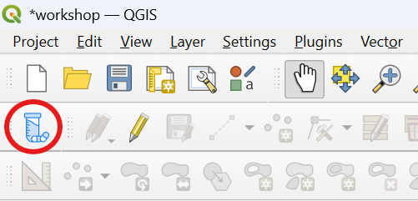

APRIORA plugin
5 – API Parameter Selection
This tool is giving the user the access to the APRIORA’s internal database related to consumption data, removal rates and PNEC values.
It is the APRIORA book of knowledge.
Here we can select certain pharmaceuticals, check their removal rates and PNEC values.

Slide 9
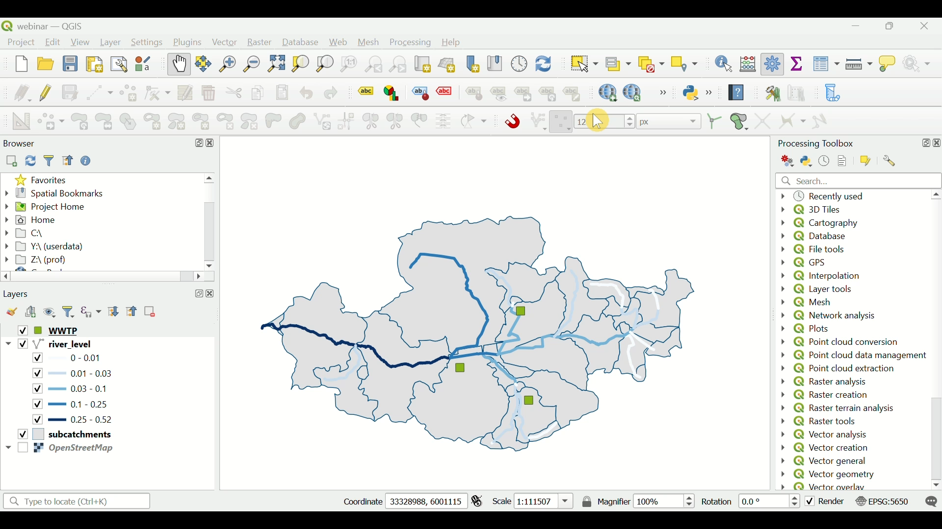
APRIORA plugin
5 – API Parameter Selection

Slide 10
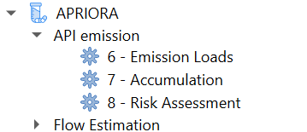
APRIORA plugin
6 – Emission Loads
This tool calculates the load of previously selected APIs at each WWTP within a catchment.
The load is expressed in kg/a.
Diclofenac: 1.6 kg/a
Diclofenac: 2 kg/a
Diclofenac: 0.4 kg/a
Catchment
Waste water treatment plant

Slide 11
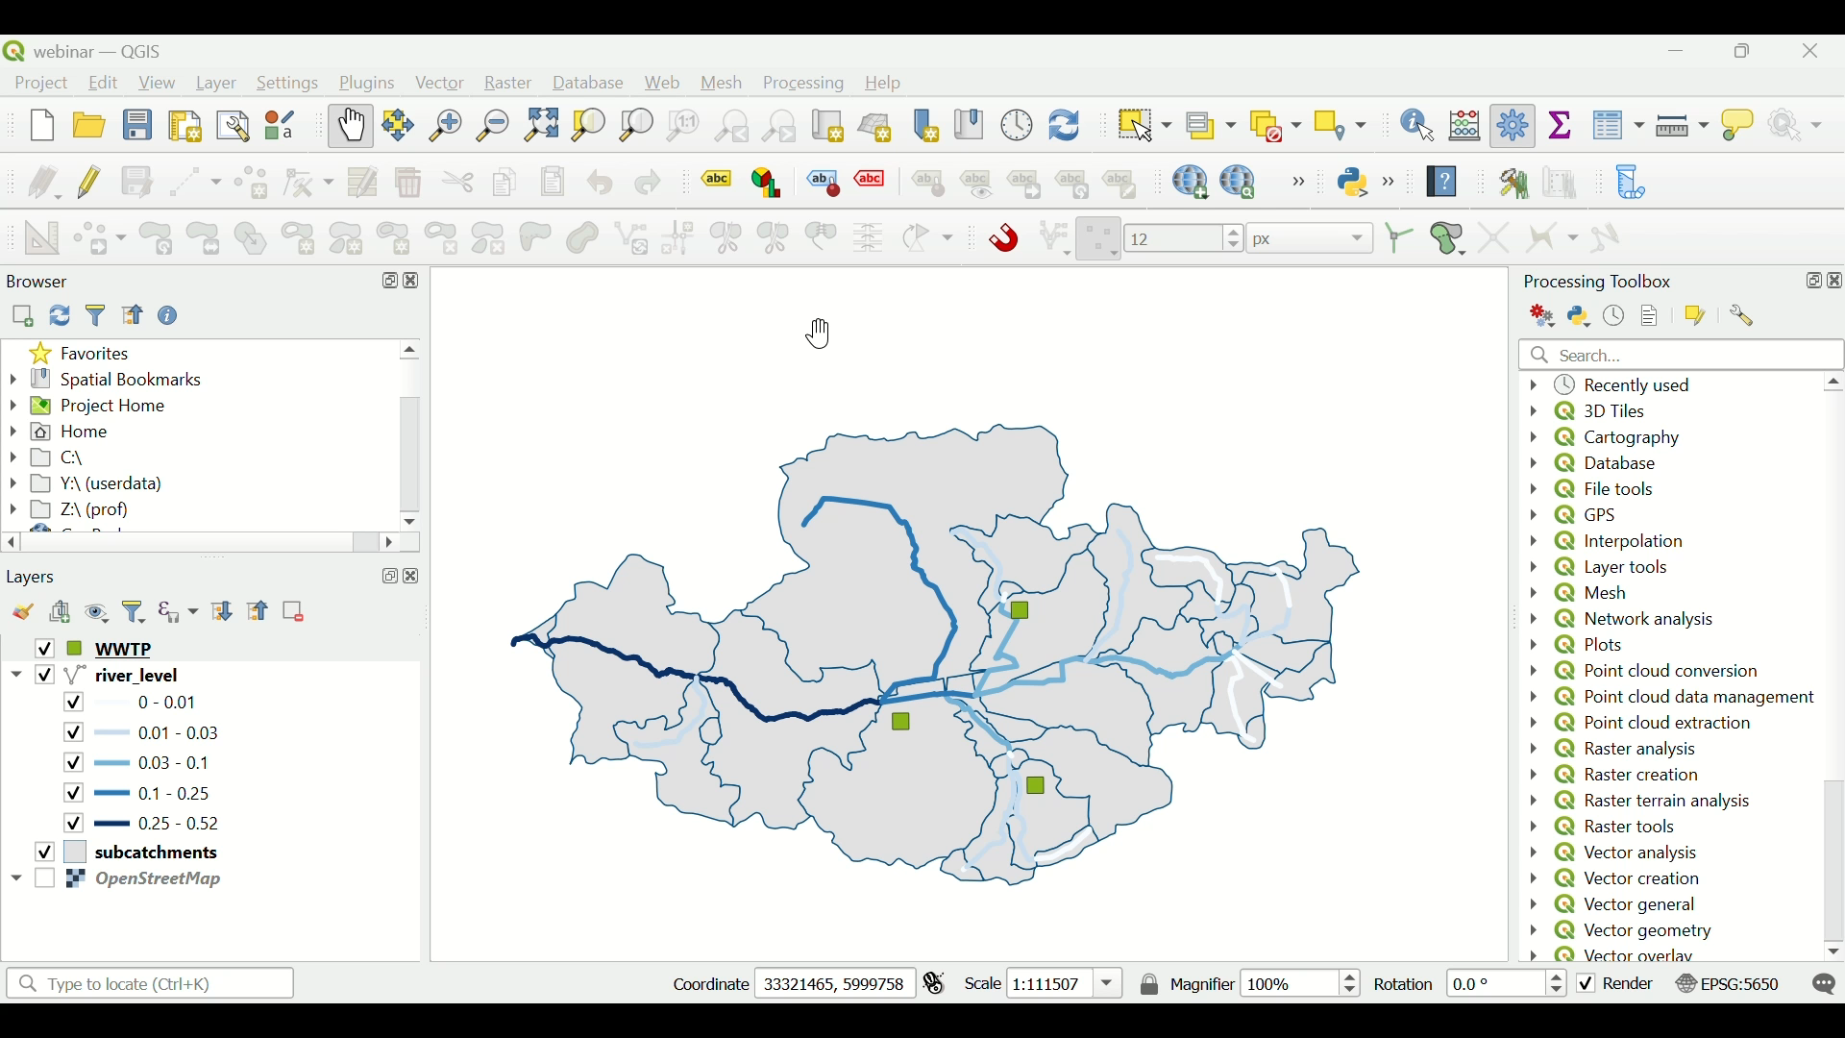
APRIORA plugin
6 – Emission Loads

Slide 12
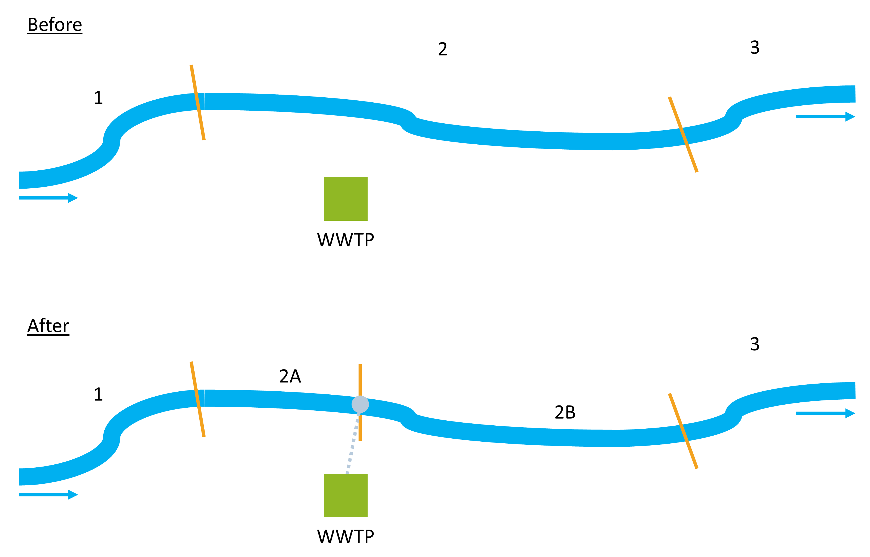
APRIORA plugin
7 – Accumulation
This tool combines the output of Flow Estimation (tool 4) with the output of Emission Loads (tool 6). In this part, the load of the selected APIs is transferred to the river network and the concentration for mean flow and mean low flow condition is calculated.

Slide 13
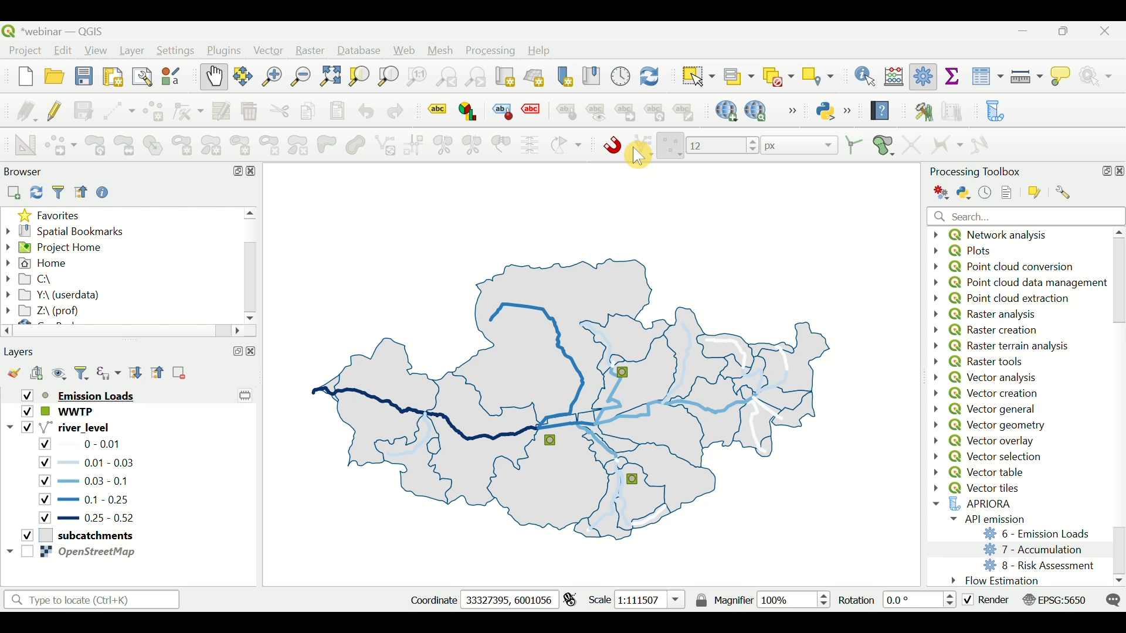
APRIORA plugin
7 – Accumulation

Slide 14
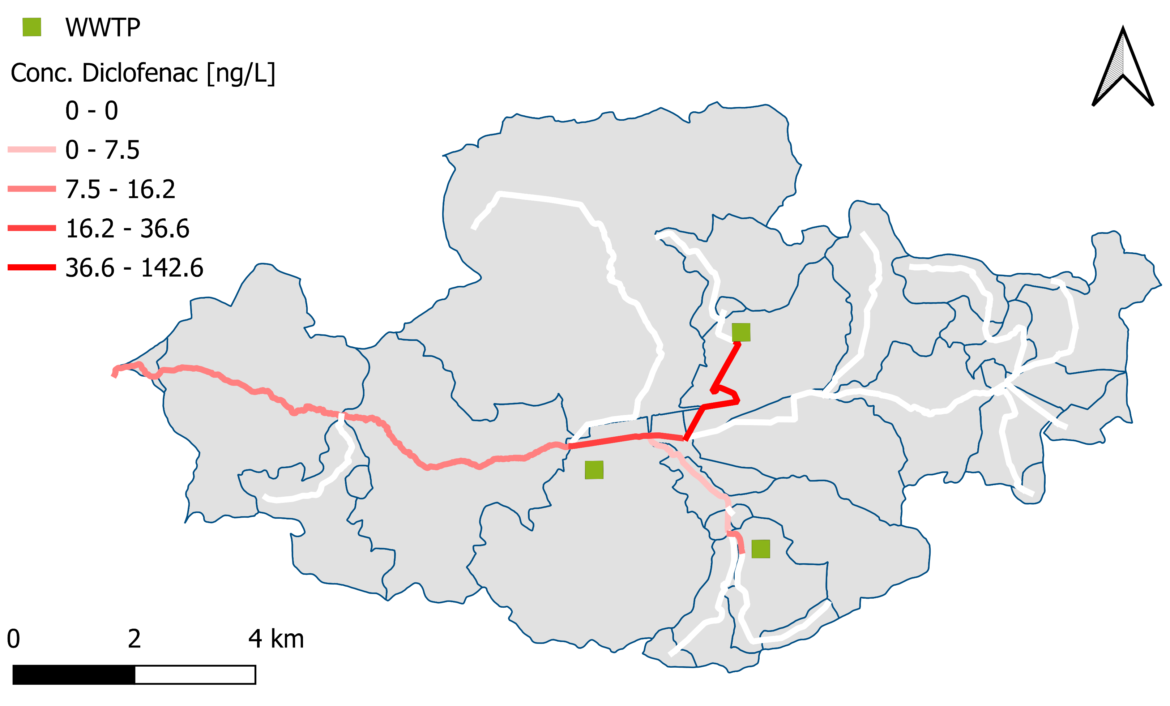
APRIORA plugin
7 – Accumulation
The output is a map with concentration values for each river section and for each pharmaceutical selected (in this case, only Diclofenac)

Slide 15
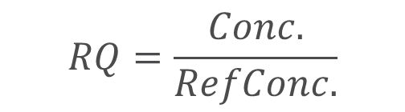
APRIORA plugin
8 – Risk Assessment
Lastly, this tool calculates the final risk from the API concentrations for each river section. So far only environmental risk assessment (ERA) is considered.
$$RQ=\frac{Conc.}{RefConc.}$$
where
RQ | = | Risk quotient
Conc. | = | Concentration in relevant environmental compactment (predicted or measured)
RefConc. | = | Reference concentration (e.g. EQS)

Slide 16
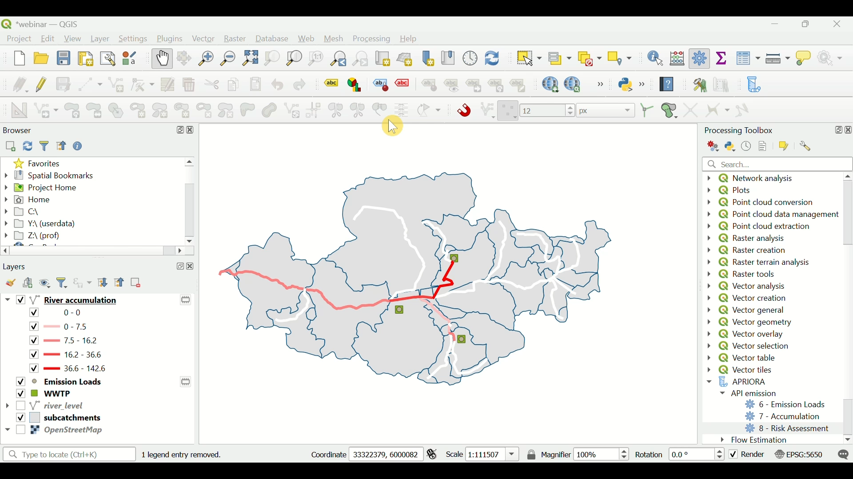
APRIORA plugin
8 – Risk Assessment

Slide 17
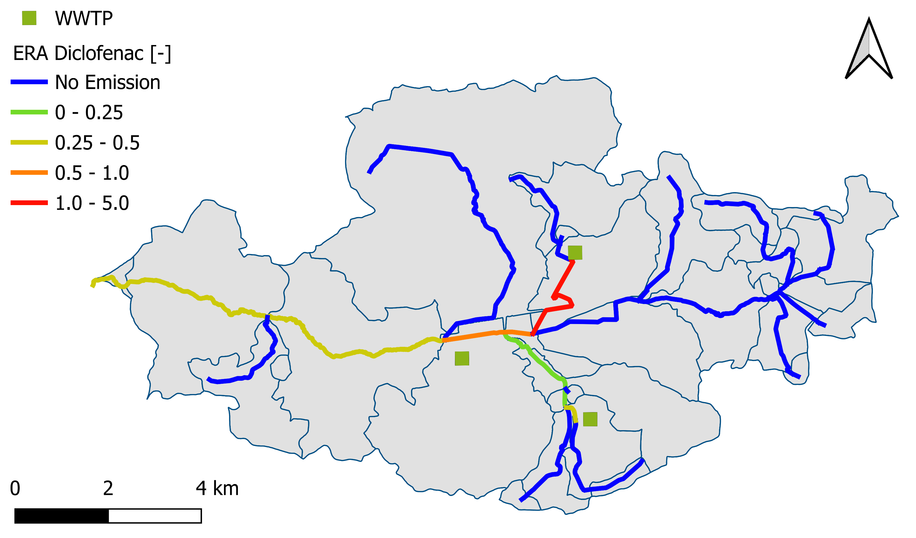
APRIORA plugin
Results
Why is this map useful?
Easy to identify river sections with higher concentration
Helps trace back WWTPs responsible for higher emission loads
Support decision-making process for mitigation, planning and monitoring

Slide 18
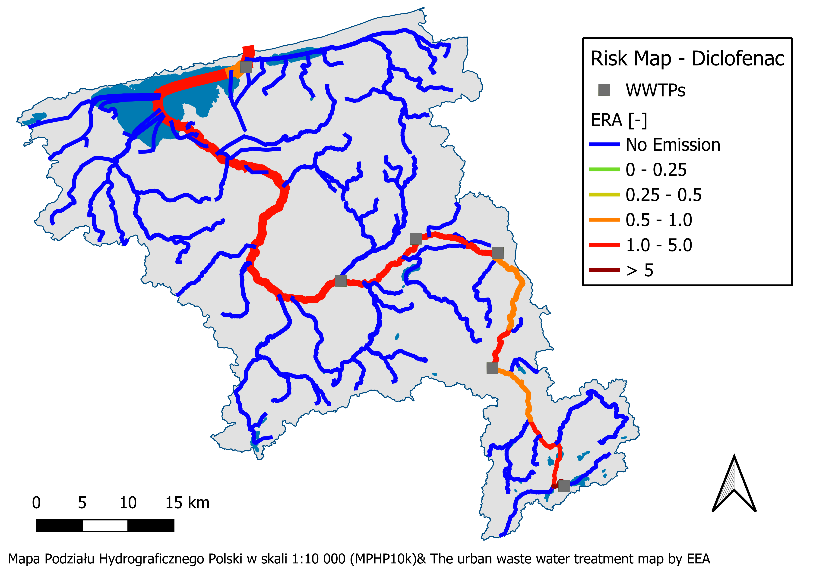
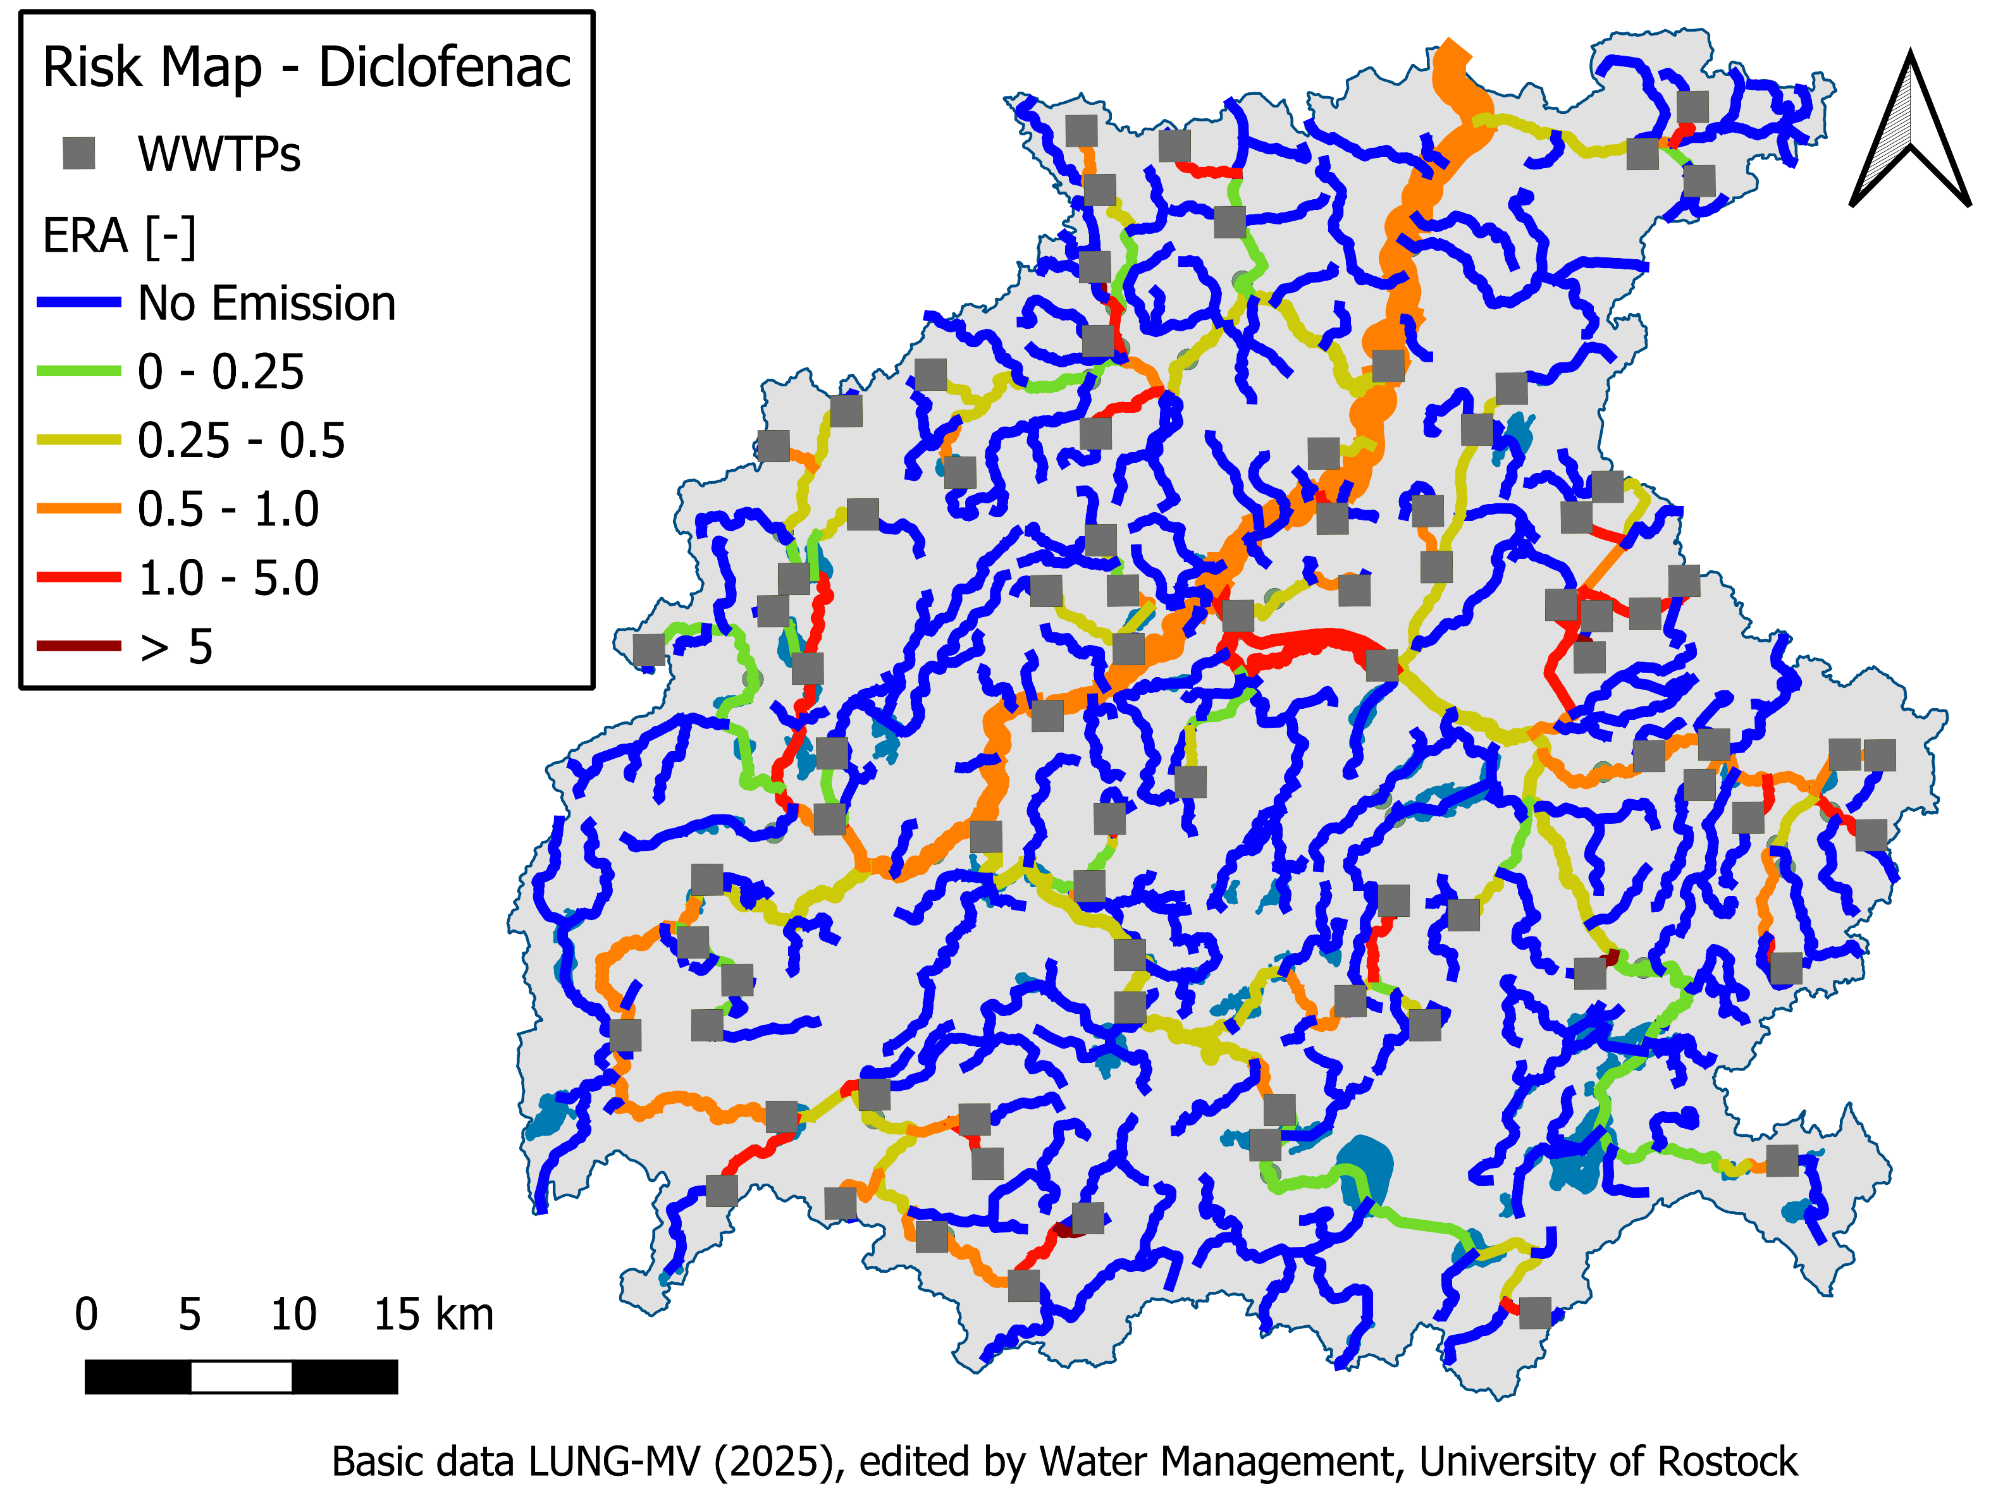
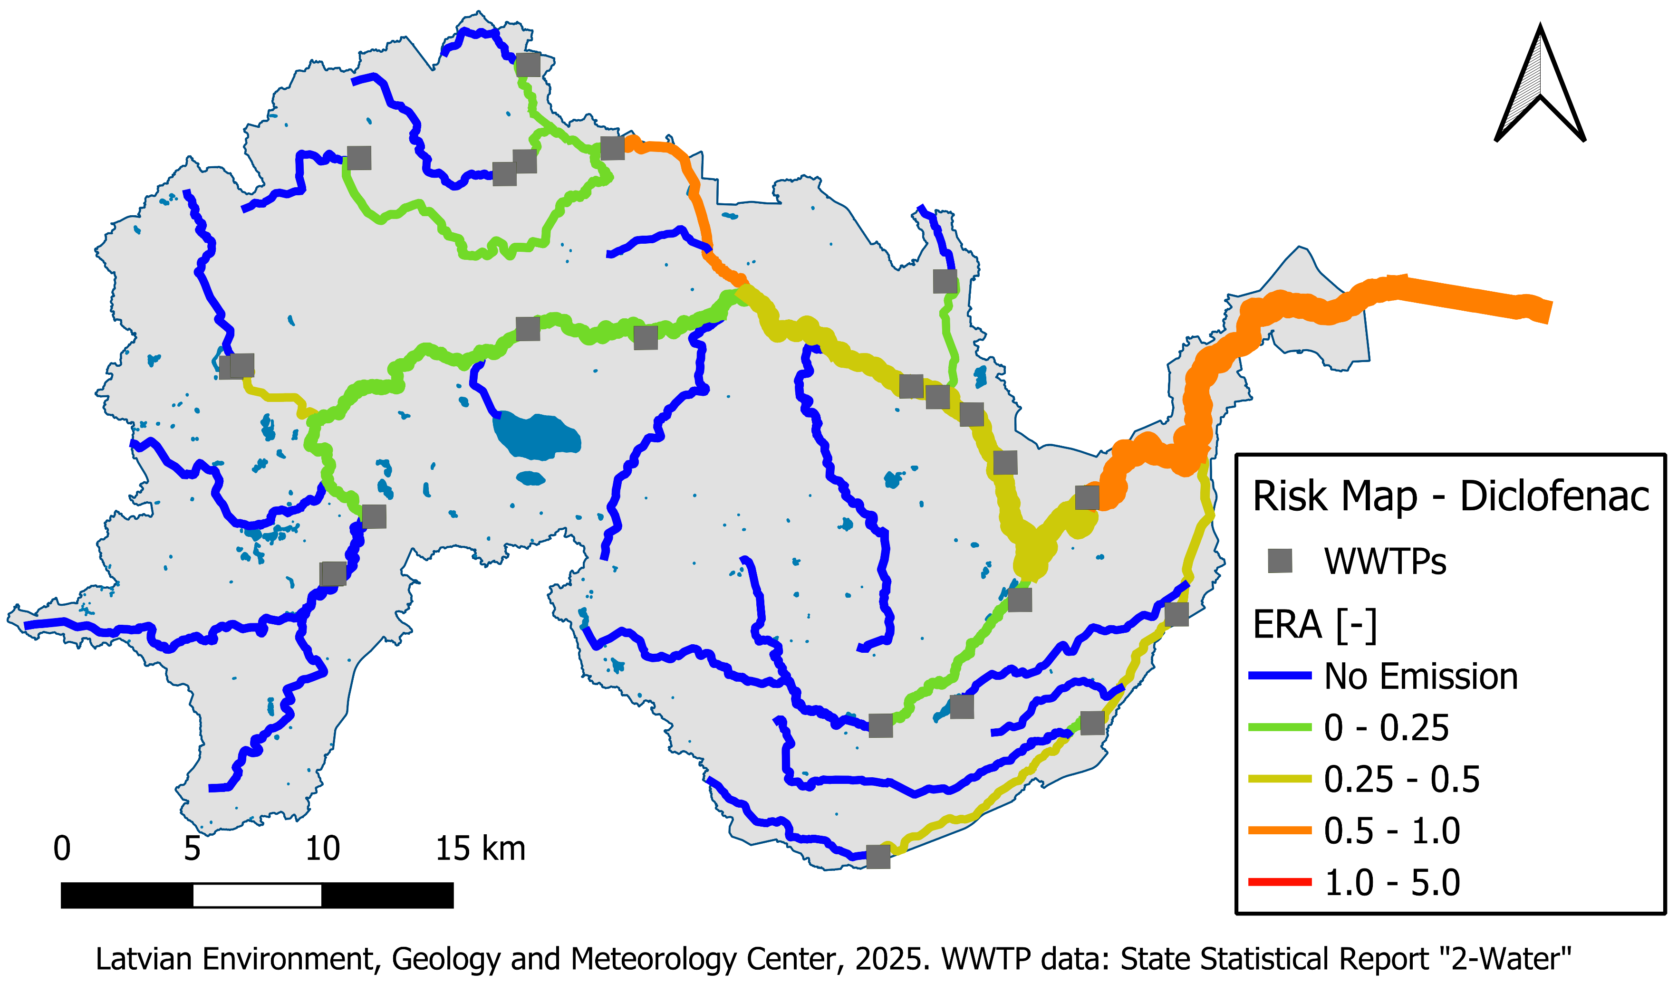
APRIORA plugin
Results

Slide 19
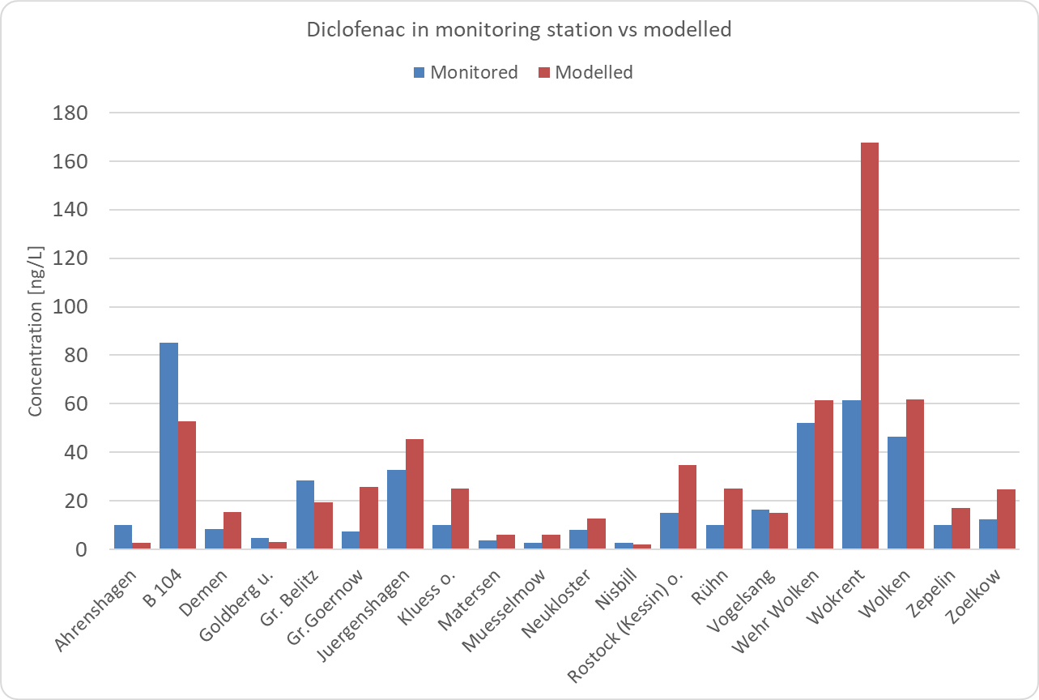
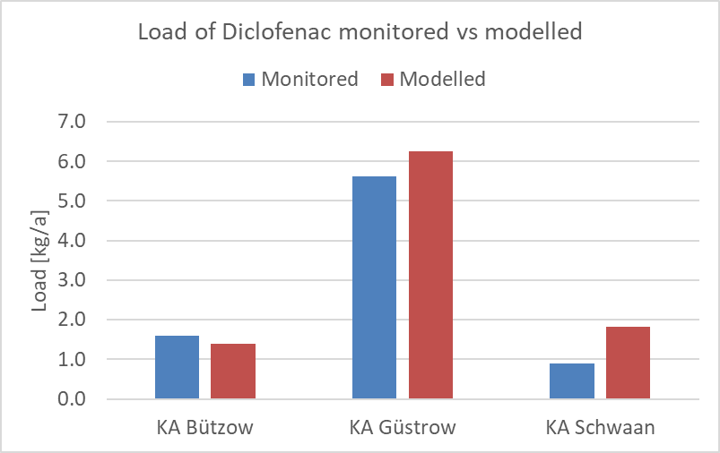
APRIORA plugin
Results
(*)
Source: Monitoring data LUNG-MV (2025)
WWTP | Conn. Inh.
KA Bützow | 7727
KA Güstrow | 34478
KA Schwaan | 10004
(*): monitoring values available only for 2016
Source: Monitoring data LUNG-MV (2025)
Source: LUNG-MV (2025)

Slide 20


APRIORA plugin
Further information
Visit our self-explaining manual website to dive deeper:
Installation instructions
Dummy dataset to test the plugin
Video tutorials for each tool
tinyurl.com/manual-apriora

Slide 21
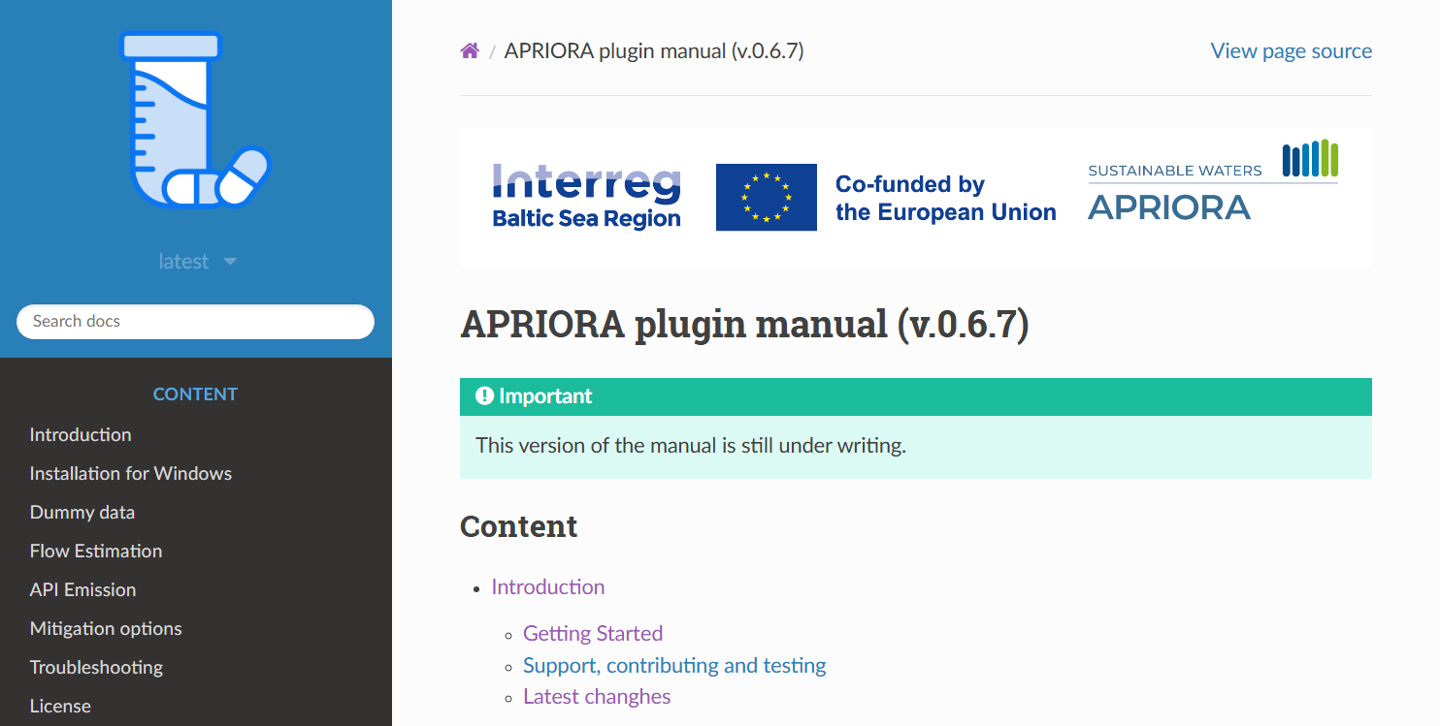
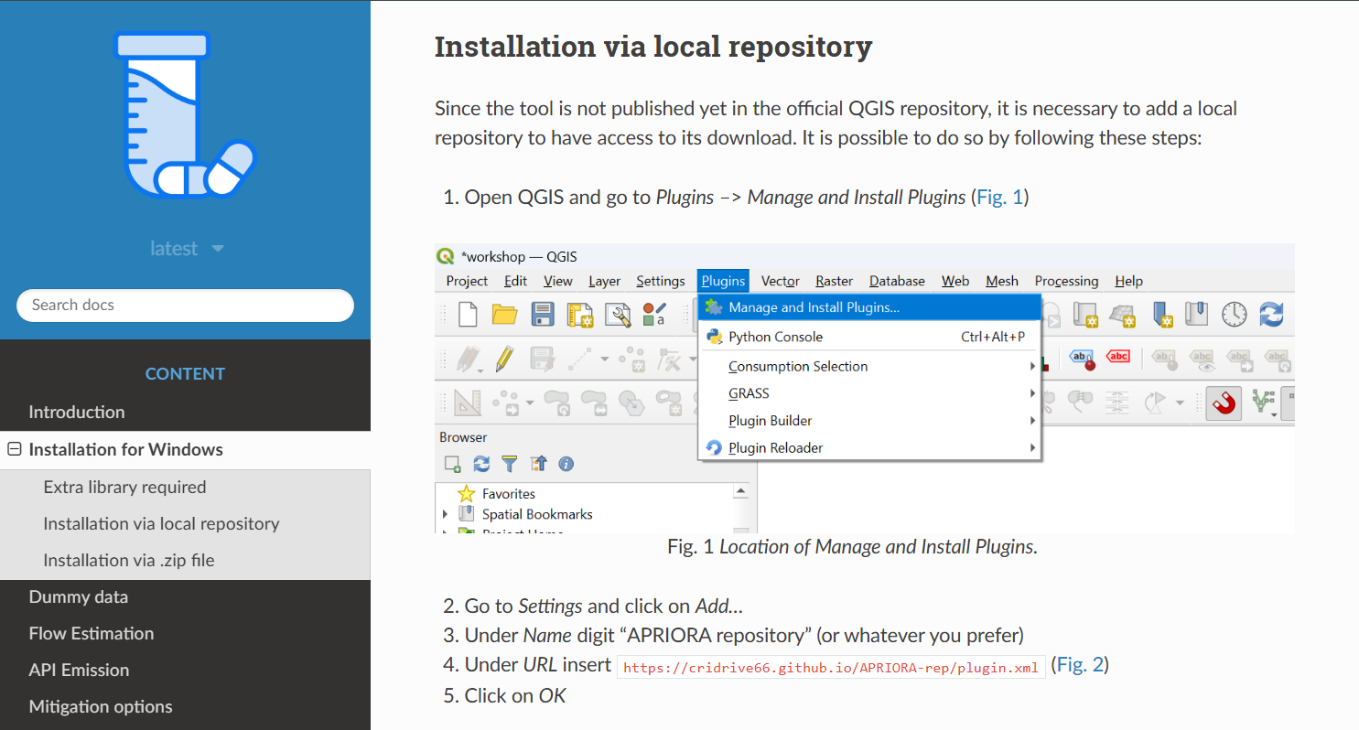
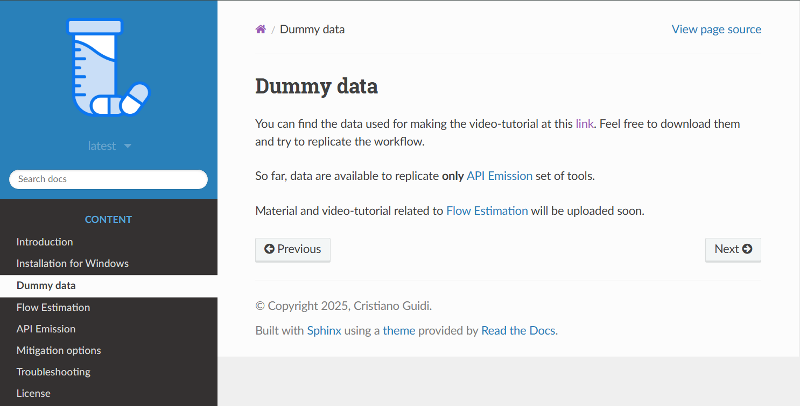
APRIORA plugin
tinyurl.com/manual-apriora
Further information
Visit our self-explaining manual website to dive deeper:

Slide 22

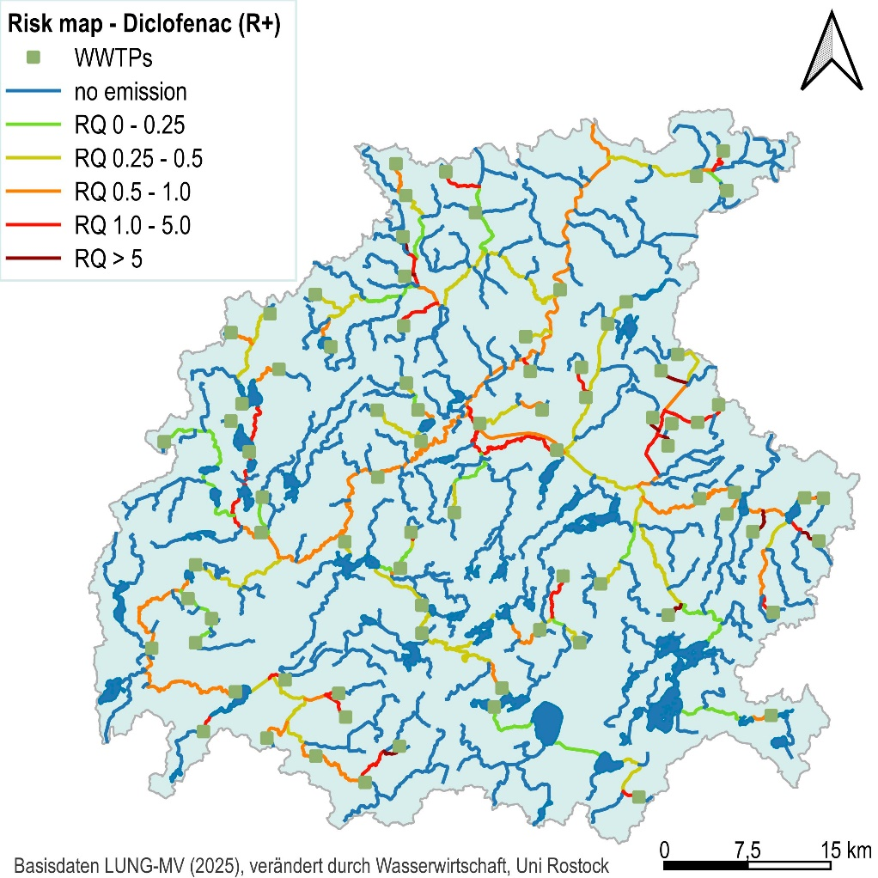
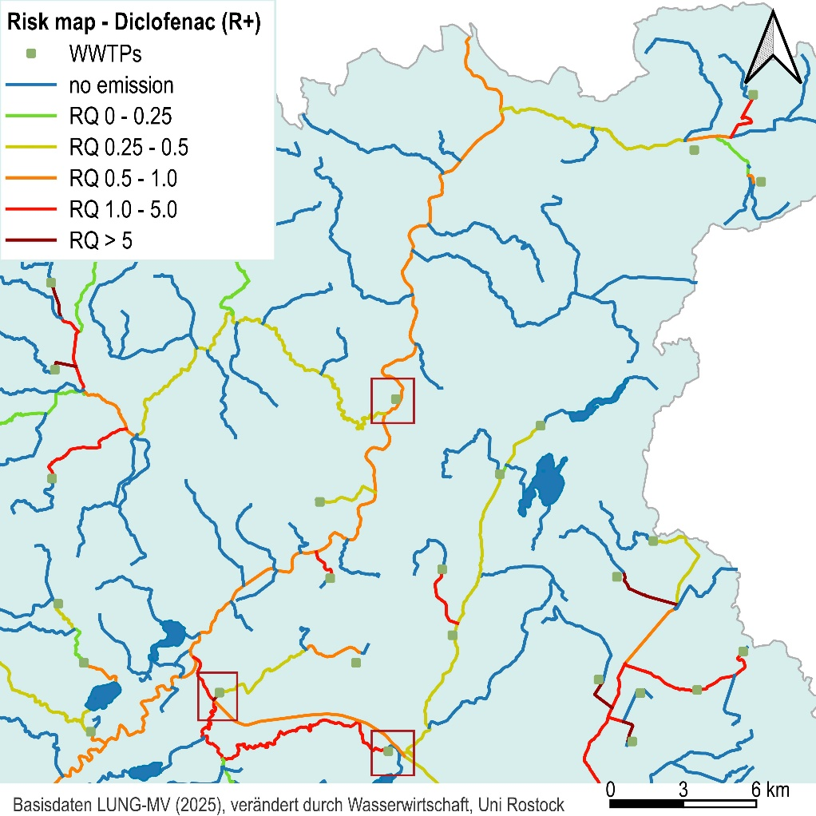
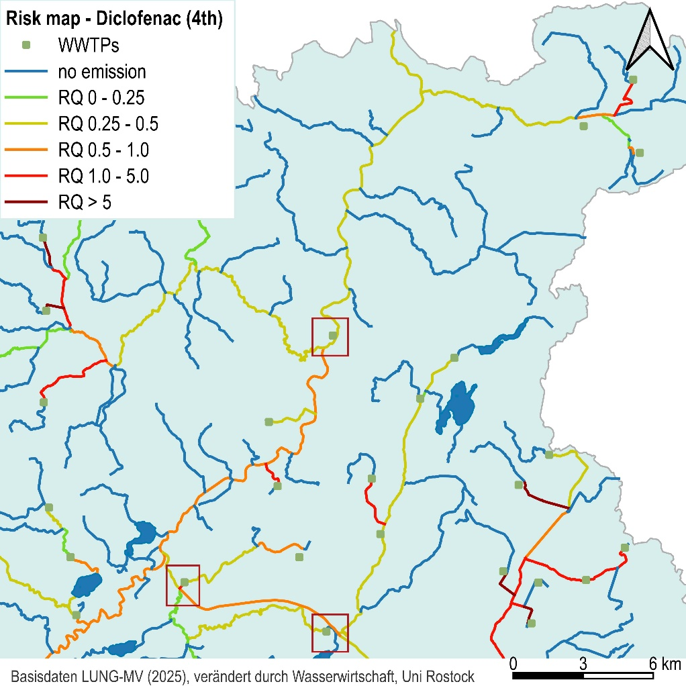
APRIORA – Piloting
Assessment of mititgation measures – example Germany
Mitigation scenario:
Quaternary treatment for all 3 WWTP > 10.000 PE
Notes:
EQS – priority substances: 40 ng/L
WC: ca 200 of 397 river sections RQ>1
including realistic removal rates: only 76 (partly RQ >100)
Relevant river sections and WWTP easy to identify for prioritising and testing mitigation

Slide 23

Output: QGIS plugin
Summary
Solution: Plugin working in a QGIS environment
Availability: official QGIS repository, but already accessible via local repository
Goal: make risk assessment easy to implement on a catchment level
Final output: catchment risk maps before and after mitigation

Slide 24
Contacts
Cristiano Guidi
cristiano.guidi2@uni-rostock.de
Co-funded by the European Union (ERDF), this #MadeWithInterreg project helps to remove pollutants from our waters.

