Slide 1

Aalborg University – Environmental Management and Sustainability Science
17th September 2025, Aalborg
Port of Aalborg
Louise Krog Mouritsen| lkm@portofaalborg.com

Slide 2
Regulatory Sandbox for CE in Port Environments
Agenda:
Circular Ports
Port environments
Definition of regulatory sandbox for CE
How to set up a regulatory sandbox
Test of Regulative Sandbox in Pilots
Pilot: Construction and Building materials

Slide 3
Circular Ports
In the project Circular Ports, Baltic Sea ports explore symbiosis opportunities within port environments for waste reduction and material reuse, establishing viable circular business models.
17 Partners from 6 countries (Germany, Finland, Estonia, Denmark, Sweden and Poland)
Duration: March 1, 2025 – March 1, 2028

Slide 4
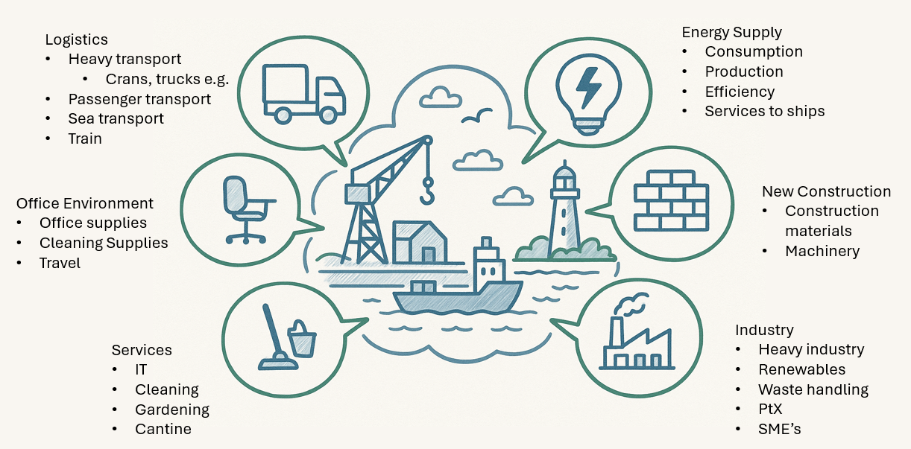
Port Environments
Example of elements in Port environment (AI generated)
Notes:
Complex logistic hus with a lot of different activities from office to heavy indrsty and everything inbetween.

Slide 5
Our Definition of Regulatory Sandbox for CE
Based on gained knowledge of regulatory sandboxes, circular economy including the R-strategies, key principles and different approaches, a definition of regulatory sandboxes for circular initiatives in port environments is defined as;
“A regulatory sandbox for circular economy initiatives is a controlled, time-bound environment that allows public authorities, businesses, and researchers to test innovative circular solutions under temporarily relaxed regulatory conditions. It facilitates the identification of risks, opportunities, and benefits, as well as collaboration among key stakeholders. The regulatory sandbox aims to accelerate circular innovation, inform policy, and support the transition to a resource-efficient economy, while maintaining ethical standards.”

Slide 6
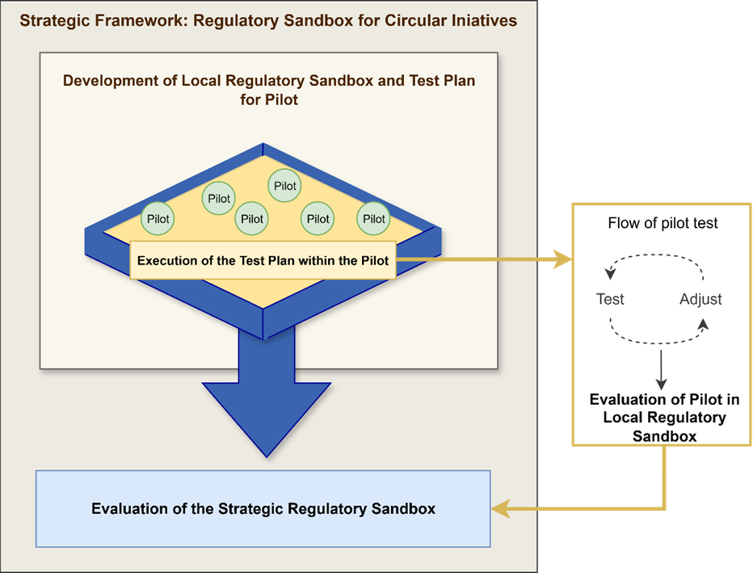
Our Approach in Circular Port
Notes:
Setting the context
CE
Port environment
Sandbox
Broad context – due to different countries and different challenges
Litteraturereviw
Unstructured litterature review on Regulatory Sandbox
Scientific Littereture review on Scopus CE in RS (85 hits – some CE business models, but not CE in Ports)
Development of Definition
Based on CE, sandbox
Development of How-to guide for local rs + pilots
Litterature
Delveoped throught discussions

Slide 7
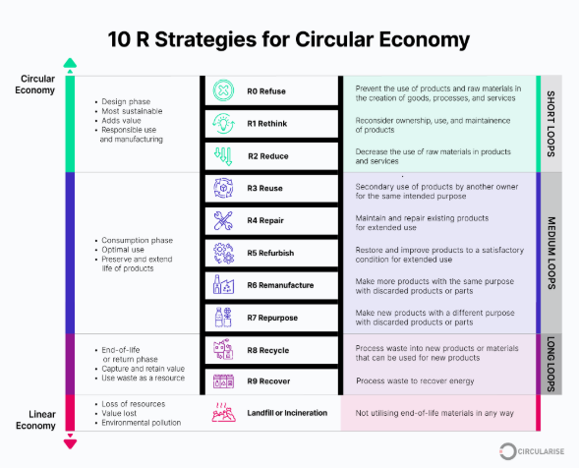
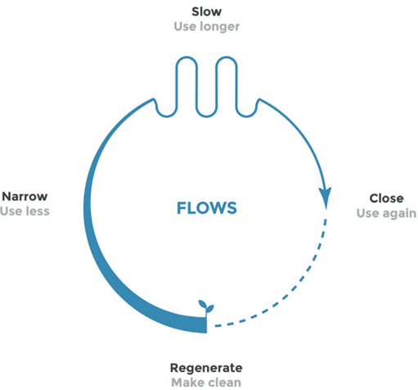
How to use the Strategic Framework for Regulatory Sandboxes
Each local regulatory sandbox shall be developed within the definition of regulatory sandbox for circular initiatives in port environments.
J. Konietzko, N. Bocken og E. J. Hultink, »Circular ecosystem innovation: An initial set of principles,« Journal of Cleaner Production, 2020.
https://www.circularise.com/blogs/r-strategies-for-a-circular-economy

Slide 8
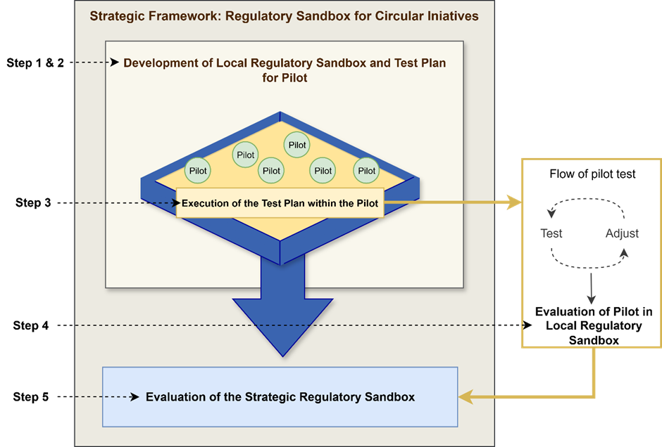
How to set-up a Regulatory Sandbox
An approach to establishing a regulatory sandbox can be broadly divided into five steps
Planning and Design
Aim: define the local regulatory frame including resources, stakeholders, risks, and safty
Test plan
Aim: develop detailed test plan for the pilot
Pilot test
Aim: carry out activities in the test plan
Evaluation of local RS
Aim: evaluation of the local pilot including scalability and knowledge sharing
Evaluation of the Strategic RS

Slide 9
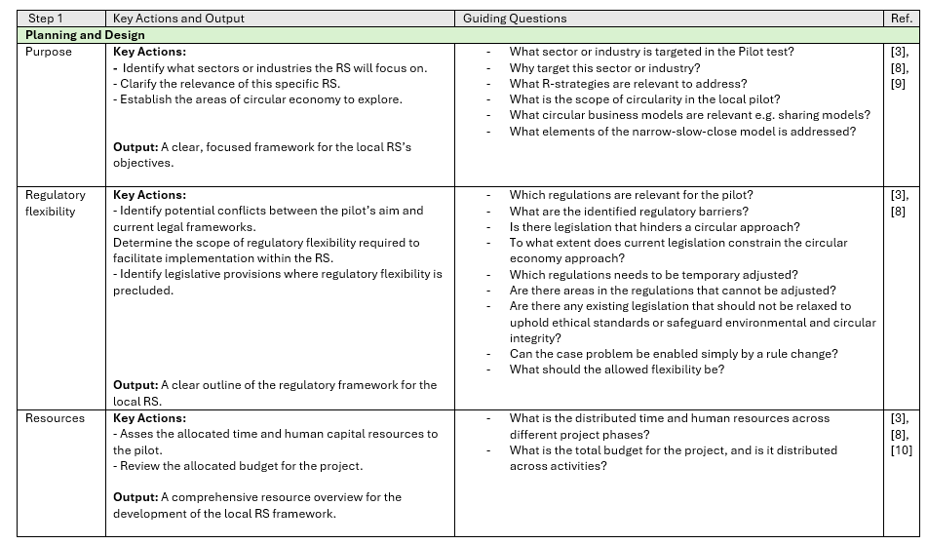
How to set-up a Regulatory Sandbox - Example

Slide 10
Test of Regulative Sandbox in Pilots
Six different pilots
Aalborg: Construction and building materials
Hamburg: Battery recycling and metal scrap
Lappeenrata: Building materials
Tallinn: Ship waste and utilisation
Norköpping: New waste streams for recycling
Gdansk: Rubber/film recycling
Each pilot are tested in a local developed regulatory sandbox for circular initiatives, designed within the local regulative set-up.

Slide 11
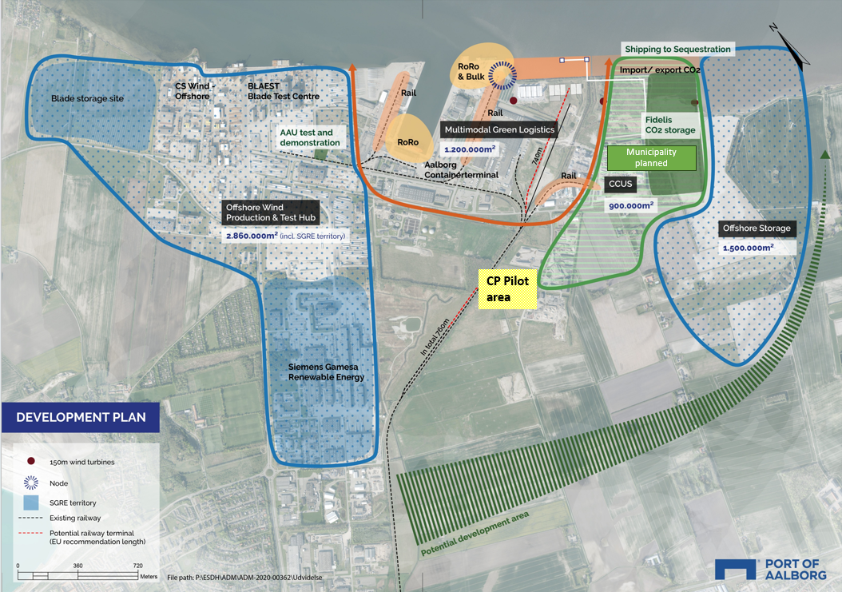
Pilot: Construction and Building Materials
Pilot aim:
To demonstrate what level of circularity it is possible to implement in the process of raising the elevation of land in an industrial area.
We aim to:
Raise the process from a R-level Zero (Virgin materials) to the R-level Reuse (reuse of materials).
Develop a positive business case.
Demonstrate CO2-reductions in a life-time perspective.
Show scalability in port environments and construction industry.
We want to be able to take the site apart after end-use and reuse the materials

Slide 12
Pilot: Construction and Building Materials
Pilot baseline (if not circular):
An area located in the business Park of 77.100 m2
Ground should be raised to elevation 3 (2-3 meters)
Material use (virgin materials):
122.000 m3 base reinforcement (gravel and sand)
4.425 m3 asphalt
Pilot aim:
An area located in the business Park of 77.100 m2
Ground should be raised to elevation 3 (2-3 meters)
Material use:
Slightly contaminated soil
Other reused materials as stabilising layers (gravel etc.)

Slide 13

Pilot: Construction and Building Materials
Pilot Stakeholders
Landowner:
Marius Pedersen
Construction Engineers:
Andreasen & Hvidberg
+
Artelia A/S
Facilitators
(Circular Ports partners)
Port of Aalborg + Klimaalliancen
Local authority:
Aalborg Municipality,
1) Team soil
2) Team waste
Authority, Virgin Materials:
Region Nordjylland
Documentation:
Aalborg University

Slide 14
Pilot: Construction and Building Materials
How:
Use framework for Regulative Sandboxes for Circular Initiatives to develop local sandbox
We need to set up local Regulatory Sandbox for Circular initiatives
Identify regulative barrieres (barriers to relax)
Theoretical calculation and documentation of the pilot
Collaboration between pilot partners
Communication of results
Communication to relevant authorities
Scalability of the project (communication to relevant stakeholders)

Slide 15
Thank You!

