Slide 1
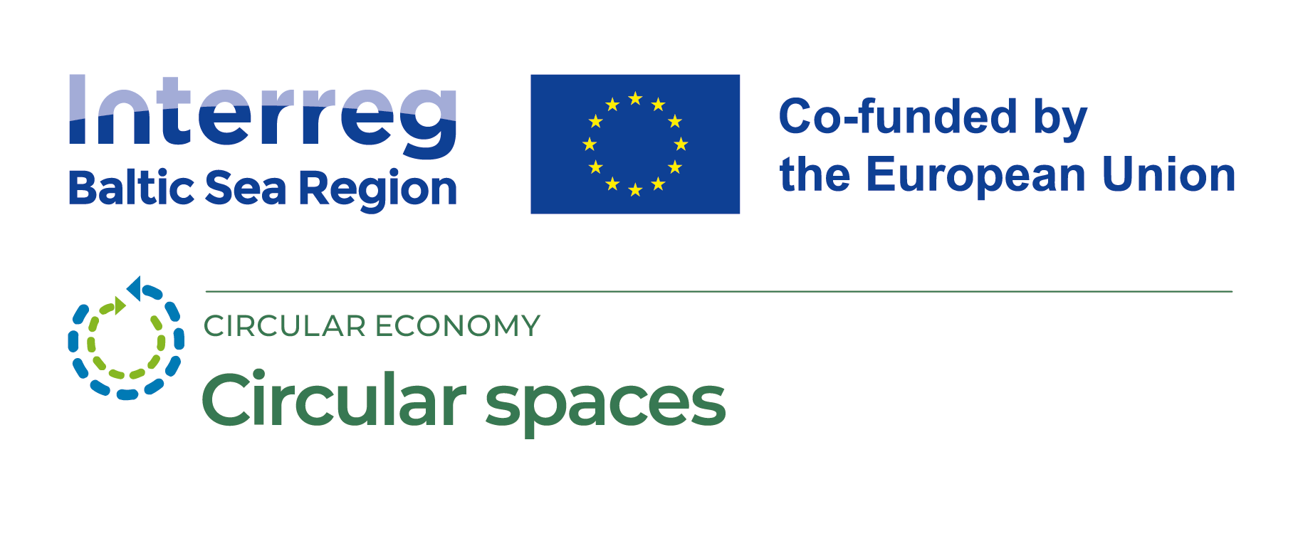
Product Life Cycle and Ecological Footprint

Slide 2
Aims:
Deepen the Understanding of Life Cycle Assessment (LCA)::
Introduce the essence of Life Cycle Assessment (LCA).
Identify what the ecological footprint entails.
Introducing circular economy thinking to makerspace visitors:
Provide insight into the circular economy and its significance in sustainable production.
Development of product eco-design.
3. What should be considered to promote the production and distribution of environmentally friendly products?
Sustainable materials, resources, technologies.
Discuss the possibilities to enhance the selection process of materials and technologies in the context of sustainability.

Slide 3
Target groups:
1. Small and Medium Enterprises (SMEs):
Specific examples and tips on incorporating LCA and circular economy principles into daily operations.
2. Interest groups:
Engagement in discussions on sustainable production and possibilities of life cycle thinking.
3. Business Support Organizations:
Practical tools and resources to assist companies in adopting life cycle thinking.
4. Regional Government Institutions:
Discussions on regional initiatives and their impact on business.
Local Government Institutions:
How to utilize life cycle thinking in local policies and project development.

Slide 4
Task
Find your team member and pair up in twos.
Choose an item/product and think of possible actions to:
reduce the consumption of raw materials and energy in its production;
possibly extend its usage life;
make it possible to recycle it.
Notes:
Such an exercise can be a creative way to develop alternative thinking skills and stimulate creativity in participants. It also provides an opportunity to rethink the use of existing items or resources and to come up with new, innovative approaches. Here are some ways participants can interpret this exercise:
Description of the task:
Writing:
Participants write all the possible alternatives that can be done with the chosen object. This can include practical and creative ideas.
Thought cloud or sketches:
Encourage participants to create mind maps or sketches to visualize their ideas and connections between them.
Group discussions:
Individual work is followed by group discussions, where participants share their ideas and proposals.
Innovative approaches:
Challenge participants to come up with innovative and unusual ideas, challenging preconceptions about the use of the subject.
This type of task is not only exciting and creative, but also promotes the development of new and innovative ideas, as well as group dynamics and cooperation.

Slide 5
The main principles of ec-odesign:
reduce consumption of raw materials (economy of materials, reduced consumption of natural resources)
reduce energy consumption (reduced consumption of energy resources)
use cleaner materials – replacement of hazardous components
use cleaner production processes (includes safe alternatives)
extend the life of the product (economy of materials, reduced consumption of natural resources)
provide an understanding of eco-design (for the user and the client)
Notes:
The ecodesign approach is fundamentally important in promoting sustainable development and protecting the environment. It helps to reduce the negative impact of products and services throughout their life cycle. Based on the aspects each of you highlighted, here is a more detailed look at each of the key principles of eco-design mentioned:
Reduce consumption of raw materials (economy of materials, reduced consumption of natural resources)
Design for less material: Optimize the design of products so that they require less material in production, without losing their quality and functionality.
Reuse and recycling: Promote reuse and recycling of materials to reduce the need for new resources.
2. Reduce energy consumption
Energy efficiency: Design products that use less energy in their production and use, such as energy-saving appliances.
Use of renewable energy sources: Promote the use of renewable energy sources such as solar or wind energy in the product life cycle.
3. Use cleaner materials – replacement of dangerous components
Use of harmless materials: Replace hazardous and toxic materials with safer, less harmful alternatives.
Healthy and environmentally friendly choices: Use materials that are biodegradable or have less negative impact on the environment and human health.
4. Use cleaner production processes (includes harmless alternatives)
Production optimization: Implement more efficient production processes that reduce waste and energy consumption.
Reduction of environmental pollution: Reduce emissions and other pollution that occur during the production process.
5. Extend the life of the product (economy of materials, reduced consumption of natural resources)
Design for long-lasting use: To create products that are durable, easy to repair and renew, thereby extending their life.
Modular design: The ability for customers to easily replace or upgrade parts of the product instead of replacing the entire product.
6. Provide an understanding of eco-design (for the user, the client)
Education and outreach: Provide consumers with clear information about product sustainability.

Slide 6
Product life cycle
production (energy, emissions, waste)
The purpose of life cycle assessment is to identify environmental aspects related to the life cycle of products or services and to provide information to producers, consumers and other stakeholders about environmental impacts. This information makes it possible to develop and choose more sustainable solutions that would reduce the negative impact on the environment.
Extraction of raw materials
Packaging and distribution
Waste (recycling)
product use (energy, emissions, waste)
waste disposal
URL reference: https://testeko.hostnet.lv/produkta-dzives-cikls/

Slide 7
The essential components of a life cycle assessment include:
Extraction and processing of raw materials: At this stage, the raw materials needed to create products or services are analyzed. This includes extracting raw materials from nature and transporting them to the manufacturing site.
Production: At this stage, energy consumption, emissions and use of resources in the production process are evaluated. This includes both the evaluation of production technologies and the pollution caused during operation.
Usage: In this phase, the use of the product and the related impacts, such as energy consumption and emissions related to the use of the products or services, are analyzed..
Waste management: This stage evaluates how products or services are managed after their end of life. This includes waste processing, recycling methods and reuse of raw materials.

Slide 8
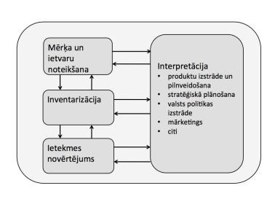
LCA distinguishes four steps :
Determine the goal: helps to explain the essence of the problem and to decide the tasks and scale of the research. Determining the boundary of the studied system and functional units, which will serve as a reference point for comparing the studied objects, is of crucial importance.
Inventory: accounting of all the resources used for the production and use of the product or service and the resulting emissions into the atmosphere, water, soil in relation to the accepted functional unit.
Impact assessment: determines the impact of listed emissions and resource use on the environment.
Interpretation: explains the results of each previous step to determine the most important factors and decide how to reduce the environmental impact more effectively.
Determine the goal
Interpretation
product development and improvement
Strategic planning
Development of national policy
Marketing
Etc.
Inventory
Impact assessment

Slide 9
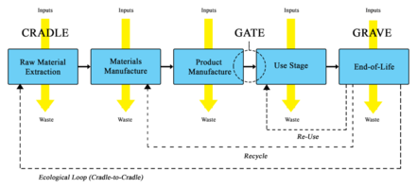
System boundaries(ISO 14040)
Cradle-to-Gate: from raw material extraction to the factory gate.
Cradle-to-Grave: from the extraction of raw materials to the use and disposal of the product.
Gate-to-Gate: from one specific point in the life cycle (for example, where raw materials enter the production building) to another point further in the life cycle (for example, where the final product is delivered to the end user).

Slide 10
LCA Software Tools:
SimaPro:
Website: SimaPro
Overview: SimaPro is a widely used LCA software that enables users to conduct life cycle assessments, including impact assessment methods, scenario analysis, and reporting.
OpenLCA:
Website: OpenLCA
Overview: OpenLCA is an open-source LCA software that allows users to model and assess the environmental impacts of products and processes. It offers a wide range of features and databases
Ecochain:
Website: Ecochain
Overview: Ecochain provides LCA software that helps companies measure, monitor, and reduce their environmental footprint. It offers features for product sustainability assessment and supply chain analysis.
Notes:
Life Cycle Assessment (LCA) software tools are designed to assess the environmental impacts of products and processes throughout their entire life cycle. These tools help organizations make informed decisions to reduce their ecological footprint.
When selecting an LCA software tool, organizations should consider factors such as the complexity of their analysis, the availability of databases, and the specific environmental impact categories they want to assess. Additionally, user training and support are crucial for effective utilization of these tools.

Slide 11
The concept of ecological footprint and its importance
Ecological footprint is a measurement that expresses the impact of a person or organization on the environment, taking into account all aspects of its activities and consumption. This includes resource consumption, energy use and the amount of emissions generated by the production of goods or services and captured during both production and usage.
material footprint
carbon footprint
water footprint
land footprint

Slide 12
The main elements of the ecological footprint are: :
Life cycle stages: Similar to life cycle assessment, the ecological footprint takes into account all stages from the extraction of raw materials to waste management in order to determine the full impact on the environment.
Resource consumption: In this context, it is evaluated how many natural resources are needed for the production and use of the specific activity or product. This includes the amount of raw materials, water use, land use, etc.
Energy consumption: Assesses energy use, including electricity and other forms of energy used in the production.
Emissions: Covers greenhouse gas emissions and other forms of pollution associated with the specific activity or product.
Waste management: Includes information on how waste is managed at the end of the product's life and how much waste is generated.

Slide 13
Linear economy
Elektrība (ogles u.c.)
Apkure (gāze u.c.)
Mehānika (metāls u.c.)
Fuel (oil)
Mechanics (metal, etc.)
Electricity (coal, etc.)Heating (gas, etc.)Mechanics (metal, etc.)
Fuel (oil)
Mechanics (metal, etc.)
Degviela (nafta),
Mehānika (metāls u.c.)
Electricity (coal, etc.)
Elektrība (ogles u.c.)
Degviela (nafta),
Mehānika (metāls u.c.)
URL reference: https://ied.eu/project-updates/projects/cem-for-smes/resource-efficiency-world-overshoot-day/
Notes:
A linear economy is a traditional economic model in which raw materials are taken, products are made, used and then discarded as waste. It is a linear flow model in which the economy operates as a linear chain of processes: extraction, production, consumption and waste disposal.
The life cycle of a product in a linear economy includes the following stages:
Extraction:
In this stage, natural resources such as minerals, metals, wood are taken to create the raw materials needed to produce the products.
Production:
In the production stage, raw materials are processed and products are made from them. Different technologies can be used at this stage.
Consumption:
Products enter the consumption stage where they are used according to their intended purpose or function. During the consumption stage, the product is subject to use and can serve various purposes, such as entertainment, transportation or household needs.
Waste:
In the end, the product is thrown away as waste. This phase includes both physical waste, such as the materials from which the product is made, as well as unused energy and resources.
This linear economic model affects the environment, causing resource depletion, pollution and increased amounts of waste. This goes against the goals of sustainable development, as the extraction and use of resources is thoughtless and waste is not always recycled or used efficiently.
This type of economy creates several problems, so in recent years there has been a transition to a circular economy. A circular economy creates a closed system in which the life cycle of products is optimized, resources are recycled and reused, thus reducing environmental impact.

Slide 14
How many kg of materials is used by one person in Europe during the year?
main resource groups: biomass, energy (oil, coal), metals and non-metals (minerals))
Notes:
*self-drawn graphics

Slide 15
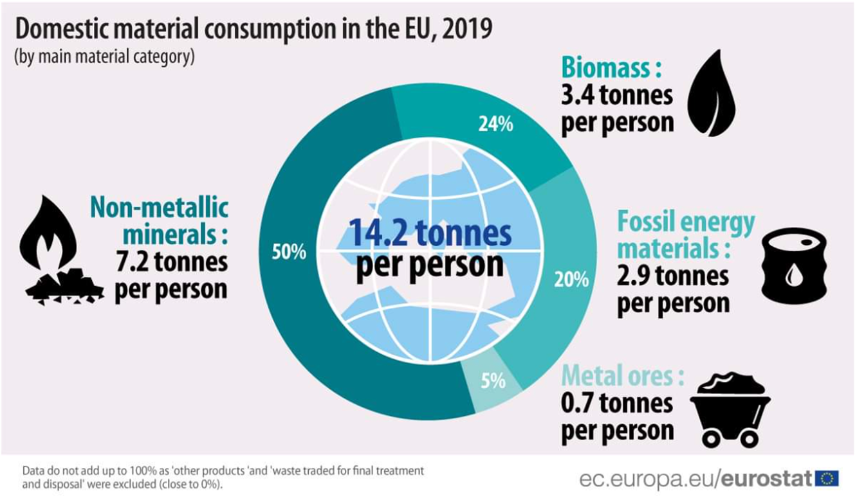
14,5
URL reference: https://ec.europa.eu/eurostat/web/products-eurostat-news/-/ddn-20210319-2
Notes:
In 2022, the domestic material consumption of the EU economy remained relatively stable at around 14.5 tonnes per person, indicating a very slight increase of 0.4% compared with 2021 (14.4 tonnes per person). Since 2000, the EU reduced its domestic consumption of material by 0.9 tonnes per person.
By calculating how many kilograms of biomass, energy, metals and non-metals one person in Europe uses in a year could give an estimate of their ecological footprint. The Ecological Footprint is an indicator that measures the impact of human consumption and lifestyle on natural resources and ecosystems. It gives a rough idea of how much land and resources people use to meet their housing, food, clothing, energy and other needs.

Slide 16
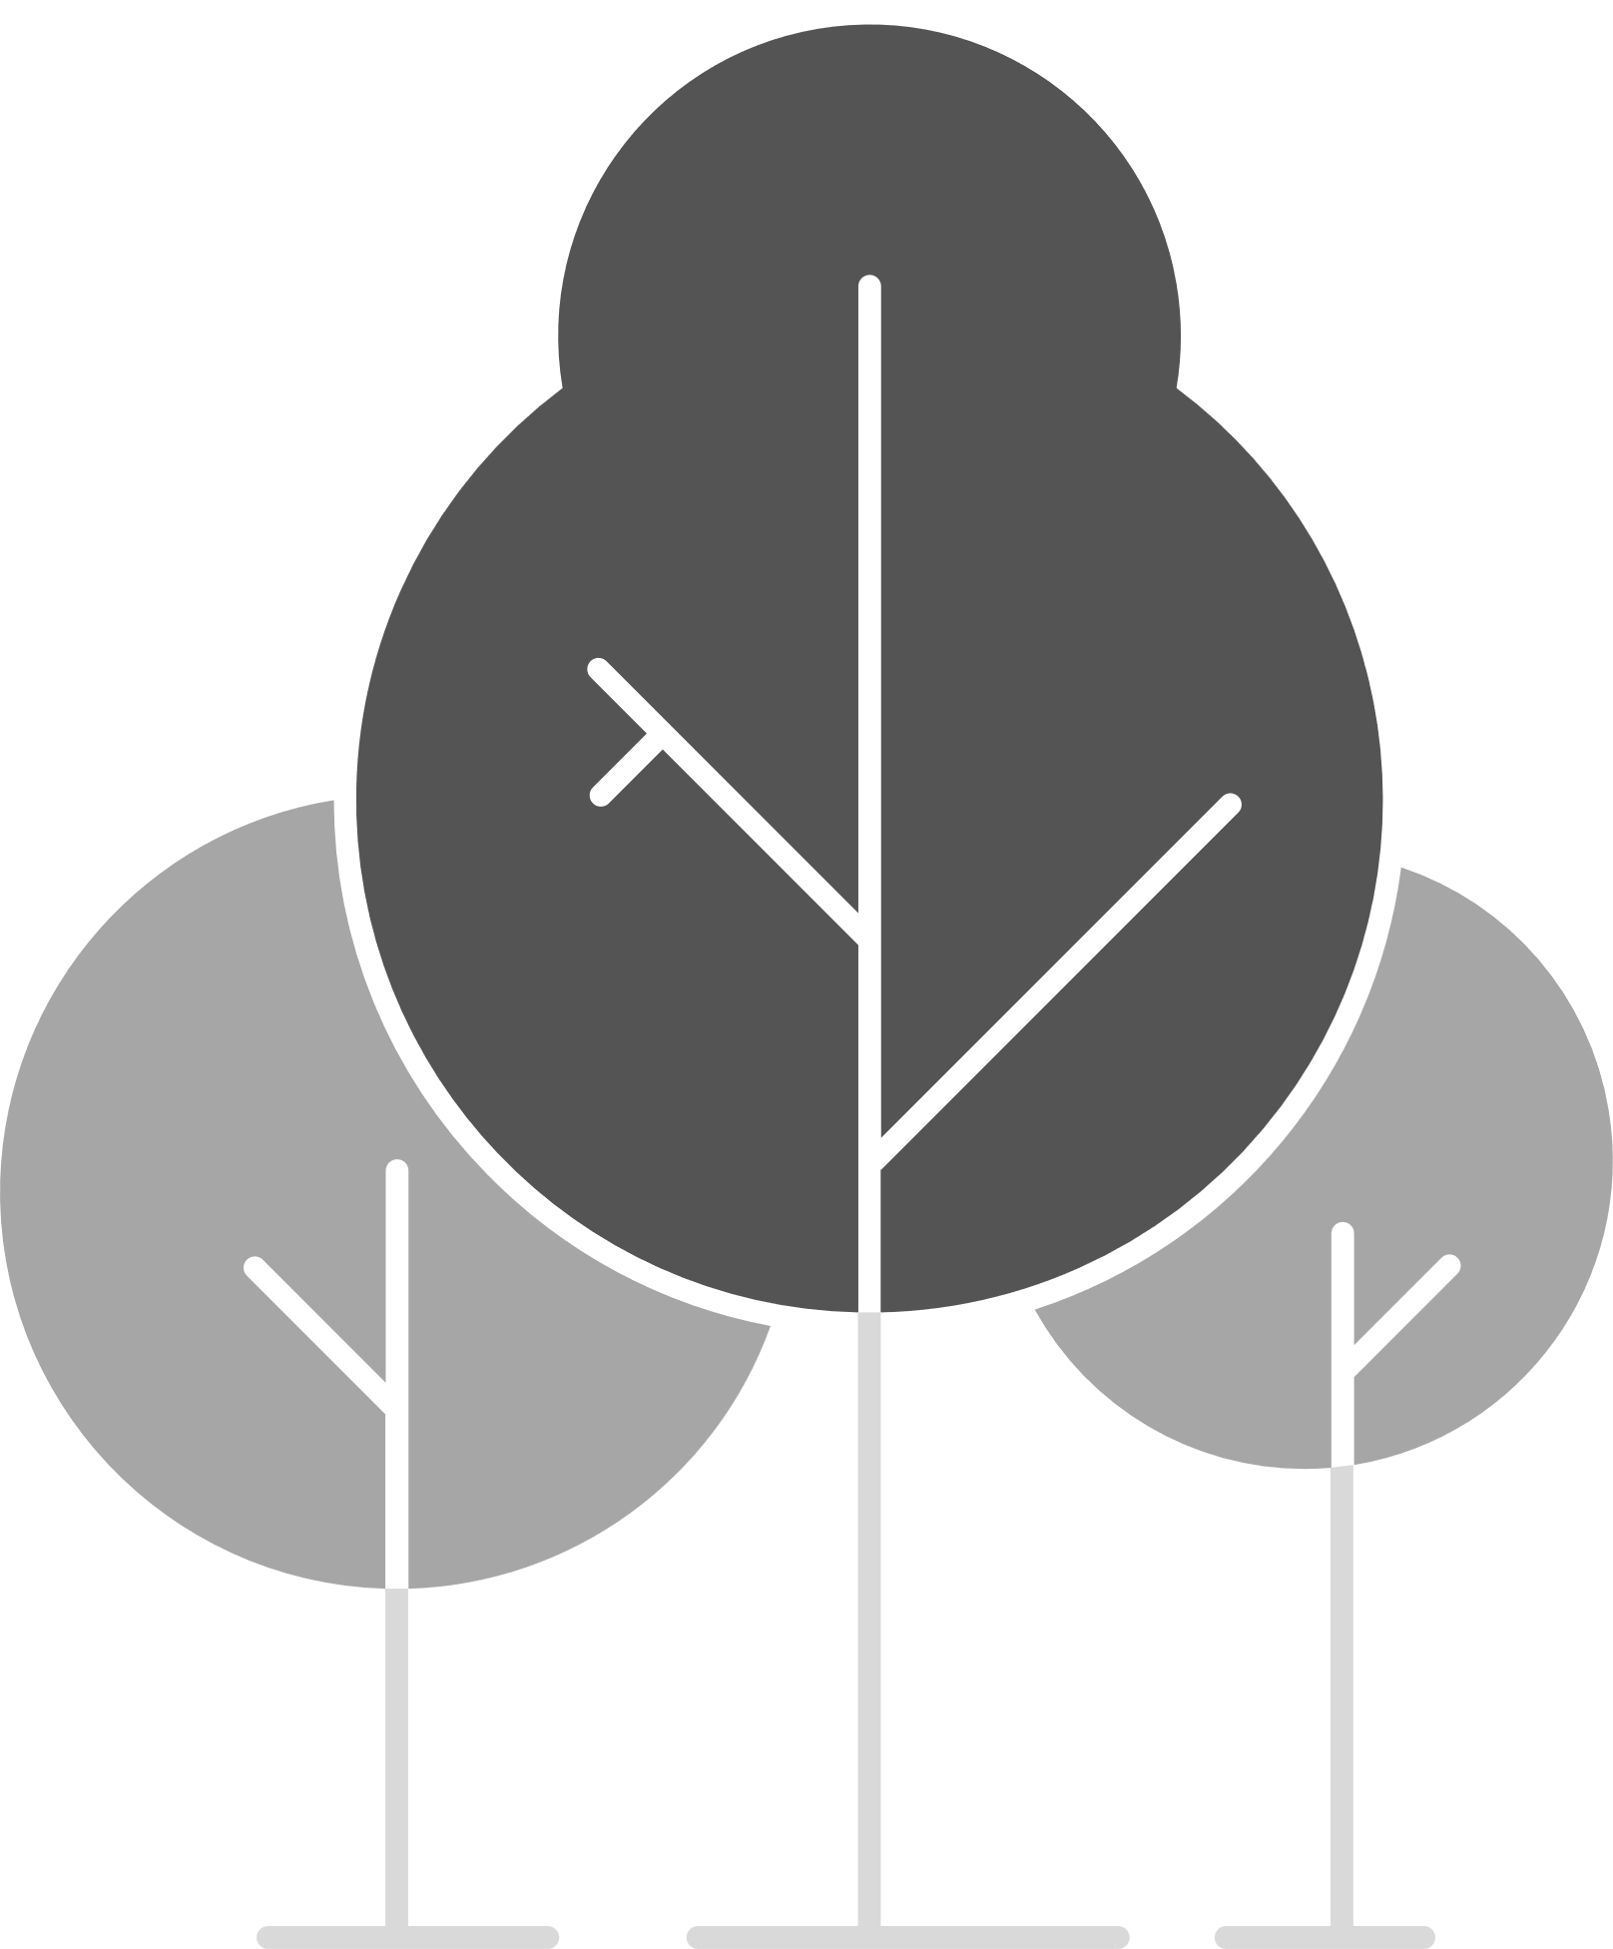
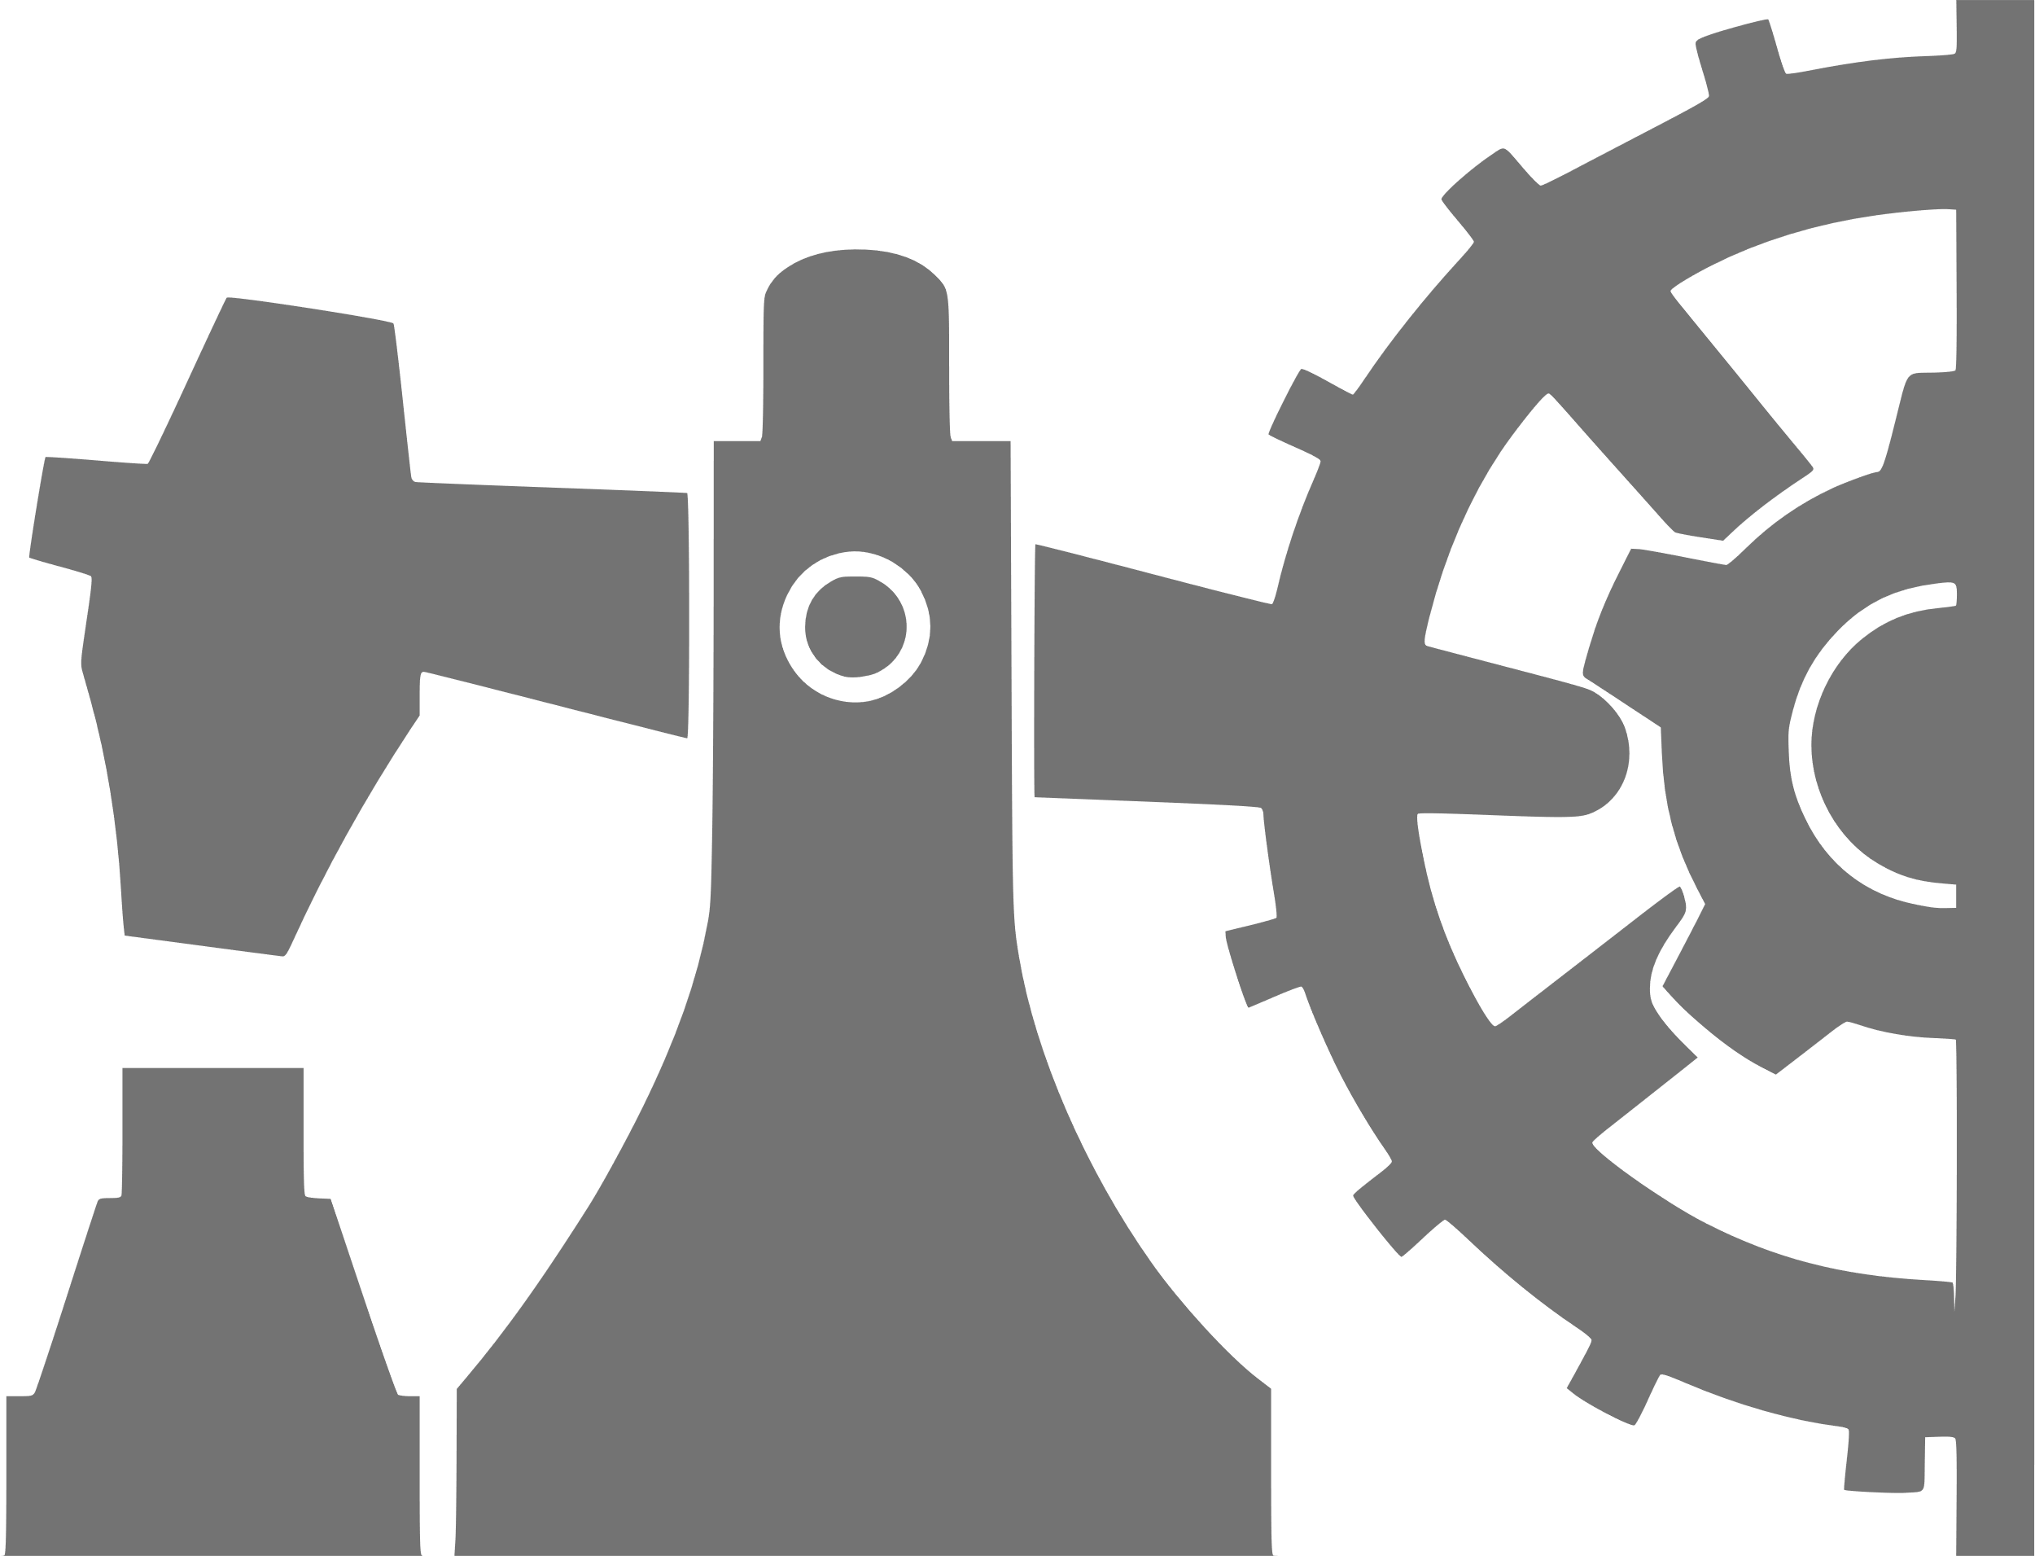
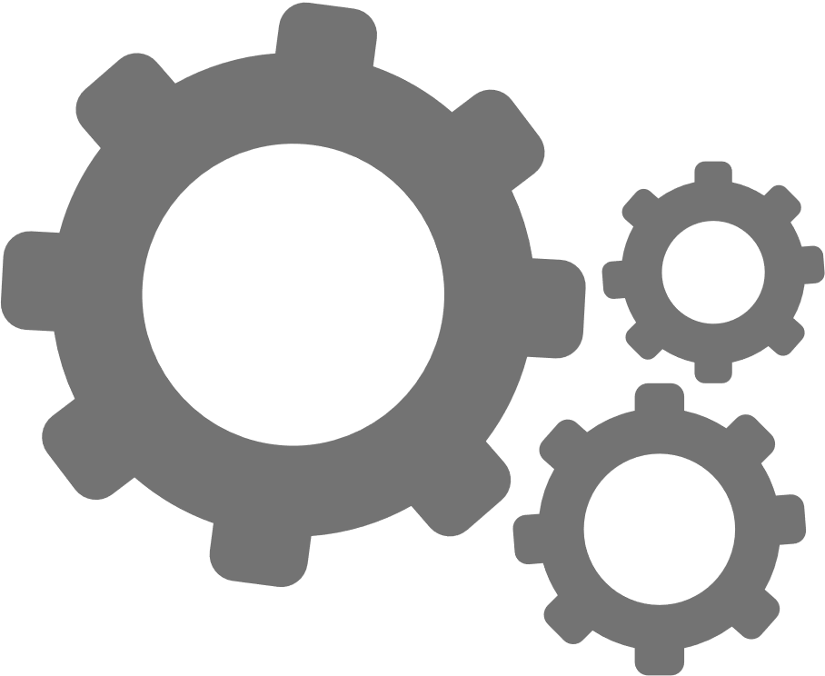
Circular economy
Raw materials
Design
Production, processing
CIRCULAR ECONOMY
processing
Distribution
Consumption
waste
Repair, reuse
Notes:
*self-drawn graphics
A circular economy is an economic model that differs from the traditional linear economy in which raw materials are taken, developed, used and then discarded as waste. In a circular economy, resources are used efficiently, thus reducing the amount of waste and the impact on the environment.
This economic model operates in a cyclical system where materials are recycled and reused, reducing the need for new raw materials. The circular economy is based on three main principles:
Recycling and reusing: Materials are reused and recycled to extend their life cycle. This includes both reusing products and recycling raw materials to create new products.
Sustainable use of resources: In a circular economy, resources are used efficiently, reducing waste and resource depletion. This principle includes efficient management of resources and reduction of waste.
Production and design changes: Changes are made to product design and manufacturing processes to facilitate easier recycling and reuse. Sustainable design is created taking into account the life cycle of products and the possibilities of recycling raw materials.
The aim of the circular economy is to achieve sustainable use of resources, reducing environmental impact and helping to prevent the accumulation of waste. It also involves engaging businesses and consumers to promote responsible consumption and change in the product life cycle. The circular economy is considered one of the paths to take towards sustainable development and a resource-efficient economy.

Slide 17
Why do we need sustainable design and circular economy principles?
TO REDUCE GREENHOUSE GAS EMISSIONS
TO MAKE MORE VALUABLE USE OF DEPLETING RESOURCES
(product production/industry is responsible for 45% of emission)
TO REDUCE PLASTIC PRODUCTION
(dependency on petroleum raw materials) and thus plastic consumption and pollution
Notes:
Sustainable design and circular economy principles include environmental, economic and social aspects.
•Promotes resource efficiency, recycling and reuse, which helps reduce waste and resource depletion.
•Reduces the negative impact on nature, water resources and biodiversity.
•This includes improving energy efficiency, which helps reduce energy consumption and emissions that contribute to climate change.
•Circular economy principles promote changes in businesse’s and consumer behavior towards sustainable production and consumption.
•Sustainable design contributes to economic stability by introducing innovative solutions in business that reflect social, environmental and economic goals.
These principles are not only part of the business strategy, but also reflect the broader sustainability goals of society and our planet. Their implementation is important to reduce the negative impact on the environment and social well-being, promoting sustainable development in business and communities.

Slide 18
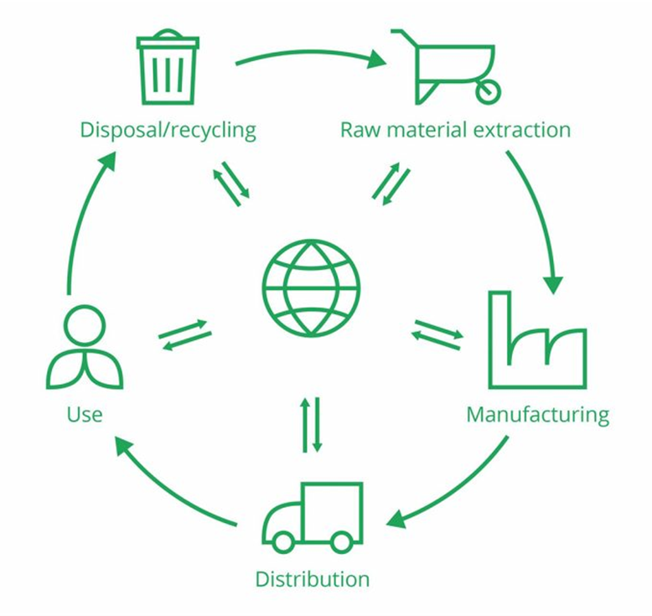
Connections between LCA and sustainable materials/technologies
With LCA, you can evaluate the environmental impacts of your product or service from the very first life cycle stage to the very last or to any life cycle stage in between.
URL reference: https://pre-sustainability.com/articles/life-cycle-assessment-lca-basics/
Notes:
Life Cycle Assessment (LCA) and the use of sustainable materials and technologies are closely connected, as both play pivotal roles in evaluating and promoting environmentally responsible practices.
Identification of Environmental Hotspots: LCA helps identify the stages of a product's life cycle with the highest environmental impact. By understanding these hotspots, businesses and industries can focus on optimizing and adopting sustainable materials and technologies in those critical areas.
Decision-Making Tool: LCA serves as a valuable tool for decision-making, allowing companies to compare the environmental performance of different materials and technologies. It helps in selecting options that align with sustainability goals.
Continuous Improvement: The data obtained from LCA can guide continuous improvement efforts. Companies can use this information to innovate and find more sustainable alternatives for materials and technologies at each stage of the life cycle.
Promotion of Circular Economy: LCA emphasizes the importance of considering the entire life cycle of a product. This aligns with the principles of a circular economy, encouraging the reuse, recycling, and reduction of waste, which often involves the use of sustainable materials and technologies.
Resource Efficiency: Sustainable materials and technologies are often associated with increased resource efficiency. LCA helps quantify the resource use at different stages, highlighting areas where resource efficiency can be improved through the adoption of sustainable practices.
In summary, the integration of LCA and the use of sustainable materials and technologies is crucial for making informed decisions, reducing environmental impact, and moving towards a more sustainable and circular approach in product development and production processes.

Slide 19
Selection of sustainable materials and technologies
Sustainable materials and technologies aim to reduce the negative impact on the environment, reduce resource consumption and promote sustainable development.
TASK: Discussion, what in your opinion are sustainable materials and technologies?

Slide 20
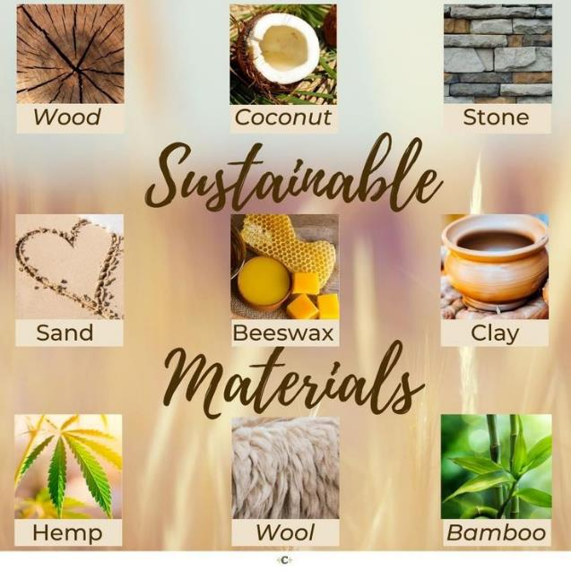
Sustainable materials
Notes:
1. Biodegradable plastic substitutes:
PLA and PHA which are biodegradable and made from natural raw materials such as corn or sugar beet.
2. Use of organic fabrics and textiles:
Hemp, bamboo and other organic fabrics grown using sustainable methods, such as without pesticides or artificial fertilizers.
3. Recyclable raw materials:
Materials that can be recycled and reused, such as recyclable plastics, glass, metals or paper.
4. Natural wood and fiber materials:
Wood, fiberboard or boards that come from sustainable forestry practices.
5. Bioplastics and biodegradable raw materials:
Biodegradable plastics or biopolymers that are made from biological sources and can break down naturally without accumulating long-term environmental waste.
6. Recyclable and reusable metal raw materials:
Recyclable steel or aluminum that can be reused, reducing the need for new resources.

Slide 21
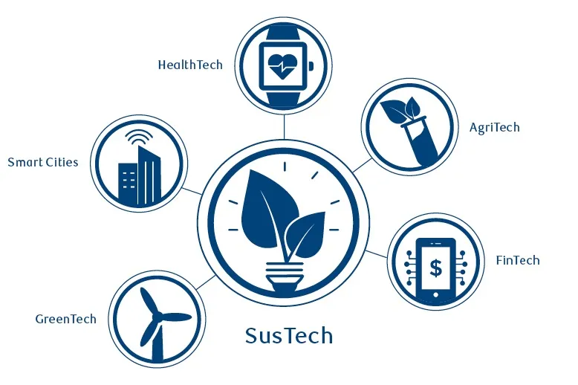
Sustainable technologies
Notes:
Sustainable technologies
Technologies of renewable energy sources:
Use of solar and wind energy and other renewable energy technologies to reduce dependence on fossil fuels and reduce greenhouse gas emissions.
Energy efficiency technologies:
Innovative technologies that help reduce energy consumption, such as energy-efficient equipment and lighting solutions.
Virtual and augmented reality for sustainable education:
Technologies that offer virtual and augmented reality experiences to promote education about environmental protection and sustainable lifestyles.
Blockchain technologies for sustainable origin labeling:
The use of blockchain to mark the origin of products to ensure transparency and compliance with sustainability standards such as fair trade or sustainable agriculture.
Using the Internet of Things (IoT) for resource efficiency:
Using IoT to optimize the use of resources, such as energy efficiency at home, water consumption monitoring or logistics optimization.
Sustainable use of 3D printing:
Using 3D printing technology to create customized and efficient products, reducing material residues and waste.
These examples show that sustainable technologies and materials can cover a wide range of industries and provide solutions to environmental problems, reducing negative impacts on nature and promoting sustainable development.

Slide 22
An example
Consumer goods from secondary resources
Online platforms and stores specializing in second-hand products.
Andele Mandele (Latvia): is an example where users can sell and buy clothes, goods, etc. from others, promoting long-lasting use of goods.
Patagonia: This company specializes in outdoor clothing and offers a "Worn Wear" program where people can sell or buy used Patagonia clothing.
The RealReal: This online store specializes in upcycled luxury clothing and accessories.
Notes:
Companies (both Latvian and global) for which the "ecological footprint" and product life cycle are important. The purchase of second-hand goods reduces the need for new resources as it utilizes existing items, thereby promoting sustainable resource use. It eliminates the necessity for new products and helps prevent the formation of waste.

Slide 23
An example
Refurbishment and repair of electronics
Companies specializing in the repair and restoration of appliances, mobile devices.
iFixit offers tools and guides to help users repair their mobile device themselves, promoting long-term use.
Notes:
Refurbishment and repair of electronics align with LCA principles by focusing on extending product life, reducing environmental impact, conserving resources, minimizing waste, improving energy efficiency, and considering the entire life cycle of electronic devices. These practices contribute to more sustainable and responsible consumption patterns in the electronics industry.

Slide 24
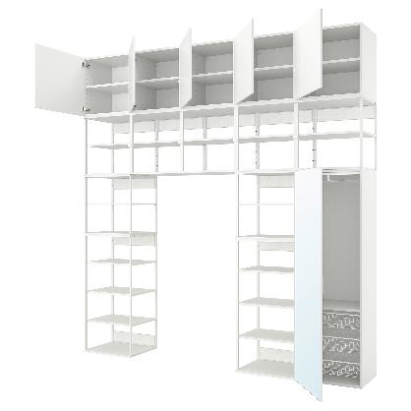
An example
Modular furniture
Companies that offer modular furniture that can be customized and added to.
IKEA has incorporated modular elements into its designs, allowing customers to customize their furniture as needed and change its appearance.
Notes:
Modular furniture is designed with interchangeable and customizable components, allowing users to reconfigure or add elements without replacing the entire piece. This promotes resource efficiency by reducing the need for new materials and minimizing waste associated with furniture production. LCA emphasizes the importance of prolonging the use phase of products. Modular furniture is designed for adaptability, allowing it to evolve with changing needs and styles. This extends the product's life cycle, reducing the frequency of disposal and the associated environmental impact.

Slide 25
An example
Transportation ecosystem
The transportation ecosystem includes transportation, delivery, car haring, and other similar services.
"Bolt", "Uber" or "Lyft"- are safe and convenient car sharing solutions.
Notes:
Car-sharing solutions contribute positively to LCA when they promote shared rides, reducing the number of individual vehicle trips and optimizing the use of available vehicles. Encouraging users to choose shared rides, opt for electric vehicles, or adopt eco-friendly travel practices contributes positively to sustainability. Transitioning to electric or low-emission vehicles powered by renewable energy sources can significantly reduce the carbon footprint associated with the transportation service.

Slide 26
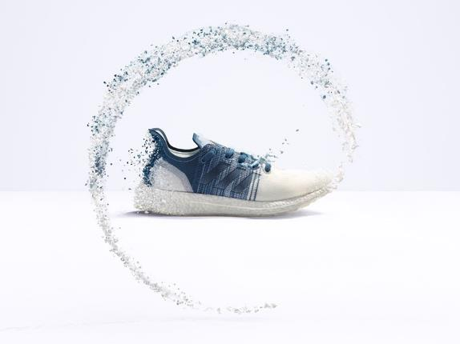
An example
Sustainable sports shoes
Adidas Futurecraft.Loop collection uses completely recyclable and reusable materials (no glue).
After wearing out the shoes, users can return the shoes and they will be recycled into new products.
Notes:
The use of completely recyclable and reusable materials in the Futurecraft.Loop collection is a key LCA consideration. Designing products with recyclability in mind reduces the environmental impact associated with the extraction and processing of raw materials. Glues and adhesives can contribute to environmental harm, and by avoiding them, Adidas reduces the environmental impact during production and facilitates easier disassembly and recycling. The Futurecraft.Loop collection addresses the end-of-life phase by implementing a return and recycling program. This closed-loop system helps minimize the environmental impact associated with the disposal of used shoes and encourages the reuse of materials.

Slide 27
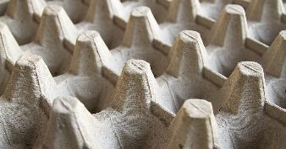
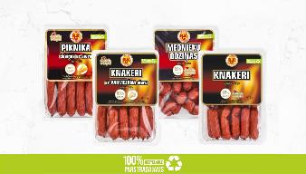
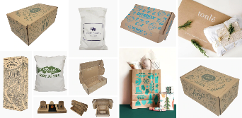
An example
Biological packaging
"V.L.T" (Latvia) company specializes in the production of egg boxes and transport pallets using 100% recyclable material - waste paper.
"Rēzekne meat plant" (Latvia) uses 100% recyclable packaging material.
The company "EcoEnclose" (USA) offers biodegradable and recyclable packaging solutions that can be used by entrepreneurs to package their products, thus reducing the impact on the environment.
Notes:
LCA assesses the energy and resource consumption throughout the life cycle. Recyclable packaging have a lower environmental impact compared to non-recyclable alternatives if it requires less energy and fewer resources in production, transportation, and disposal. LCA promotes the reduction of environmental impacts associated with waste. Recyclable packaging solutions aim to reduce the amount of packaging waste sent to landfills. This aligns with the principles of a circular economy by keeping materials in use for as long as possible.

Slide 28
Different ways to create value in the circular economy.
Return
Reuse
Take
Create
Use
Discard
Recycle
Repair
Notes:
The image shows the process that represents value creation in the circular economy. A circular economy is a system for the sustainable use of resources where materials are reused and recycled to reduce waste and resource consumption. Here are the steps that make up this cycle:
«Take" – take resources or materials.
«Create" – create products from these resources.
«Use" - use the products created.
«Return" - return products or materials back into the economic cycle.
«Reuse" - use these returned materials again in the production of products.
«Discard" - discard materials that cannot be reused or recycled.
In addition to these main points, there are also two side processes in the picture:
«Recycle" - the process of converting used materials into reusable resources.
«Repair" - repair and restore products to extend their useful life.
All these steps are interconnected and form a closed loop, which is the basis of the circular economy. It helps reduce environmental impact and promotes more efficient use of resources.

Slide 29
Task
Taking into account the product life cycle, ecological footprint and circular economy principles, develop a product concept, for example :
Work table;
raincoat;
mobile phone holder;
storage box;
etc.
Notes:
Find your teammate and split into pairs of 2;
Taking into account the principles of the product life cycle, ecological footprint and circular economy, develop a product concept;
Discuss the results in the group.

Slide 30
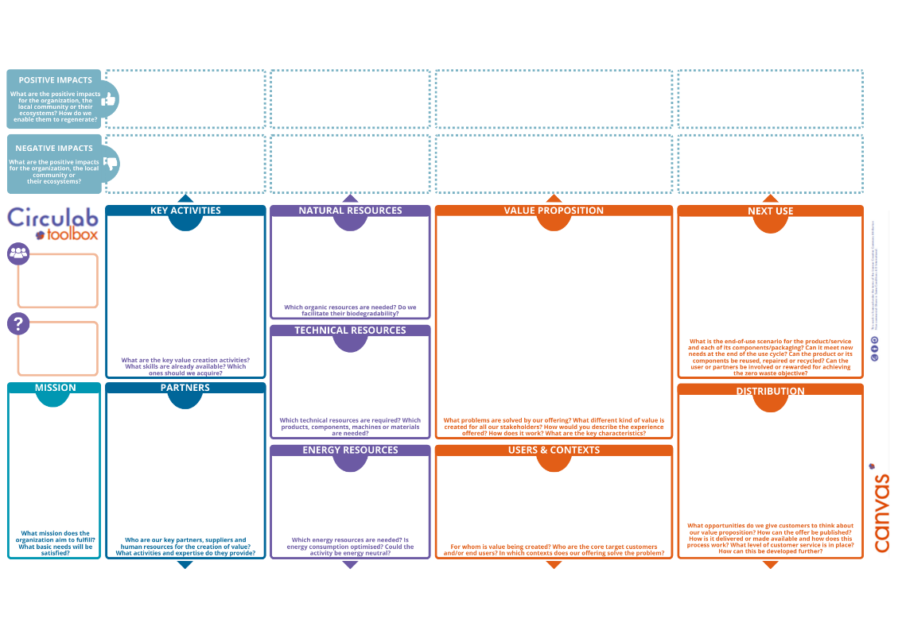
Notes:
ASSIGNMENT: map your own product or those created from the previous task (slide 29). It is important to be aware of the impact on the environment, to understand each step, to evaluate the benefits. Objective: to develop a sustainable solution for the product. Find a balance between economic viability, ecosystem and sustainability.

Slide 31
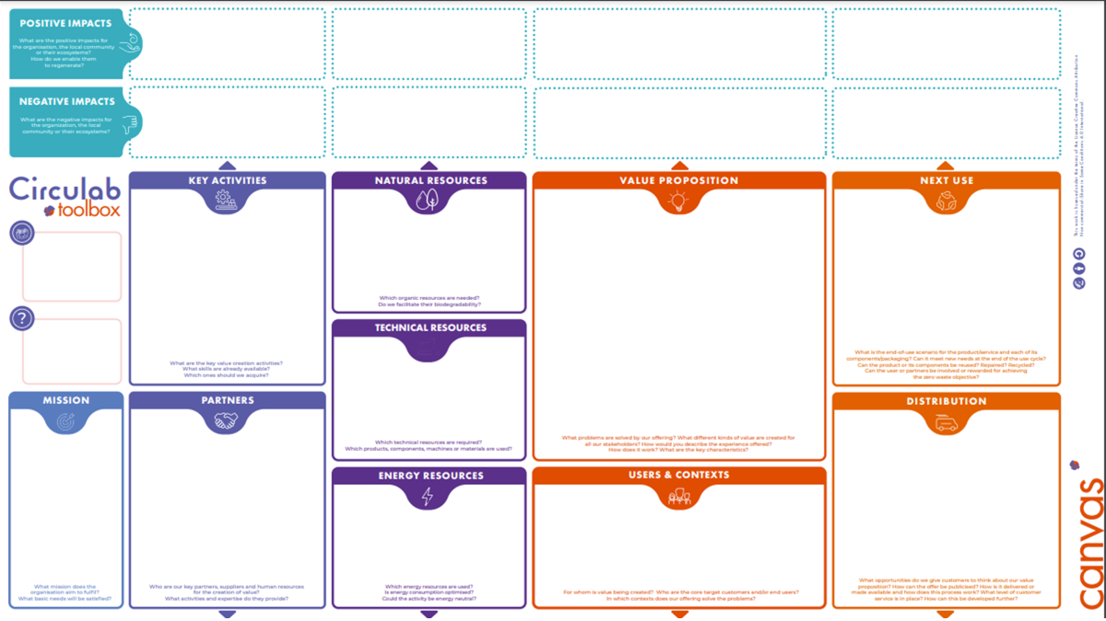
An example
Promotes cooperation and sustainable business development
Recycled materials, less consumption of resources and energy
Supports the local economy
Reduce the amount of waste
Can't respond, influence processes that happen in other org.
Recycled materials also consume energy when they are recycled
Possible negative effects from long-distance transportation
Can be recycled
The parts of the shelf are designed in such a way that they can be renewed if necessary and in cases when a part has worn out
The ability to transform, change its function and application, is given a «second chance».
Wooden shelf
made from 50% recycled materials and 98% further recyclable materials
A shelf that creates less impact on the environmen,t during the production process consumes fewer resources
Companies that can hand over unused wood materials
Makerspaces
Using recycled materials consumes less energy than new materials
It's not the "brand" that matters.
Notes:
Choose a product
Determine what is your MISSION to create this product?
Put the big picture together - what is the VALUE PROPOSITION for your product? What makes it better? What else?
What materials will be needed for your product?
What could be the future life of the product?
What "PLAYERS" should be involved to make such a product possible?
Who is my client??
What positive, negative effects arise from my actions?

Slide 32
A story of experience
Invite a representative from a company that has succeeded in implementing innovative and sustainable practices.
An inspirational story that reflects the experience of implementing sustainable innovations and operating on circular economy principles.
The aim is to engage and encourage others to implement sustainable practices in their company and to think about the life cycle of the product, the ecological footprint.

