Slide 1
Circular business models

Slide 2
Methodological Notes
Summary
This education program provides a comprehensive understanding of circular business models, enabling participants to apply circular principles in their professional activities or entrepreneurship ventures. It is adaptable to different educational settings and can be customized to meet specific learning objectives and time constraints.
Duration: 4 hours
Training modes: in person; online; hybrid (both – in person and online)
Requirements for trainers
Knowledge and experience in circular economy
Green thinking, willing to change the way business operates
©Pixabay

Slide 3
Methodological Notes
Target Groups
Makers: Information and samples that can be used for transferring to circular economy
Makerspaces: Inform makers about circular business models, help to use reusable materials in the prototyping faze.
Suppliers: Offer more reusable materials
Start-ups: reusable materials in the prototyping faze, circular business thinking in developing their product
SMEs: Reuse of leftovers, rethinking the product cycle
Business support organisations: Less materials that cannot be recycled, more businesses with less pollution in the region.
Training Outcomes
Understanding of circular and linear business models
Knowledge about types of circular business models
Possibilities to transfer from linear to circular business models
Recourses for information about circular economy
©Pixabay

Slide 4
Methodological Notes
Training Tools and Resources
For trainer:
Presentation
Equipment for showing the presentation
Access to video conferencing platform
Paper and pens for activity
For trainee:
Computer, good internet connection, headset (if attending online)
©Pixabay

Slide 5
Methodological Notes
Ethical aspects of carrying trainings
Inclusivity and Diversity
Transparency and Honesty
Voluntary Participation
Informed Consent
Confidentiality
Competence of Trainers
Avoiding Discrimination and Bias
Feedback and Continuous Improvement
©Pixabay

Slide 6
Introduction
Content of the lecture
Introduction (45 minutes)
Main topic – Circular business models (2,5 hours)
Circular business models and good practices
How to transfer from linear to circular business model
Task – Circular Business Model Innovation Challenge
Summary (45 minutes)
©Pixabay

Slide 7
Introduction What are Linear and Circular Business Models?
©Pixabay

Slide 8
Introduction
Linear Business Model
A linear business model is based on an approach «take, make, dispose», where resources are extracted, transformed into products, and then discarded as waste after use.
This model emphasizes short-term consumption and efficiency at the expense of sustainability and resource depletion.
TAKE
PRODUCE
USE
DESPOSE
©Pixabay

Slide 9
Introduction
Circular Business Model
A circular business model focuses on sustainability by keeping products, materials, and resources in use for as long as possible, reducing waste through reuse, recycling, and regeneration.
It aims to create a closed-loop system that minimizes environmental impact and promotes the efficient use of resources.
PRODUCE
USE
TAKE
RECYCLE
©Pixabay

Slide 10
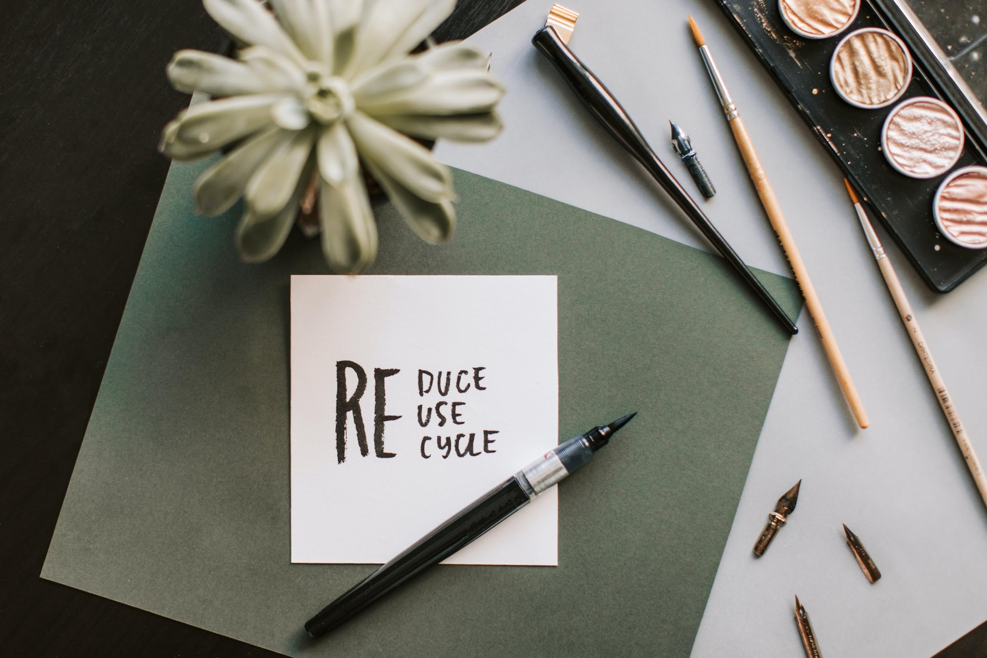
Introduction
Principles of the Circular business models
Design out waste and pollution
Keep products and materials in use
Regenerate natural systems
Rethink the business model
Design for adaptability and disassembly
Use waste as a resource
Promote systems thinking
Foster innovation and collaboration
Photo source: pexels.com
©Pixabay

Slide 11
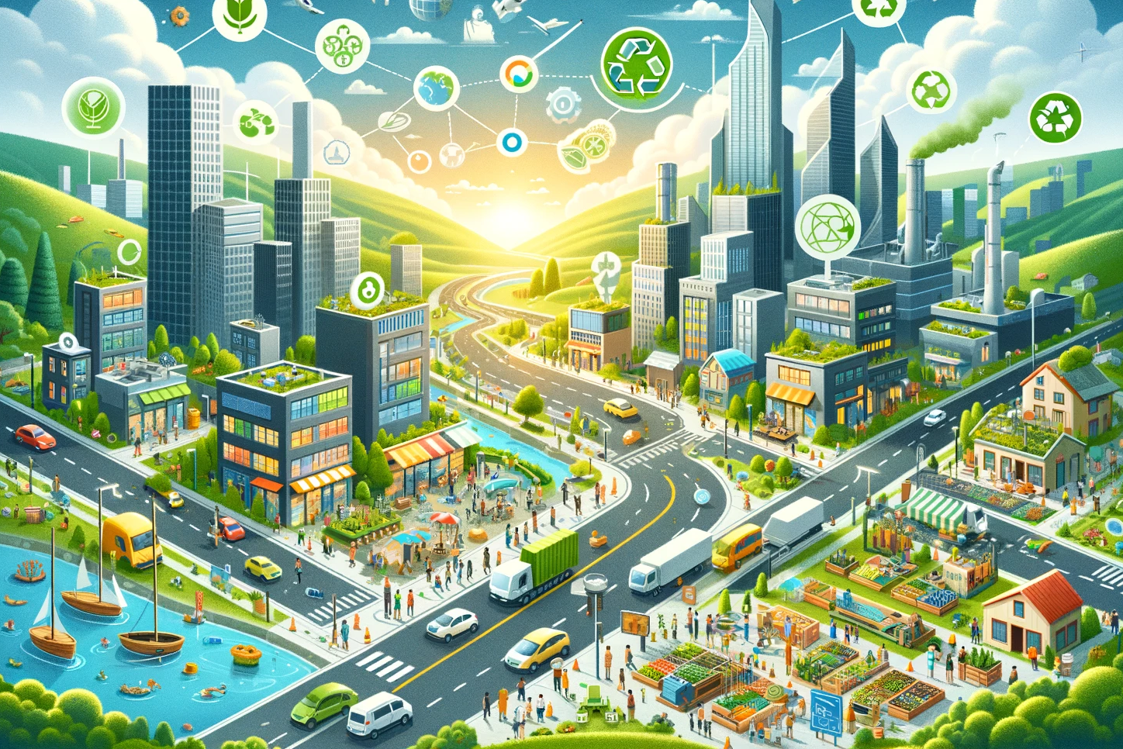
Introduction
Benefits of implementing circular business model
Environmental Benefits
Reduced Waste and Pollution
Conservation of Resources
Lower Carbon Footprint)
Social Benefits
Job Creation
Improved Quality of Life
Innovation and Collaboration
Strategic and Operational Benefits
Enhanced Brand Image and Reputation
Regulatory Compliance and Incentives
Long-term Viability
©Pixabay

Slide 12
Circular Business Models
©Pixabay

Slide 13
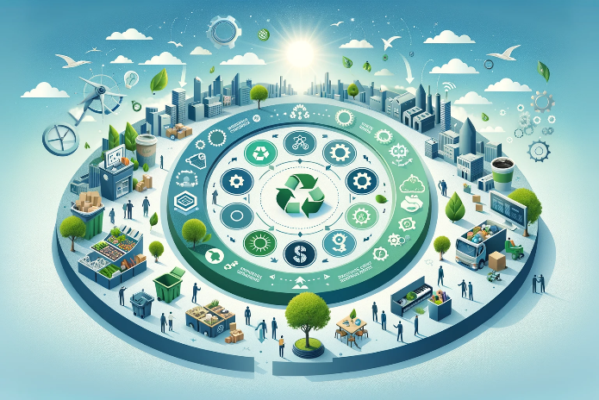
Circular business models
Content of the lecture
Circular business models and good practices
How to transfer from linear to circular business model
Task – Circular Business Model Innovation Challenge
Photo source: AI generated
©Pixabay

Slide 14
Circular Business Models and Good Practices
©Pixabay

Slide 15
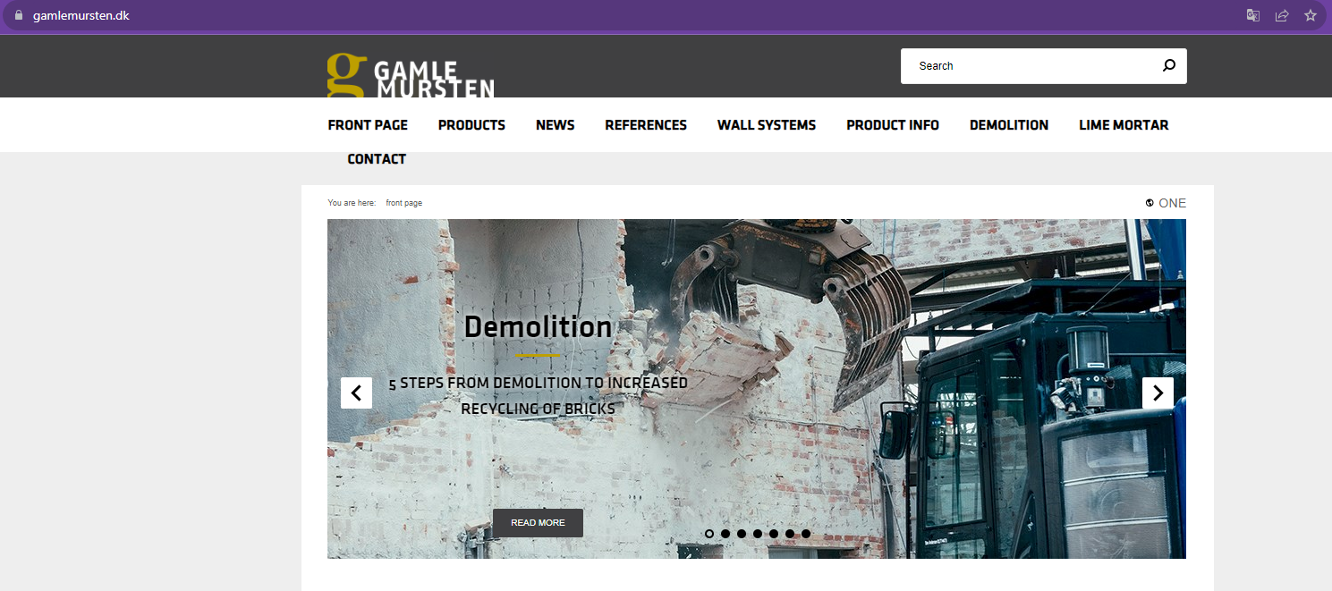
Circular Business Models
RECYCLING MODEL
Focuses on the recovery and reuse of materials from end-of-life products. It aims to bring materials back into the production cycle, thereby reducing the need for virgin materials and minimizing waste.
URL reference: gamlemursten.dk
©Pixabay

Slide 16
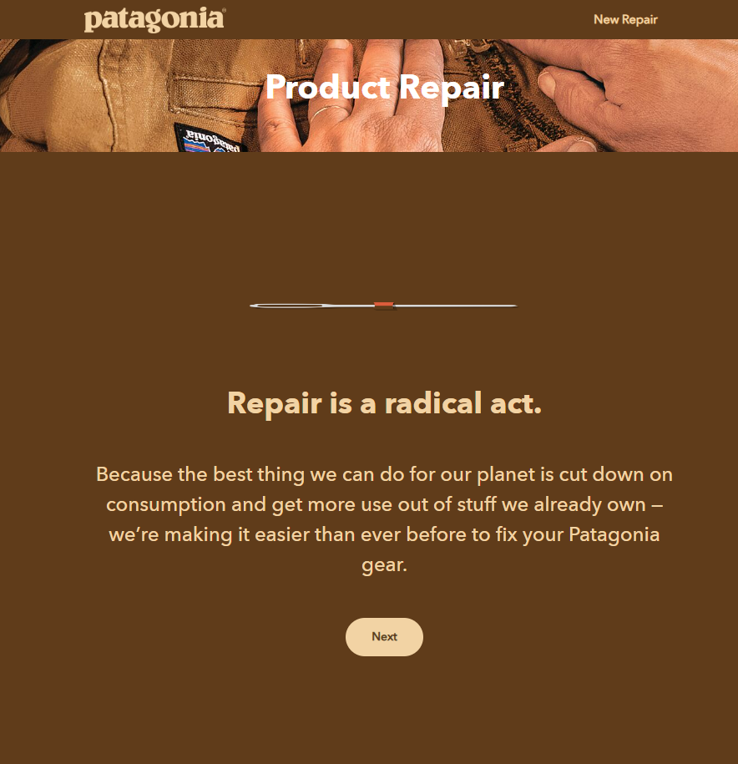
Circular Business Models
REFURBISHMENT MODEL
This approach involves restoring used products to good condition. It extends the lifecycle of products and reduces the need for new resources.
URL reference: customers.eu.patagonia.com/en-US/repairs
©Pixabay

Slide 17
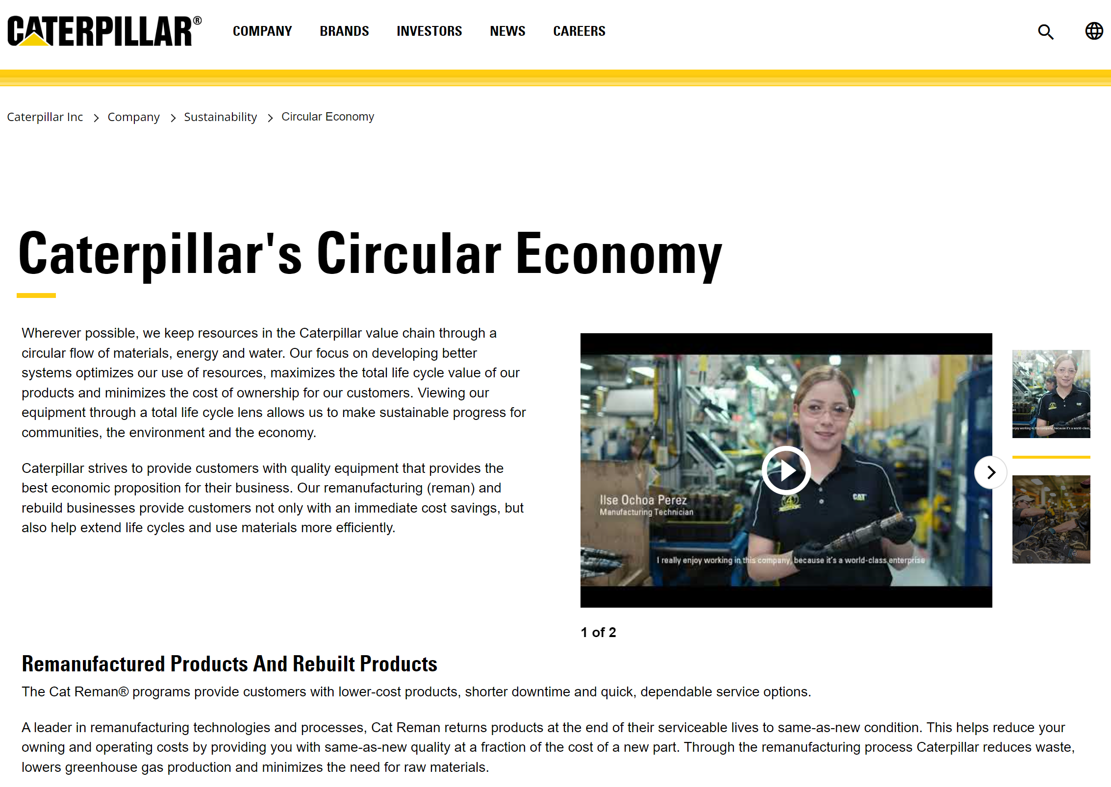
Circular Business Models
REMANUFACTURING MODEL
This approach involves updating and upgrading items to a like-new condition. It extends the lifecycle of products and reduces the need for new resources.
URL reference: www.caterpillar.com/en/company/sustainability/remanufacturing.html
©Pixabay

Slide 18
Circular Business Models
PRODUCT-AS-A-SERVICE (PAAS) MODEL
Instead of selling products, companies offer them as services. For example, instead of selling light bulbs, a company might sell lighting as a service. This model encourages companies to create durable, repairable products and to recycle or refurbish them at the end of their service life.
URL reference: www.lighting.philips.co.uk/oem-emea/products/connected-lighting
©Pixabay

Slide 19
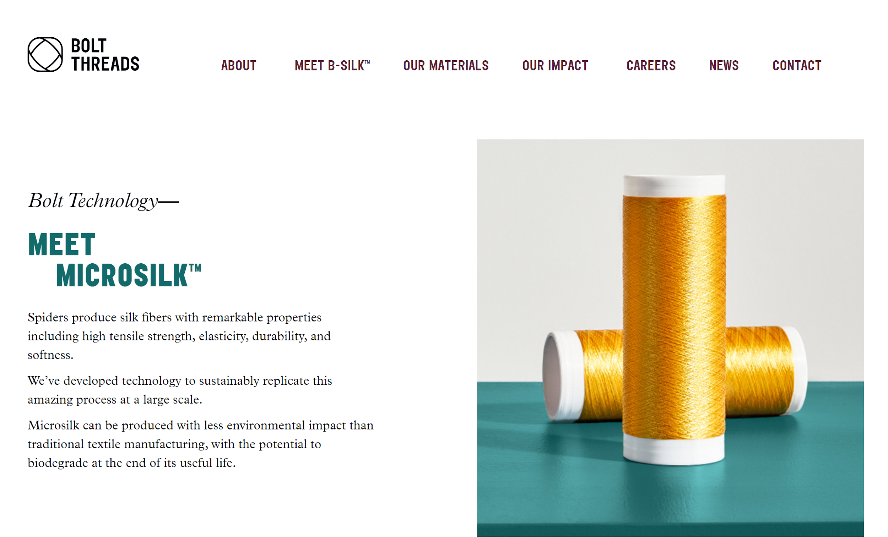
Circular Business Models
BIOLOGICAL CYCLES MODEL
This model involves designing products so that, at the end of their lifecycle, they can be safely returned to the environment. This approach is often seen in compostable products or materials that can be broken down naturally.
URL reference: boltthreads.com/technology/microsilk/
©Pixabay

Slide 20
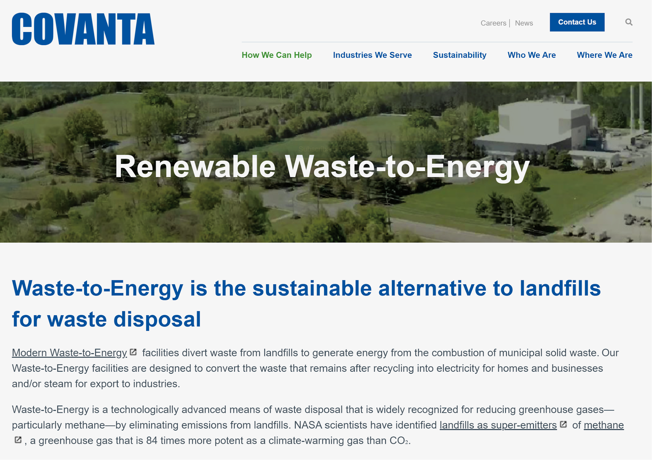
Circular Business Models
RESOURCE RECOVERY MODEL
This model focuses on extracting valuable materials from waste streams. This can involve technologies that convert waste into energy, or processes that extract raw materials from waste products.
URL reference: covanta.com
©Pixabay

Slide 21
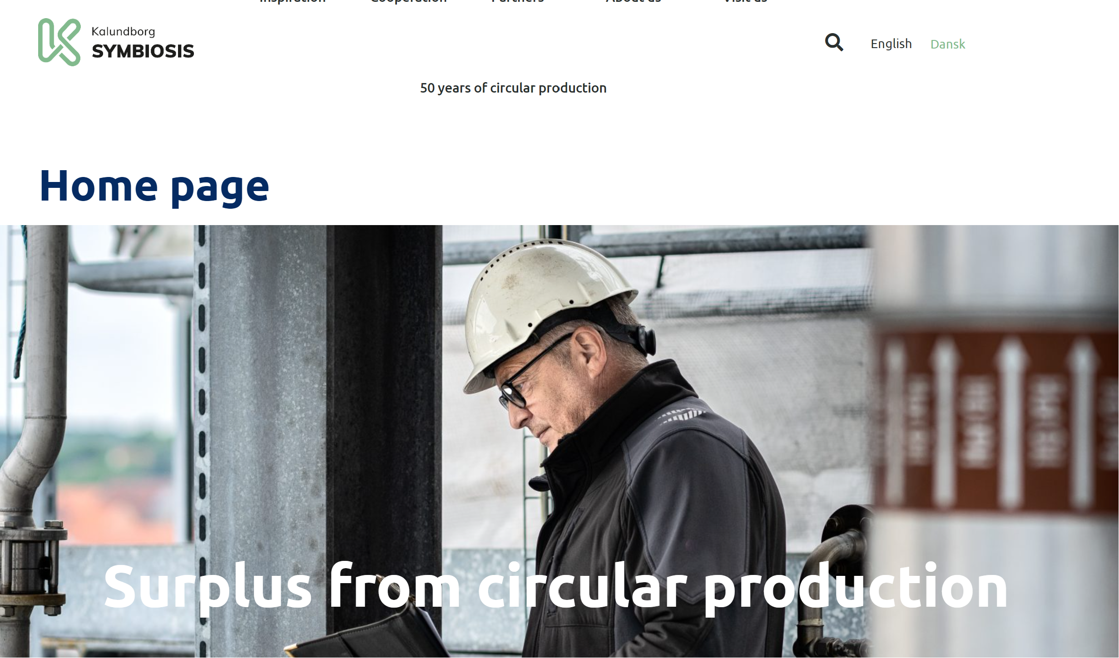
Circular Business Models
INDUSTRIAL SYMBIOSIS MODEL
This model involves different industries working together so that the waste or byproducts of one process become the raw materials for another. This inter-industry collaboration helps create a closed-loop system where waste is minimized.
URL reference: www.symbiosis.dk
©Pixabay

Slide 22
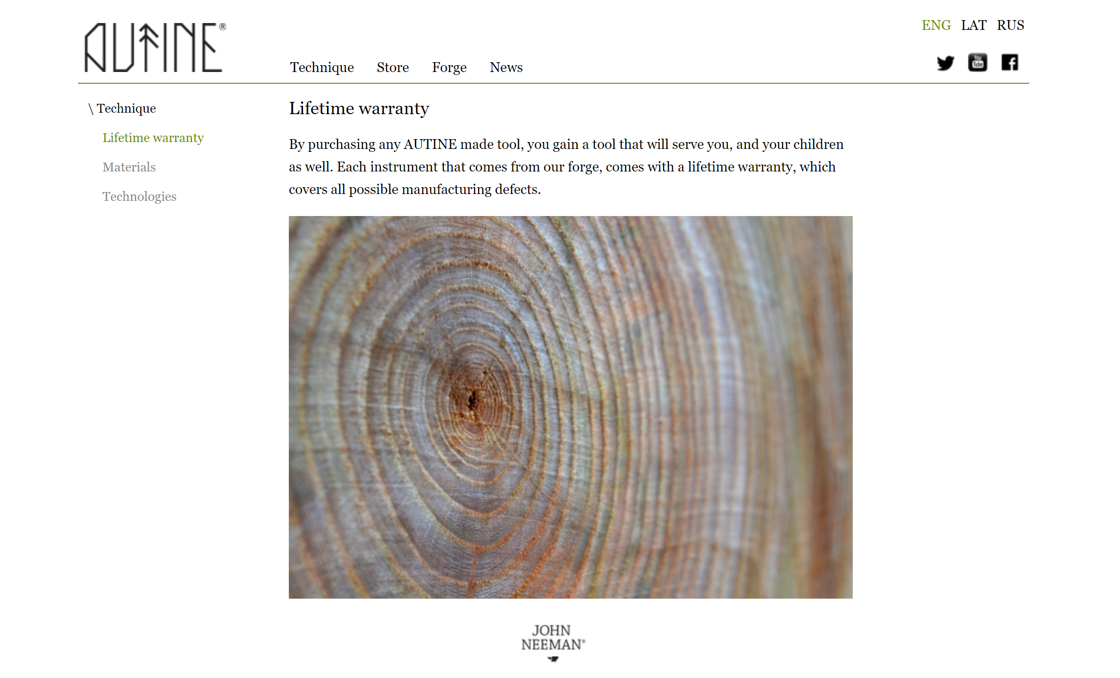
Circular Business Models
DESIGN FOR DURABILITY AND LONGEVITY MODEL
Products are designed from the outset to be durable, repairable, and upgradeable, thus extending their lifespan and reducing the need for replacement.
URL reference: www.autinetools.com
©Pixabay

Slide 23
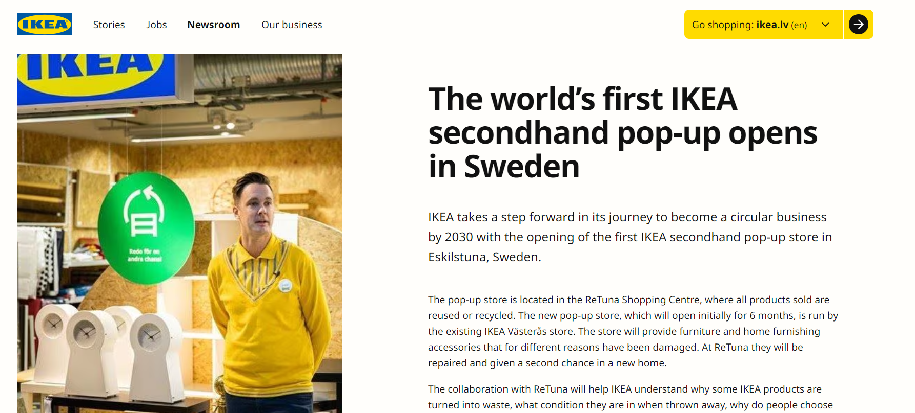
Circular Business Models
REPURCHASING OF GOODS
Products are repurchased and selled in second hand stores to reduce the consumption of newly produced goods.
URL reference: www.ikea.com/global/en/newsroom/sustainability/the-worlds-first-secondhand-ikea-popup-store-opens-in-sweden-201104/
©Pixabay

Slide 24
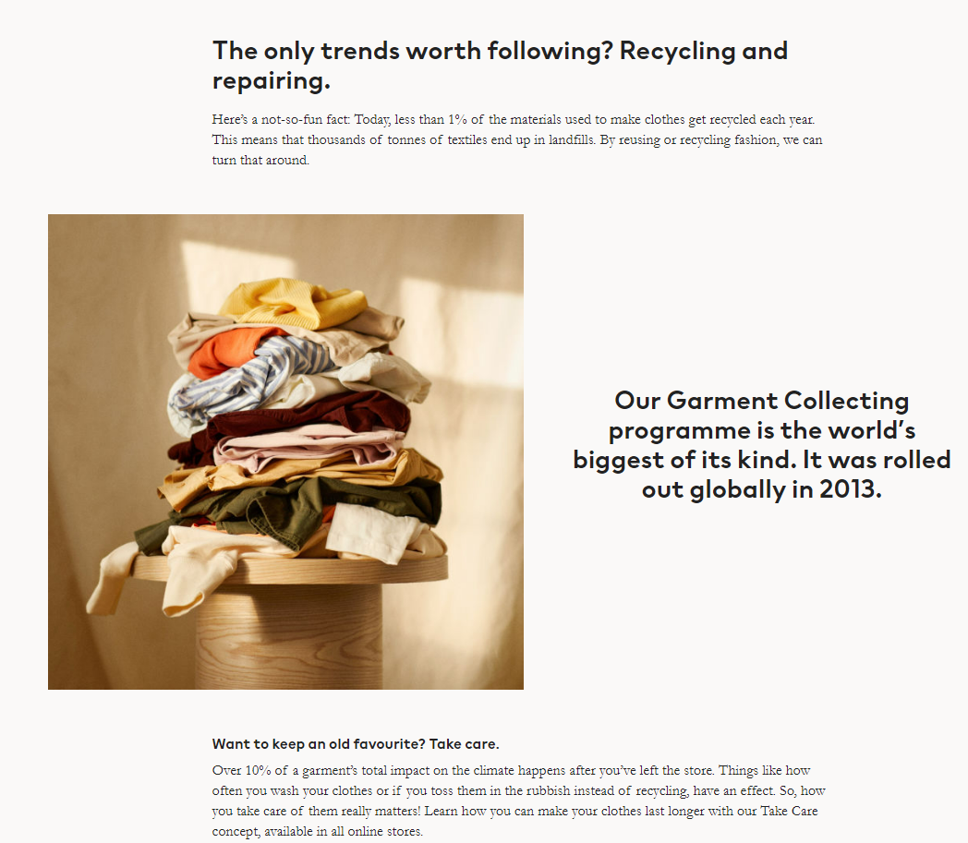
Circular Business Models
RECYCLING OF GOODS
Products are are accepted back and recycled, focusing on converting waste materials into new products or raw materials.
URL reference: www2.hm.com/en_us/sustainability-at-hm/our-work/close-the-loop.html
©Pixabay

Slide 25
Circular Business Models
EQUIPMENT AND TECHNOLOGY SHARING
MODEL
This model promotes the sharing of equipment and technology, such as workshop premises and tools. It maximizes the use of products, reduces the need for individual ownership, and often leads to reduced resource consumption.
URL reference: https://www.vatp.lv/en/rade
©Pixabay

Slide 26
Circular Business Models
Each of these models contributes to the overarching goal of a circular economy, which is to create a sustainable economic system that reduces waste and minimizes environmental impact.
They are often used in combination to achieve the best outcomes for sustainability.
©Pixabay

Slide 27
How to Transfer from Linear to Circular Business Model
©Pixabay

Slide 28
Circular Business Models
HOW TO TRANSFER FROM LINEAR TO CIRCULAR BUSINESS MODEL
Assess current practices (1)
Begin by evaluating your current business model, focusing on how resources are used and waste is generated. Identify areas where changes can lead to more sustainable practices.
Photo source: AI generated
©Pixabay

Slide 29
Circular Business Models
HOW TO TRANSFER FROM LINEAR TO CIRCULAR BUSINESS MODEL
Set clear goals and objectives (2)
Define specific, measurable objectives for the transition. These could include reducing waste, increasing the recyclability of products, or implementing a take-back program for used products.
Photo source: AI generated
©Pixabay

Slide 30
Circular Business Models
HOW TO TRANSFER FROM LINEAR TO CIRCULAR BUSINESS MODEL
Rethink product design (3)
Design products for longevity, repairability, and recyclability. Consider using modular designs that allow for easy repair or upgrading parts instead of replacing whole products.
Photo source: AI generated
©Pixabay

Slide 31
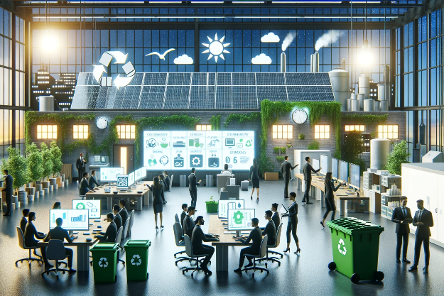
Circular Business Models
HOW TO TRANSFER FROM LINEAR TO CIRCULAR BUSINESS MODEL
Implement resource-efficient processes (4)
Optimize manufacturing processes to minimize waste and resource use. This might involve adopting new technologies or rethinking production techniques to be more efficient.
Photo source: AI generated
©Pixabay

Slide 32
Circular Business Models
HOW TO TRANSFER FROM LINEAR TO CIRCULAR BUSINESS MODEL
Develop new business models (5)
Consider models like Product-as-a-Service (PaaS), where you offer services rather than selling products, or leasing models where products are returned for refurbishment and reuse.
Photo source: AI generated
©Pixabay

Slide 33
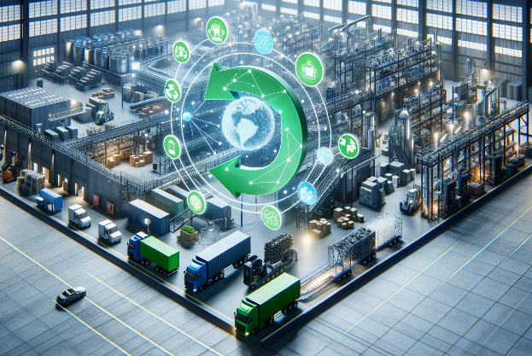
Circular Business Models
HOW TO TRANSFER FROM LINEAR TO CIRCULAR BUSINESS MODEL
Establish closed-loop supply chains (6)
Create or join networks for recovering and reusing materials. This could involve setting up systems for returning used products or collaborating with other companies to utilize each other's waste products.
Photo source: AI generated
©Pixabay

Slide 34
Circular Business Models
HOW TO TRANSFER FROM LINEAR TO CIRCULAR BUSINESS MODEL
Engage with suppliers (7)
Work with suppliers who are also committed to circular principles. Ensure that the materials you use are sustainably sourced and can be recycled or composted at the end of their life.
Photo source: AI generated
©Pixabay

Slide 35
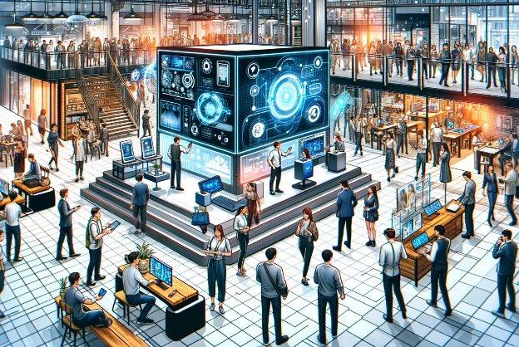
Circular Business Models
HOW TO TRANSFER FROM LINEAR TO CIRCULAR BUSINESS MODEL
Educate and engage customers (8)
Inform your customers about the benefits of a circular model. Encourage them to participate in take-back schemes, recycling programs, or other initiatives that support the circular economy.
Photo source: AI generated
©Pixabay

Slide 36
Circular Business Models
HOW TO TRANSFER FROM LINEAR TO CIRCULAR BUSINESS MODEL
Leverage technology for efficiency (9)
Use technology to track resource flows, manage reverse logistics for returned products, and optimize the lifecycle of your products.
Photo source: AI generated
©Pixabay

Slide 37
Circular Business Models
HOW TO TRANSFER FROM LINEAR TO CIRCULAR BUSINESS MODEL
Monitor, evaluate and adapt (10)
Continuously monitor the impact of your changes. Collect data on resource use, waste reduction, and customer feedback to evaluate your progress and make necessary adjustments.
Photo source: AI generated
©Pixabay

Slide 38
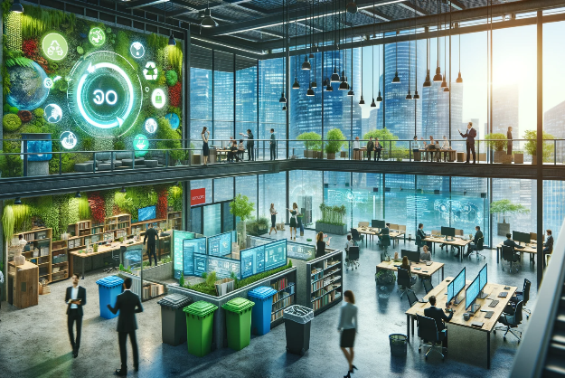
Circular Business Models
HOW TO TRANSFER FROM LINEAR TO CIRCULAR BUSINESS MODEL
Promote a Circular culture internally (11)
Foster a culture of sustainability within your organization. Educate employees about the importance of circular practices and encourage innovation in this area.
Photo source: AI generated
©Pixabay

Slide 39
Circular Business Models
HOW TO TRANSFER FROM LINEAR TO CIRCULAR BUSINESS MODEL
Collaborate and build partnerships (12)
Engage in partnerships with other companies, governmental bodies, and NGOs to expand the reach and effectiveness of your circular initiatives.
Photo source: AI generated
©Pixabay

Slide 40
Task Circular Business Model Innovation Challenge
©Pixabay

Slide 41
Circular Business Model Innovation Challenge
1. Divide into small teams (3-4 people each).
2. Use the circular business model principles to rethink the assigned scenario.
3. Present circular business model solution, explaining how it addresses the principles of the circular economy.
4. Discuss how these circular business model innovations can be applied in real-world contexts to drive sustainability and economic value.
©Pixabay

Slide 42
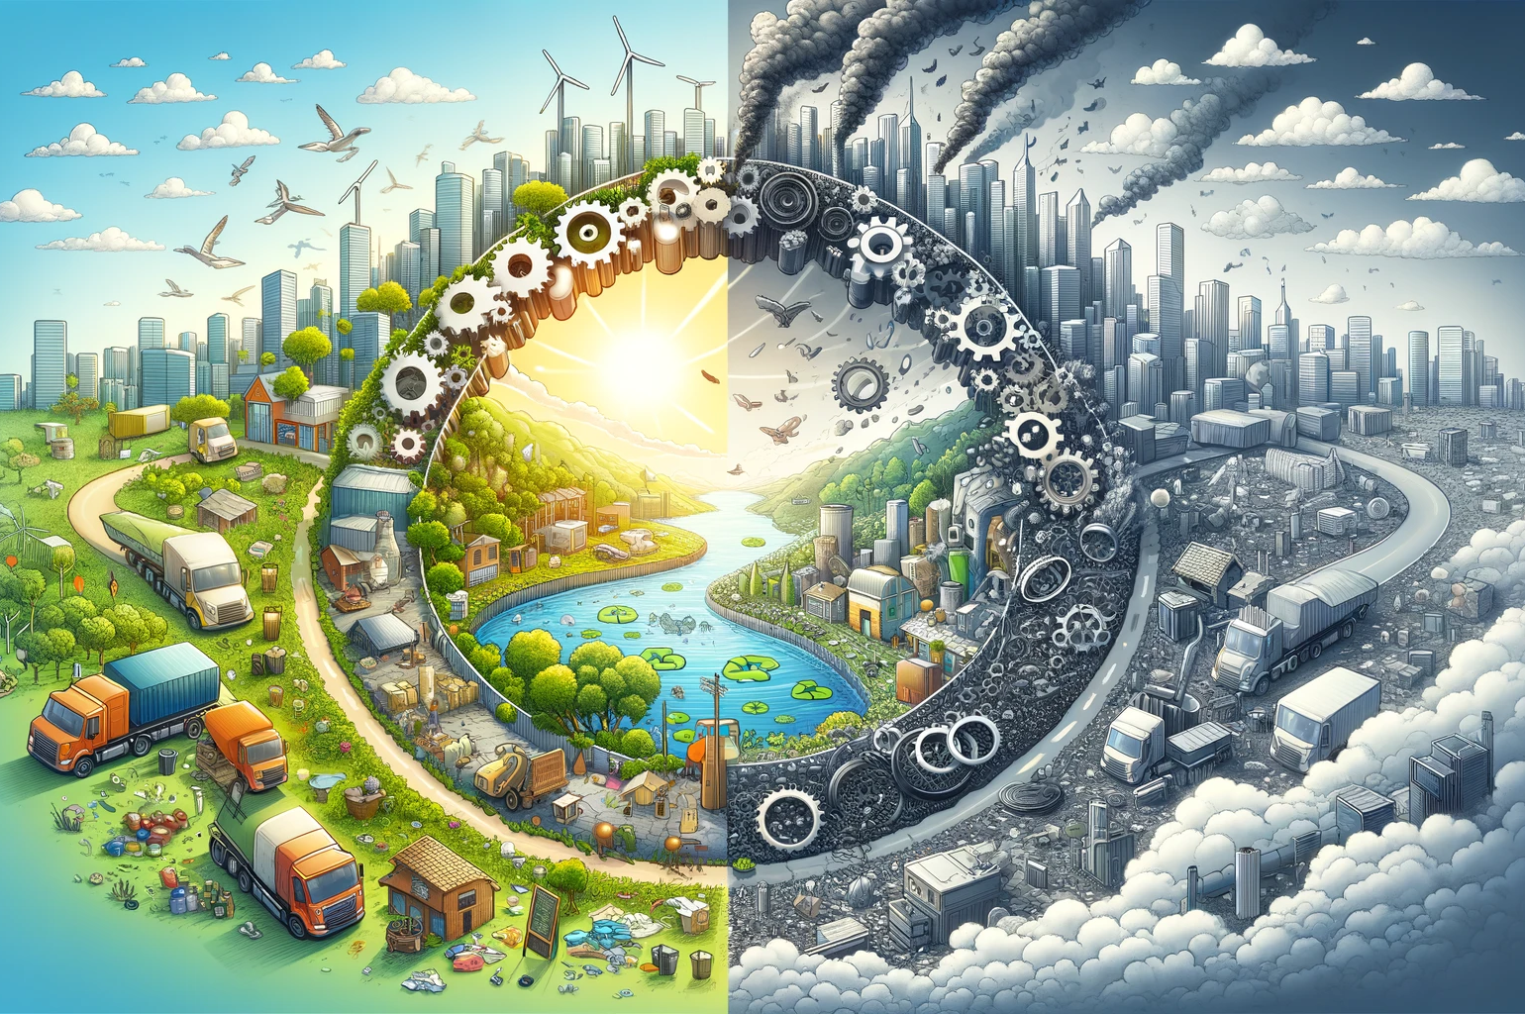
Summary
Challenges and Considerations
Upfront Investment and Cost
Consumer Acceptance and Behavior
Supply Chain Complexity
Regulatory and Policy Barriers
Technical Challenges
Market Demand for Recycled Materials
Design Considerations
Intellectual Property and Data Security
Logistics and Infrastructure
Cultural and Organizational Change
Photo source: AI generated
©Pixabay

Slide 43
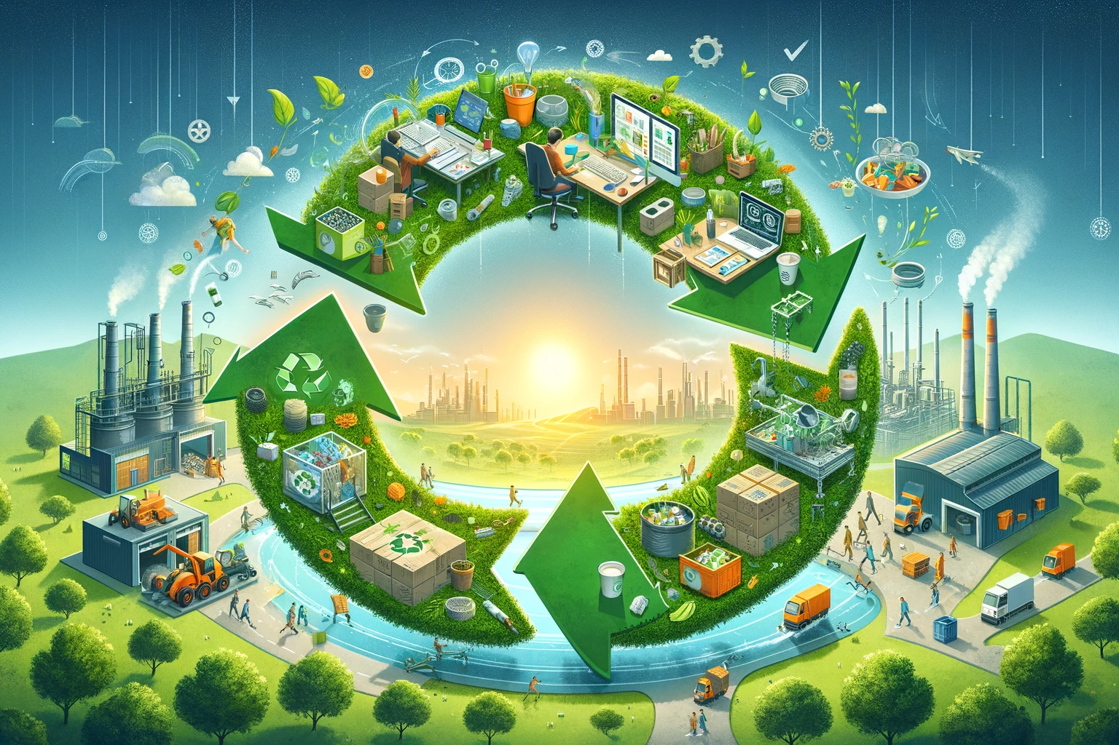
Summary
Opportunities
Innovation in Product Design and Development
Creation of New Business Models and Revenue Streams
Cost Reduction and Efficiency Gains
Competitive Advantage
Access to New Markets and Customer Segments
Regulatory Compliance and Leadership
Enhanced Supply Chain Sustainability
Social and Environmental Impact
Attracting Investment
Building Resilience
Photo source: AI generated
©Pixabay

Slide 44
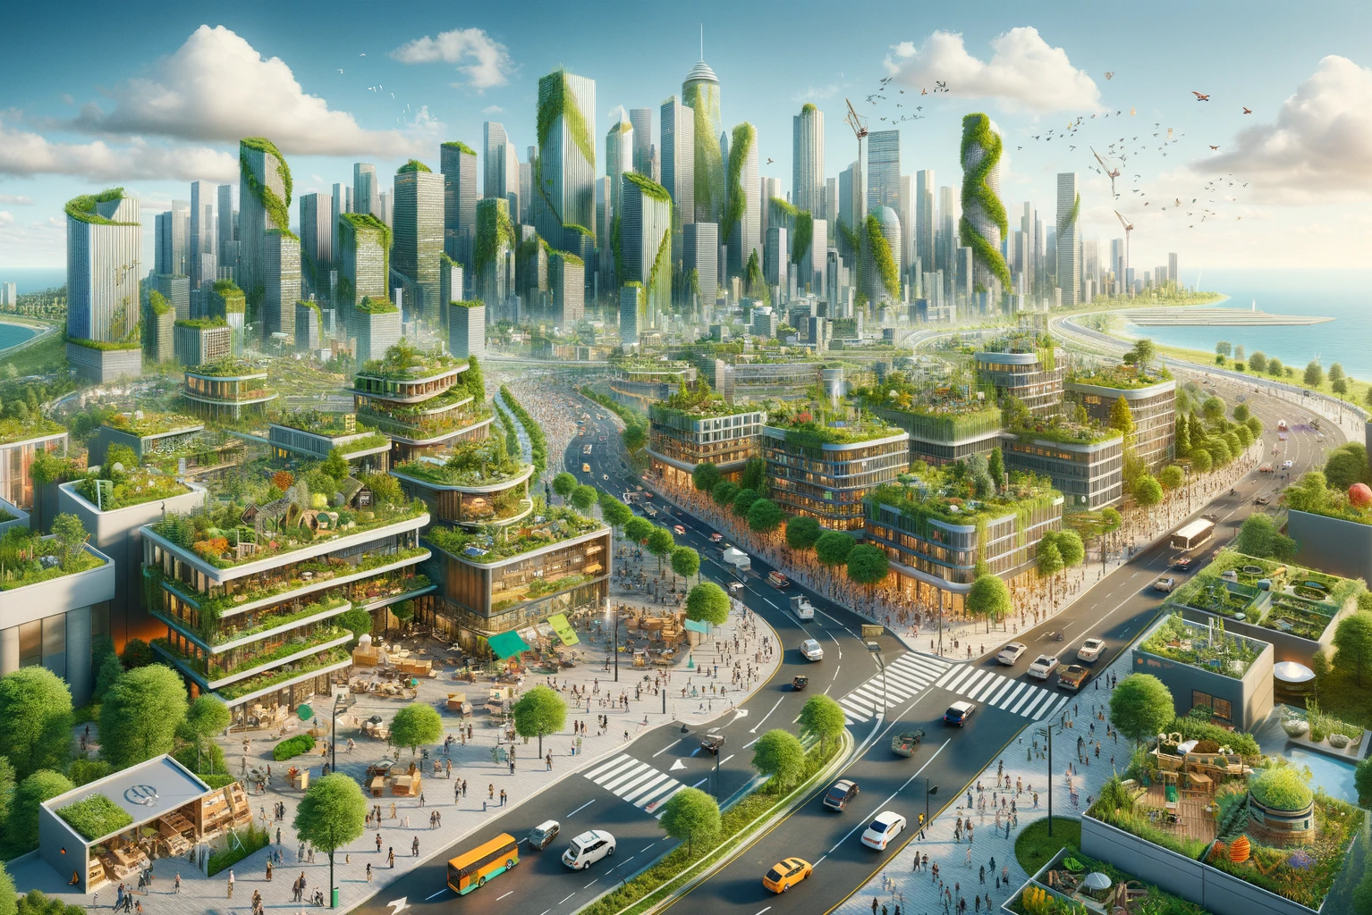
Summary
Conclusion – The Future is Circular
Emphasize the importance of transitioning to circular business models for sustainable development.
Encourage the audience to consider how businesses can innovate and transform to contribute to a more sustainable and economically viable future.
©Pixabay

Slide 45
Questions and discussion
©Pixabay

