Slide 1
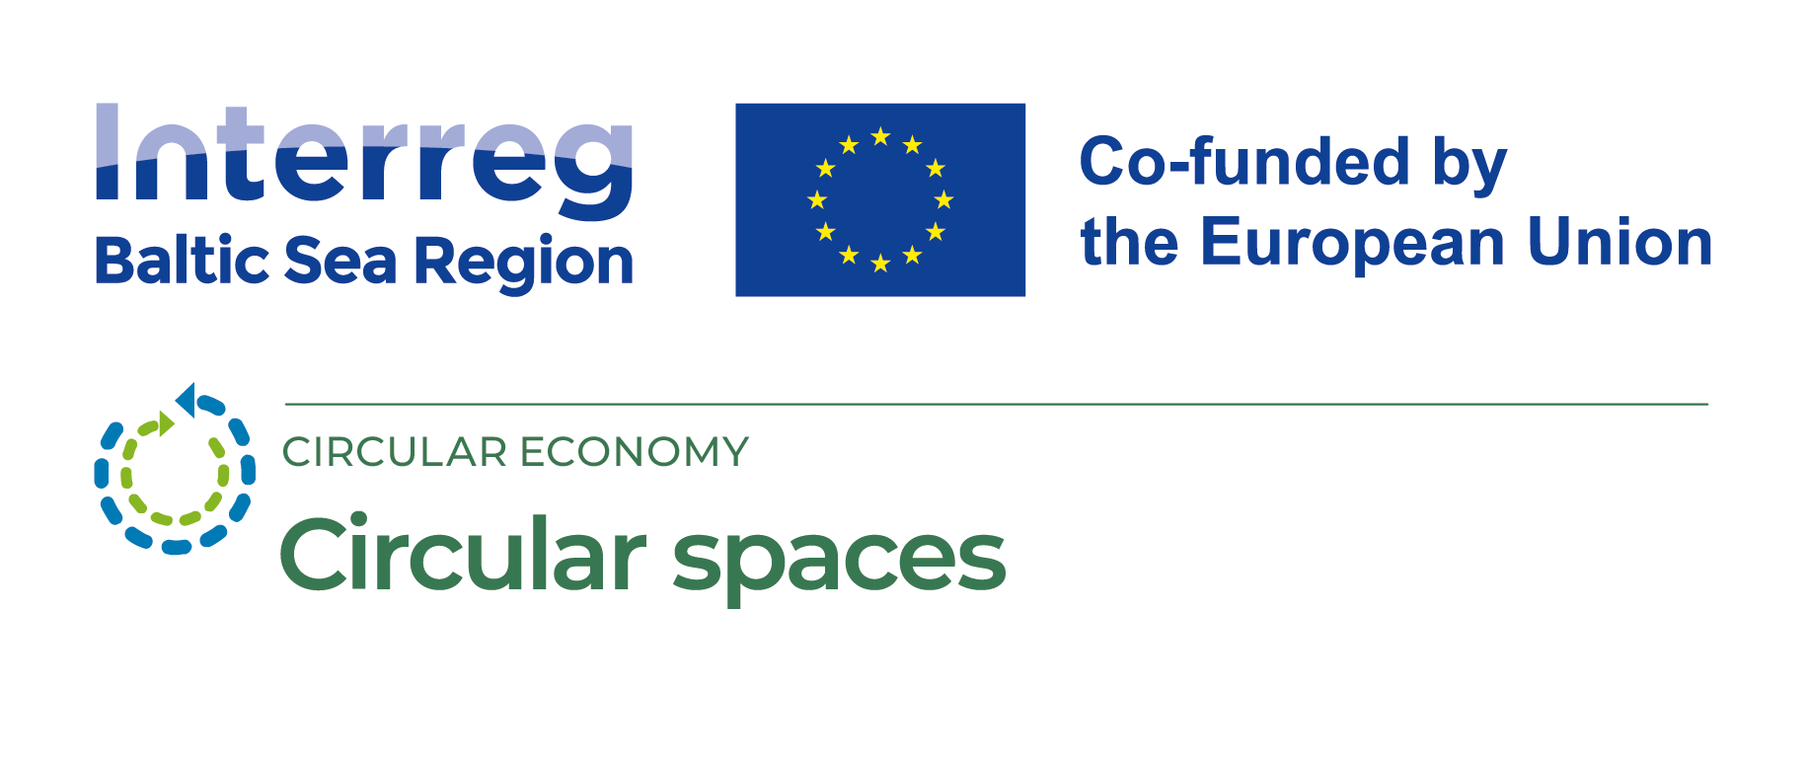

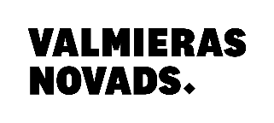

Circular value chains, ecosystems and people
Maira Leščevica

Slide 2
Š The aim of this lesson:
To recognize stakeholders in circular economy
To gain understanding of circular value chains
To identify/ recognize barriers and ecosystems
To observe ideas how to involve companies, people in circular thinking
To perform changes in society
Topic programme
This topic takes 2 (120’) hours, hence the following programme is suggested
Minutes | TOPIC
25 min. | A presentation about stakeholders role in the CE – from linear to circular
25 min. | A presentation and discussion about changes in value chain
30 min. | Exercise: How different value chain organizations can change their processes towards CE?
10 min. | A presentation about barriers to CE and Ecosystems as another aspect of CE
10 min. | A presentation of organizations working towards CE
10 min. | A presentation about society possible activities towards circular society
10 min. | A presentation about integrated learning approach when dealing with performing changes for stakeholders
120 min.

Slide 3
Changes in the World
Natural disasters
Political instability
Climat changes
Scarcity of natural resources, pollution

Slide 4
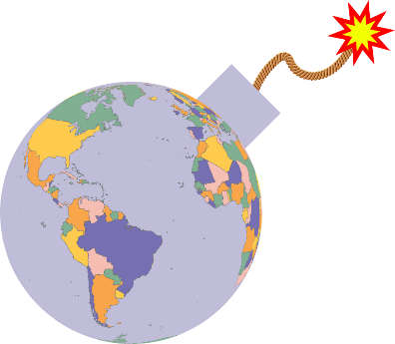
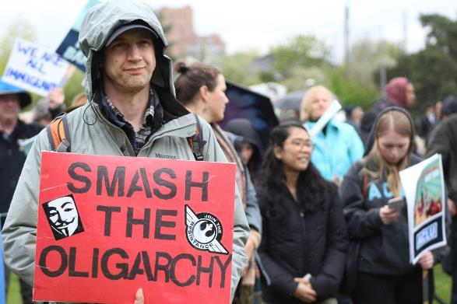
Political instability

Slide 5
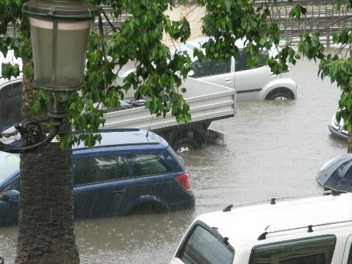
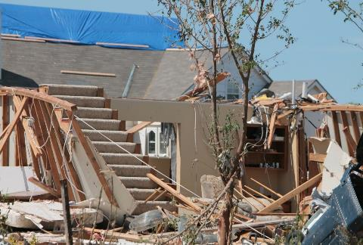


Natural disasters

Slide 6

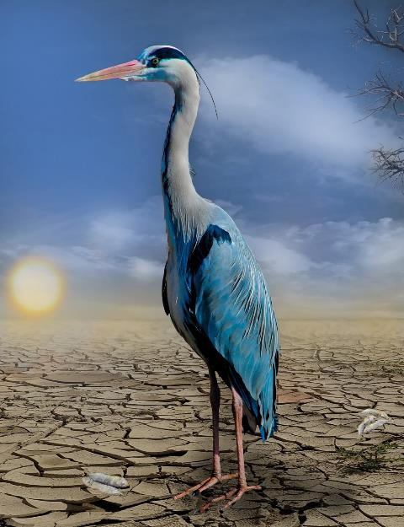
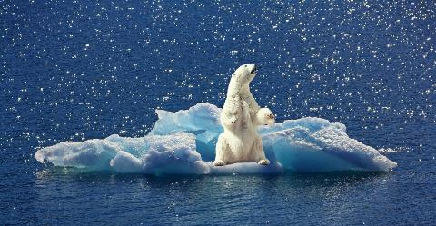
Climat changes

Slide 7
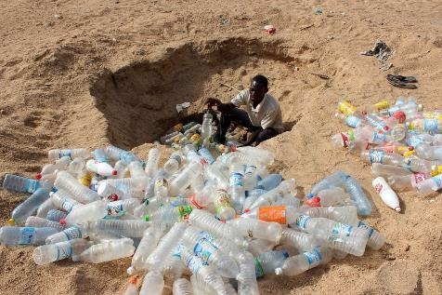
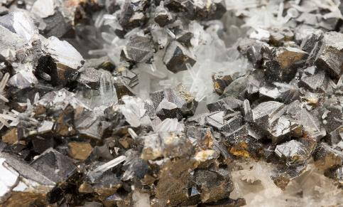
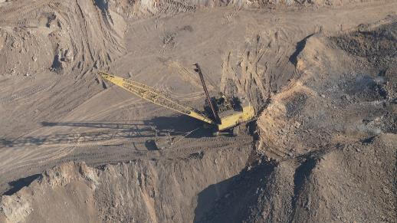
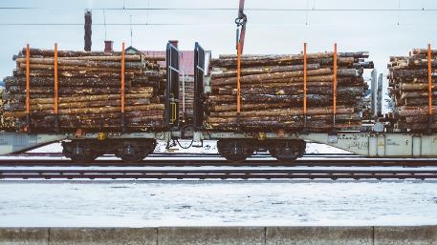
Dabas resursu izsmeļamība, piesārņojums
Scarcity of natural resources, pollution

Slide 8
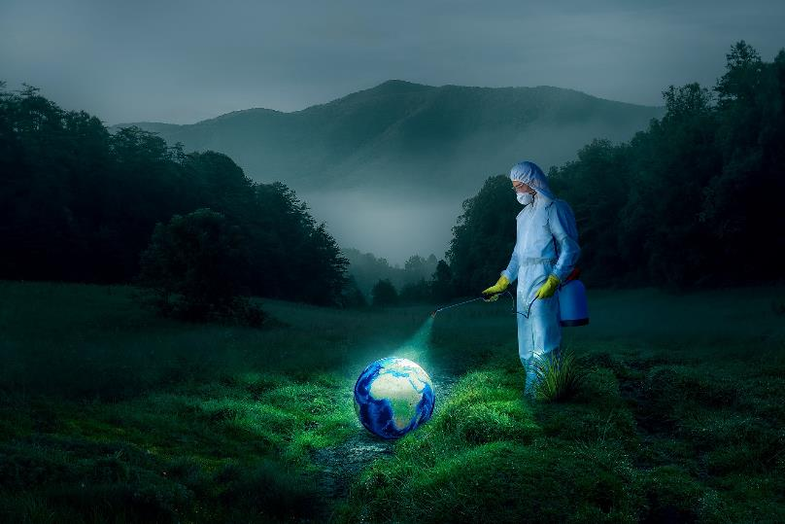
We still have time to CHANGE...
Picture from www.pixabay.com

Slide 9
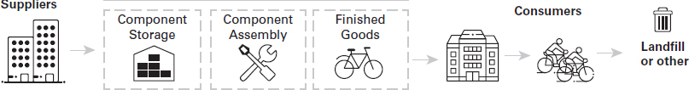
Linear economy value chain
Weenk, E., & Henzen, R. (2021). Mastering the Circular Economy. Kogan Page
Notes:
Discover value chain in linear economy and find out which parts of value chain must be influenced at first in order to make changes to circularity.
Suggested reading: Weenk, E., & Henzen, R. (2021). Mastering the Circular Economy. Kogan Page, 5-34 pages

Slide 10
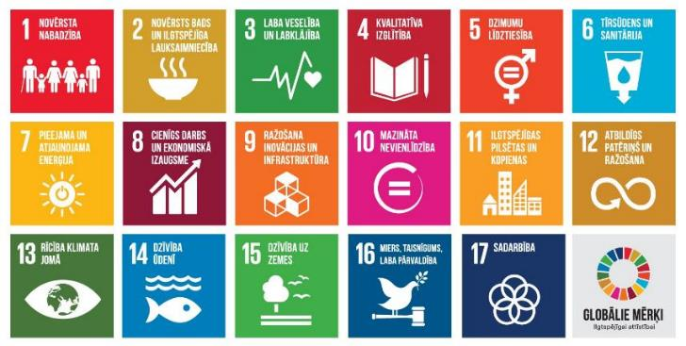
9 Major Problems
The 17 Sustainable Development Goals to Transform the World
Global Warming
Deforestation
Water Supply
Pollution
Waste
Biodiversity
Ocean Acidification
Soil Erosion
Decreasing Resources
Wilson-Powell G. Is it really green? Penguin Random House, 2021
https://pkc.gov.lv/lv/attistibas-planosana-latvija/ano-ilgtspejigas-attistibas-merki

Slide 11
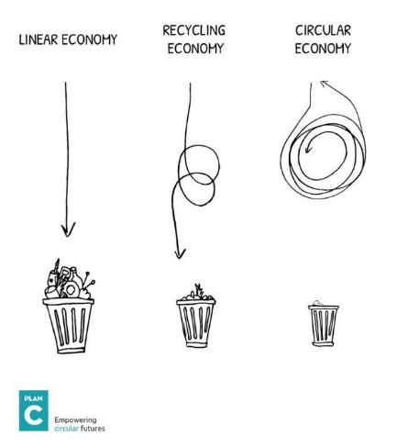
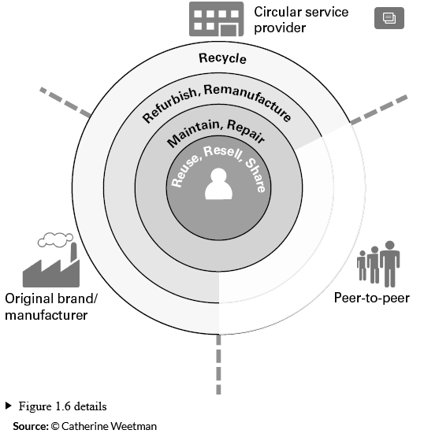
Circle flow
© Catherine Weetman 2022
Notes:
Vērtību ķēdes pamatideja mainās, lai aizvērtu cilpu vai saglabātu visu ķēdē kā aplī. Šis slaids iepazīstina ar priekšstatu par pakalpojumu sniedzējiem kā galvenajiem spēlētājiem, nevis ražotājiem. Tas arī palielina sabiedrības daļu – dalīšanās ekonomiku.
Lielākā daļa produktu plūst caur četrām tipiskām cilpām:
Atkārtoti izmantot, pārdot tālāk un kopīgot — veidi, kā oriģinālo produktu paturēt lietošanā, piemēram, to tālākpārdot, atdot pēc lietošanas, lai kāds cits to izmantotu, vai koplietot, lai to varētu izmantot vairāk cilvēku.
Apkope un remonts, lai izstrādājums darbotos efektīvi un produktīvi ilgāk.
Atjaunot un pārbūvēt, kam nepieciešama dziļāka iejaukšanās. Atjaunošana ietver tīrīšanu, virsmas līmeņa remontu un apkopi, iespējams, produkta vai aprīkojuma pārkrāsošanu un pulēšanu.
Pārstrāde ir visattālākā un neefektīvākā cilpa. Pārstrāde prasa daudz enerģijas un var būt nepieciešams dārgs darbaspēks vai aprīkojums dažādu materiālu šķirošanai un atdalīšanai. Ir arī dažādi pārstrādes “līmeņi”. Ideālā gadījumā mēs vēlamies materiālus pārstrādāt, lai tos atkal izmantotu tāda paša veida lietošanā; un izvairieties no to “pārveidošanas” par zemākas kvalitātes, zemākas vērtības materiālu ar zemākām funkcionālajām specifikācijām. More reading: Weetman, Catherine. A Circular Economy Handbook. Available from: VitalSource Bookshelf, (2nd Edition). Kogan Page, 2020, 13-44 pages
The basic idea of value chain changes in order to close the loop or the maintain everything in chain as in circle. This slide introduces idea of service providers as main players instead of manufacturers. It also increases part of society role – sharing economy.
Most products flow through four typical loops:
Reuse, resell and share – ways to keep the original product in use, such as reselling it, returning it after use for someone else to use it, or sharing it, so more people can use it.
Maintain and repair, to keep the product working efficiently and effectively for longer.
Refurbish and remanufacture, which needs deeper levels of intervention. Refurbishing involves cleaning, surface-level repairs and maintenance, perhaps repainting and polishing the product or equipment.
Recycling is the outermost and least effective loop. Recycling requires lots of energy and may need expensive labour or equipment to sort and separate different materials. There are different ‘levels’ of recycling too. Ideally, we want to recycle materials to use them again in the same kind of application; and avoid ‘downcycling’ them into a lower-grade, lower-value material with inferior functional specifications. More reading: Weetman, Catherine. A Circular Economy Handbook. Available from: VitalSource Bookshelf, (2nd Edition). Kogan Page, 2020, 13-44 pages

Slide 12
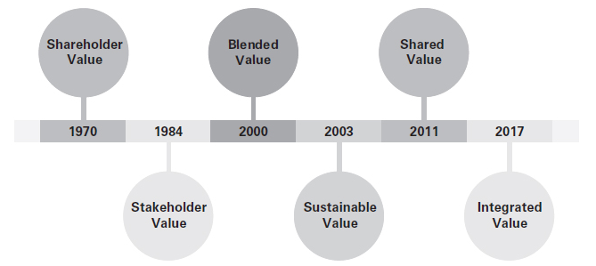
Leading value creation concepts
Weenk, E., & Henzen, R. (2021). Mastering the Circular Economy. Kogan Page
Notes:
Pašlaik ir piecas vadošās vērtības radīšanas koncepcijas, kas atspoguļo biznesa vērtību sabiedrībai.
Ieinteresēto pušu vērtība. Šajā koncepcijā galvenais ir tas, kā ieinteresētās personas (piemēram, klienti, piegādātāji, darbinieki, finansisti, kopienas un vadība) sadarbojas, lai radītu vērtību. Tas nozīmē, ka bizness ir “vērtību radošu attiecību kopums starp grupām, kurām ir likumīgas intereses par uzņēmuma darbībām un rezultātiem un no kurām bizness ir atkarīgs, lai sasniegtu savus mērķus” (Phillips et al, 2019).
Jauktā vērtība. Šajā konceptuālajā sistēmā, kas pazīstama arī kā ar misiju saistītas investīcijas, ietekmes investīcijas, saskaņots kapitāls un sociālie ieguldījumi, uzņēmumi, investīcijas un bezpeļņas organizācijas tiek novērtētas, pamatojoties uz to spēju radīt sociālās, vides un finansiālās vērtības sajaukumu (Emerson, 2000). Šo holistisko pieeju dažreiz izmanto aizvietojot ar trīskāršās līnijas cilvēkiem, planētu un peļņu.Kopīgā vērtība. Kopīgās vērtības radīšanai jau ir akronīms CSV, un tas ir ietvars, kurā uzņēmuma panākumi un sociālais progress ir savstarpēji atkarīgi. Tas uzlabo uzņēmuma konkurētspēju, vienlaikus "uzlabojot ekonomiskos un sociālos apstākļus kopienās, kurās tas darbojas". Kopīgās vērtības radīšana koncentrējas uz saikņu noteikšanu un paplašināšanu starp sociālo un ekonomisko progresu” (Porter un Kramer, 2011).Ilgtspējīga vērtība. Ietvars aplūko globālos ilgtspējības izaicinājumus, izmantojot biznesa objektīvu, kas palīdz noteikt pareizās stratēģijas un praksi, kas veicina ilgtspējīgāku pasauli, vienlaikus palielinot akcionāru vērtību. Šī abpusēji izdevīgā pieeja tiek definēta kā ilgtspējīgas vērtības radīšana (Hart and Milstein, 2003).Integrētā vērtība. Integrētas vērtības radīšana ir vairāku “nefinansiālu” kapitālu (piemēram, cilvēkkapitāla, ekoloģiskā, sociālā, tehnoloģiskā un infrastruktūras kapitāla) vienlaicīga veidošana, izmantojot sinerģiskas inovācijas visā saiknes ekonomikā (tostarp aprites, labklājības, piekļuves, eksponenciālas un noturības). ekonomikas), kas rada neto pozitīvu ietekmi, tādējādi padarot mūsu pasauli apmierinošāku, ilgtspējīgāku, kopīgāku, gudrāku un drošāku (Visser, 2017a).Ieteicamā literatūra: Weenk, E., & Henzen, R. (2021).
Aprites ekonomikas apgūšana. Kogan Page, 34-91 lppThere are currently five leading value creation concepts that reconceive business’s value to society.
Stakeholder Value. Central to this concept is how stakeholders (e.g. customers, suppliers, employees, financiers, communities and management) work cooperatively to create value. This means that business is a ‘set of value-creating relationships among groups that have a legitimate interest in the activities and outcomes of the business and upon whom the business depends to achieve its objectives’ (Phillips et al, 2019).
Blended Value. In this conceptual framework – also known as mission-related investing, impact investing, aligned capital and social investments – businesses, investments and non-profit organizations are evaluated based on their ability to generate a blend of social, environmental and financial value (Emerson, 2000). This holistic approach is sometimes used interchangeably with the triple bottom line’s people, planet and profit.
Shared Value. Creating Shared Value already has an acronym, CSV, and it’s a framework in which a business’s success and social progress are interdependent. It enhances the competitiveness of a business while ‘simultaneously advancing the economic and social conditions in the communities in which it operates. Shared Value creation focuses on identifying and expanding the connections between societal and economic progress’ (Porter and Kramer, 2011).
Sustainable Value. The framework views global sustainability challenges through the business lens, which helps to identify the right strategies and practices that contribute to a more sustainable world while simultaneously driving shareholder value. This win-win approach is defined as the creation of sustainable value (Hart and Milstein, 2003).
Integrated Value. Creating integrated value is the simultaneous building of multiple ‘non-financial’ capitals (such as human, ecological, social, technological and infrastructural capital) through synergistic innovation across the nexus economy (including the circular, well-being, access, exponential and resilience economies) that result in net-positive effects, thus making our world more satisfying, sustainable, shared, smart and secure (Visser, 2017a).
Suggested reading: Weenk, E., & Henzen, R. (2021). Mastering the Circular Economy. Kogan Page, 34-91 pages

Slide 13
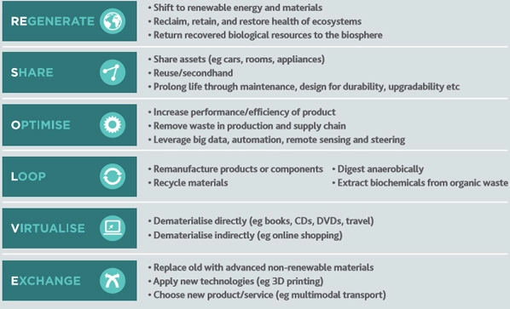
We can reach changes in step by step
ReSOLVE framework, McKinsey
Roberta De Angelis. Business models in CE: Concepts, Examples and Theory, 2018

Slide 14
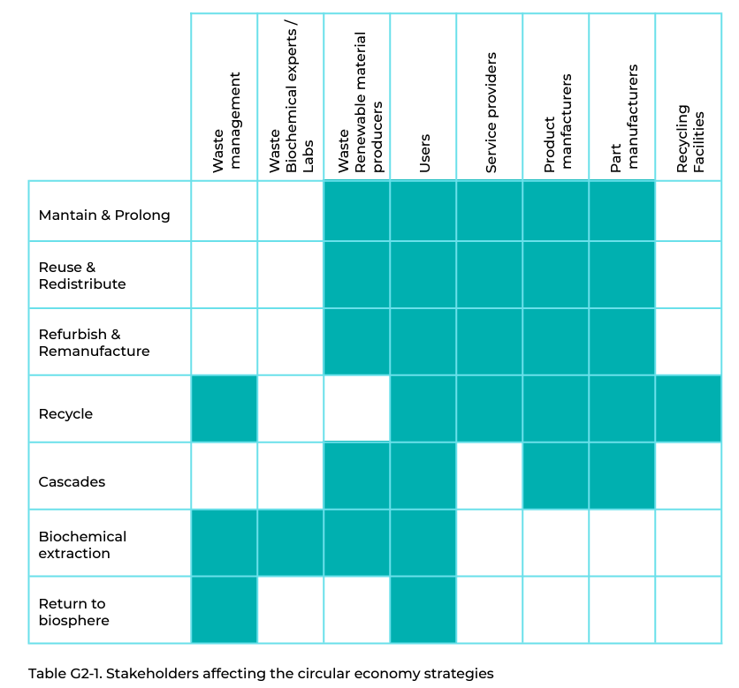
Stakeholders & CE strategies
https://upcommons.upc.edu/bitstream/handle/2117/179149/Handbook-in-IDfS.pdf;jsessionid=F6DFB47D850447FD5C055455F65484EB?sequence=1
©Pixabay
Notes:
From picture you can see, that all identified stakeholders has possibility to affect value chain by different strategies. Each organization involved in value chain should be examined from point of view their power or influence of product through collaboration (5-10 min.). This matrix can be used as example when examining own company/ organization by identifying and defining intervention points. Discussion of particular example of identified stakeholders takes 5-10 min.
Suggested reading: G2: Stakeholders and collaboration, https://upcommons.upc.edu/bitstream/handle/2117/179149/Handbook-in-IDfS.pdf;jsessionid=F6DFB47D850447FD5C055455F65484EB?sequence=1

Slide 15
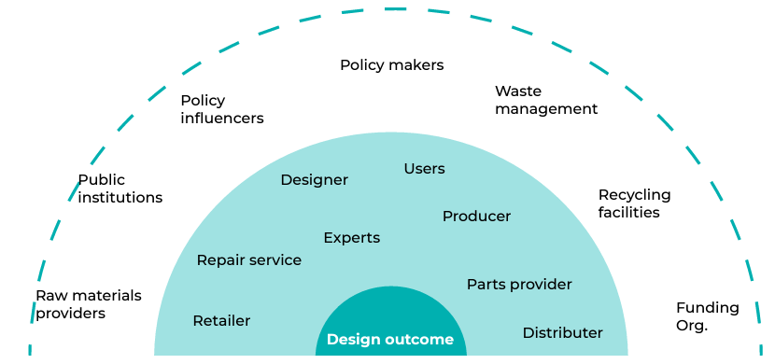
Stakeholders – direct and indirect
Product outcome
https://upcommons.upc.edu/bitstream/handle/2117/179149/Handbook-in-IDfS.pdf;jsessionid=F6DFB47D850447FD5C055455F65484EB?sequence=1
©Pixabay
Notes:
This picture suggests to look at the example of stakeholders for particular product outcome. As you can see there are direct and indirect stakeholders. Audience need to discuss why there is such division. (15 min.)
Then discuss each stakeholder and their role and importance in particular process of product development.
Suggested reading: G2: Stakeholders and collaboration, https://upcommons.upc.edu/bitstream/handle/2117/179149/Handbook-in-IDfS.pdf;jsessionid=F6DFB47D850447FD5C055455F65484EB?sequence=1

Slide 16
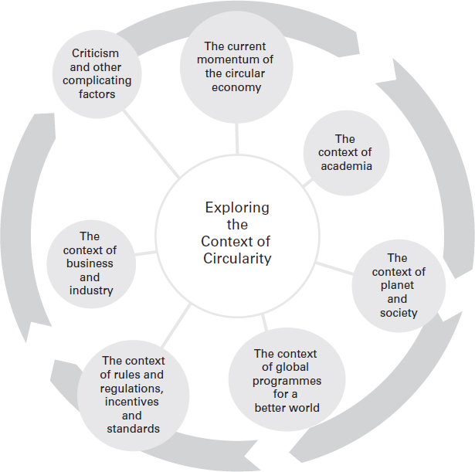
Introducing the CE
The context
of
Circularity
Weenk, E., & Henzen, R. (2021). Mastering the Circular Economy. Kogan Page
©Pixabay
Notes:
Before getting to practical exercise this slide needs to be discussed, because it helps to understand different aspects or views on circular economy and its development stage (2 min.)
Suggested reading: Weenk, E., & Henzen, R. (2021). Mastering the Circular Economy. Kogan Page, 5-34 pages

Slide 17
Imagine transformation…
Discussion in groups
What are benefits from being circular for (1) entrepreneurs, (2) local government, (3) citizens?
What are problems to become circular for (1) entrepreneurs, (2) local government, (3) citizens?
Where would you start to act more circular in your closest surrounding? Please, mention 3-5 examples.
©Pixabay
Notes:
The biggest group can be divided in three groups – entrepreneurs, local government and citizens. And then these three groups should find answers on these three tasks.
Or you can have representatives of these three stakeholders and then they can work on these three tasks.
Exercise all together takes 40 mins. 15-20 takes getting answers and other 15-20 mins. takes presentations. 5-10 min. - summary from lecturer.

Slide 18
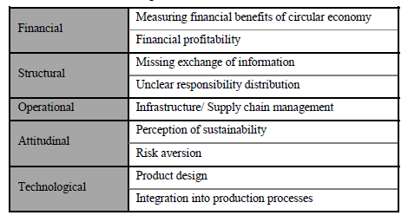
CE implementation milestones
Established legal framework
Administrative support and conditions
Economic and financial instruments
Educated and involved society
Barriers to CE AE barjeras
Theoretical
Results
Attitude and knowledge
Integration between functions
Value chain structure
Values and finances
Technology
Ritzén S. et al. (2017) Barriers to the Circular Economy – integration of perspectives and domains, Elsevier, Procedia CIRP 64
Notes:
EU planning documents has set CE implementation milestones, which has to be followed by all stakeholders. The next research shows researchers analysis about barriers to integration of CE.
Lecturer should discuss with audience the results of barrier analysis. Then it is suggested to compare and agree about crucial aspects of succesful CE implementation, based on both. (5-10 min.)
Additional reading: Ritzén S. et al. (2017) Barriers to the Circular Economy – integration of perspectives and domains, Elsevier, Procedia CIRP 64

Slide 19
Ecosystems
Drivers of ecosystem change
(habitat destruction, invasive species, pollution, population, overexploitation, climate change)
Conservation and restoration
(disturbance, structural complexity, connectivity, resilience)
Living together: reconciliation ecology
(Yards and parks, birds, bats, green roofs, cemeteries, military sites, golf courses, agricultural lands, public lands, utility corridors, roads and wildlife crossings)
Robertson M. (2021) Sustainability Principles and Practice, 3rd Edition. Routledge
Notes:
First of all should be discussed drivers of ecosystem change by using one of mentioned aspects – e.g. invasive species. Then conservation and restoration aspects should be discussed, again from one of mentioned aspects – e.g. disturbance.
The third ecosystem aspect is reconciliation – how all mentioned aspects can live together – e.g. expanding military sites. (5-10 min.)
Suggested reading: Robertson M. (2021) Sustainability Principles and Practice, 3rd Edition. Routledge, 137-169 pp.

Slide 20
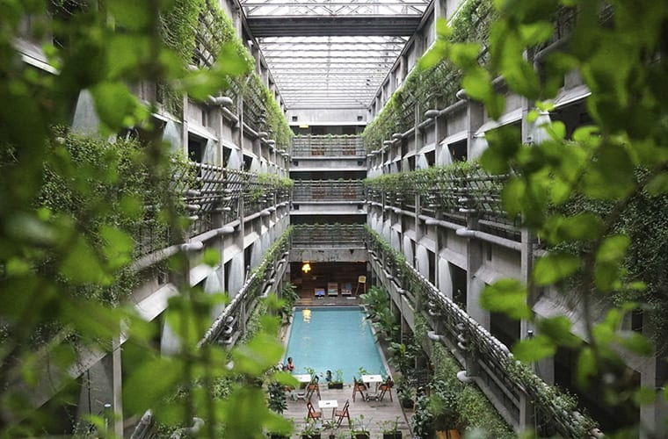
Examples of circularity - business
Hotels
https://www.dawnvale.com/news/hotels-planet-friendly-ideas-for-lowering-your-carbon-footprint/
©Pixabay
Notes:
This is real, existing hotel in global environment and presents solution, how to co-exist with nature.
Suggested reading: https://www.dawnvale.com/news/hotels-planet-friendly-ideas-for-lowering-your-carbon-footprint/

Slide 21
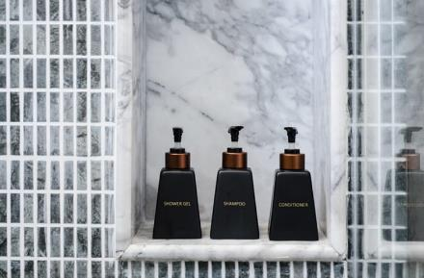
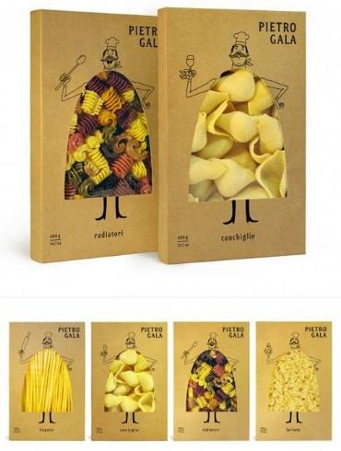
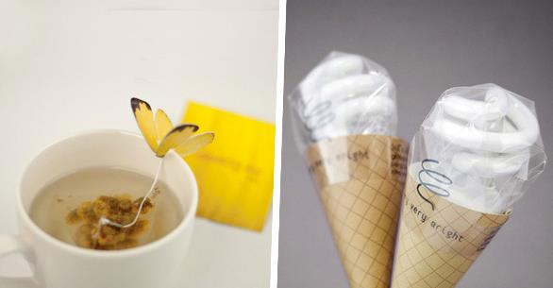
Examples of circularity - business
Packaging
Foto: www.pixabay.com
©Pixabay
Notes:
Different examples of packaging, which can be more sustainable and eco-friendly.
Suggested reading: https://www.dawnvale.com/news/hotels-planet-friendly-ideas-for-lowering-your-carbon-footprint/

Slide 22
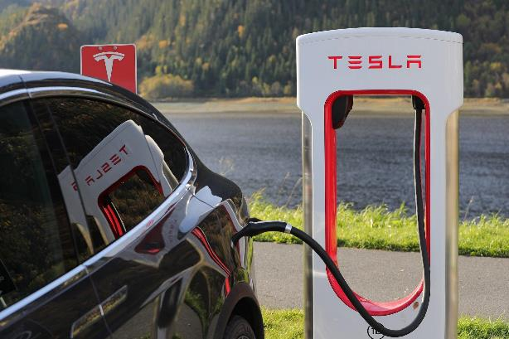
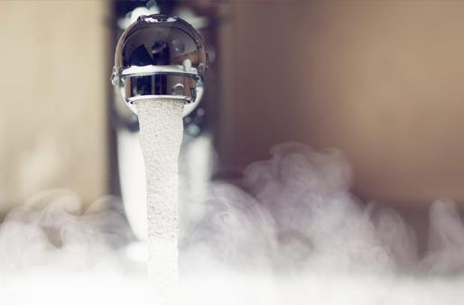
Examples of circularity - society
Energy effiency
Foto: www.pixabay.com
Notes:
Examples how society in general can change their everyday life by saving energy, water. Small discussion about examples.
Suggested reading: https://www.dawnvale.com/news/hotels-planet-friendly-ideas-for-lowering-your-carbon-footprint/

Slide 23
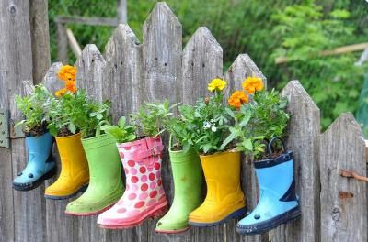
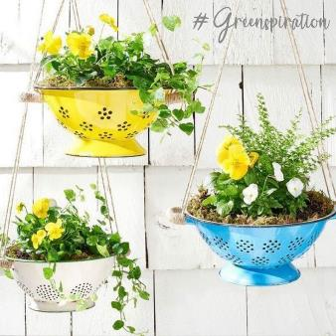
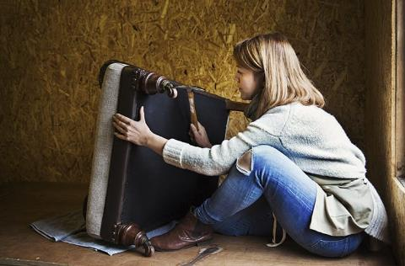
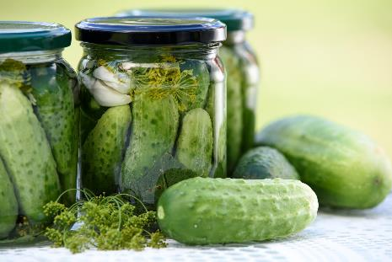
Examples of circularity - society
Re-using
Notes:
Examples how society in general can change their everyday life by giving new life to used things – second, third life. Small discussion about examples in pictures.
Suggested reading: https://www.dawnvale.com/news/hotels-planet-friendly-ideas-for-lowering-your-carbon-footprint/
https://maximizeminimalism.com/25-ways-to-reuse-common-household-items/

Slide 24
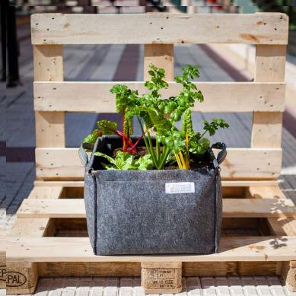
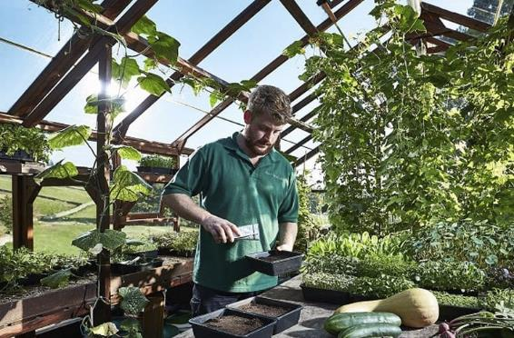
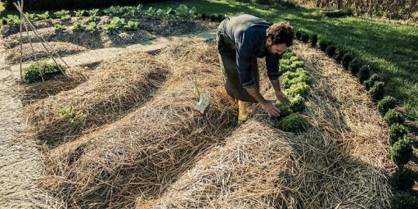
Examples of circularity– pilsētas komūnas, sabiedrība
Urban communes, society
Kitchen garden
Notes:
Urban gardening, small scale gardening is good example, how citizens can use their bio-waste. Discussion about possibilities and regulations.
Suggested reading: https://grocycle.com/how-to-start-a-permaculture-garden/
https://www.eventbrite.ca/e/what-to-do-now-to-begin-creating-an-eco-climate-friendly-garden-system-tickets-383570588957

Slide 25
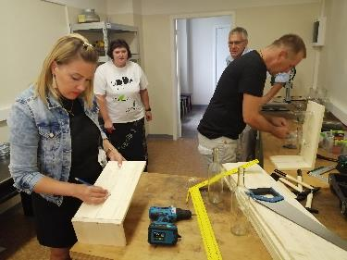
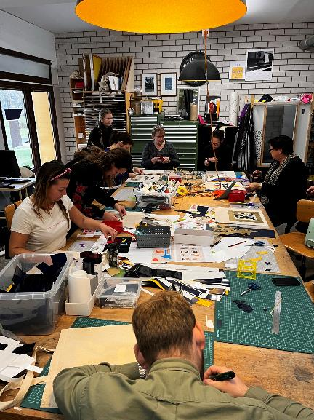
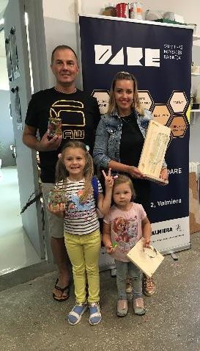
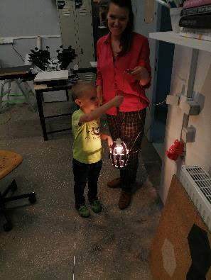
Examples of circularity – DARE for families with children
Notes:
Makerspace DARE has already been setting up great examples of circularity in the past by promoting more environmentally friendly decision-making through workshops. There have been various activities for families with children and adults. For example, creating interior elements from used glass bottles (such as vases, glasses and light objects), upcycled lamps with new design elements from different scrap materials. Another form of workshop is using scrap material left from plottering stickers and creating new designs with these colourful pieces on fabric

Slide 26
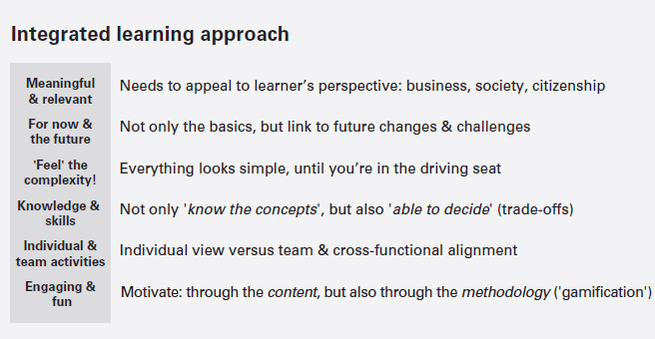
How to manage changes
Weenk, E., & Henzen, R. (2021). Mastering the Circular Economy. Kogan Page
Notes:
When dealing with stakeholders and trying to change their attitude always should be taken integrated learning approach, which involves these topics. Lecturer should discuss them and agree about next steps to be taken.
Suggested reading: Weenk, E., & Henzen, R. (2021). Mastering the Circular Economy. Kogan Page, Preface, 286 pages

