Slide 1
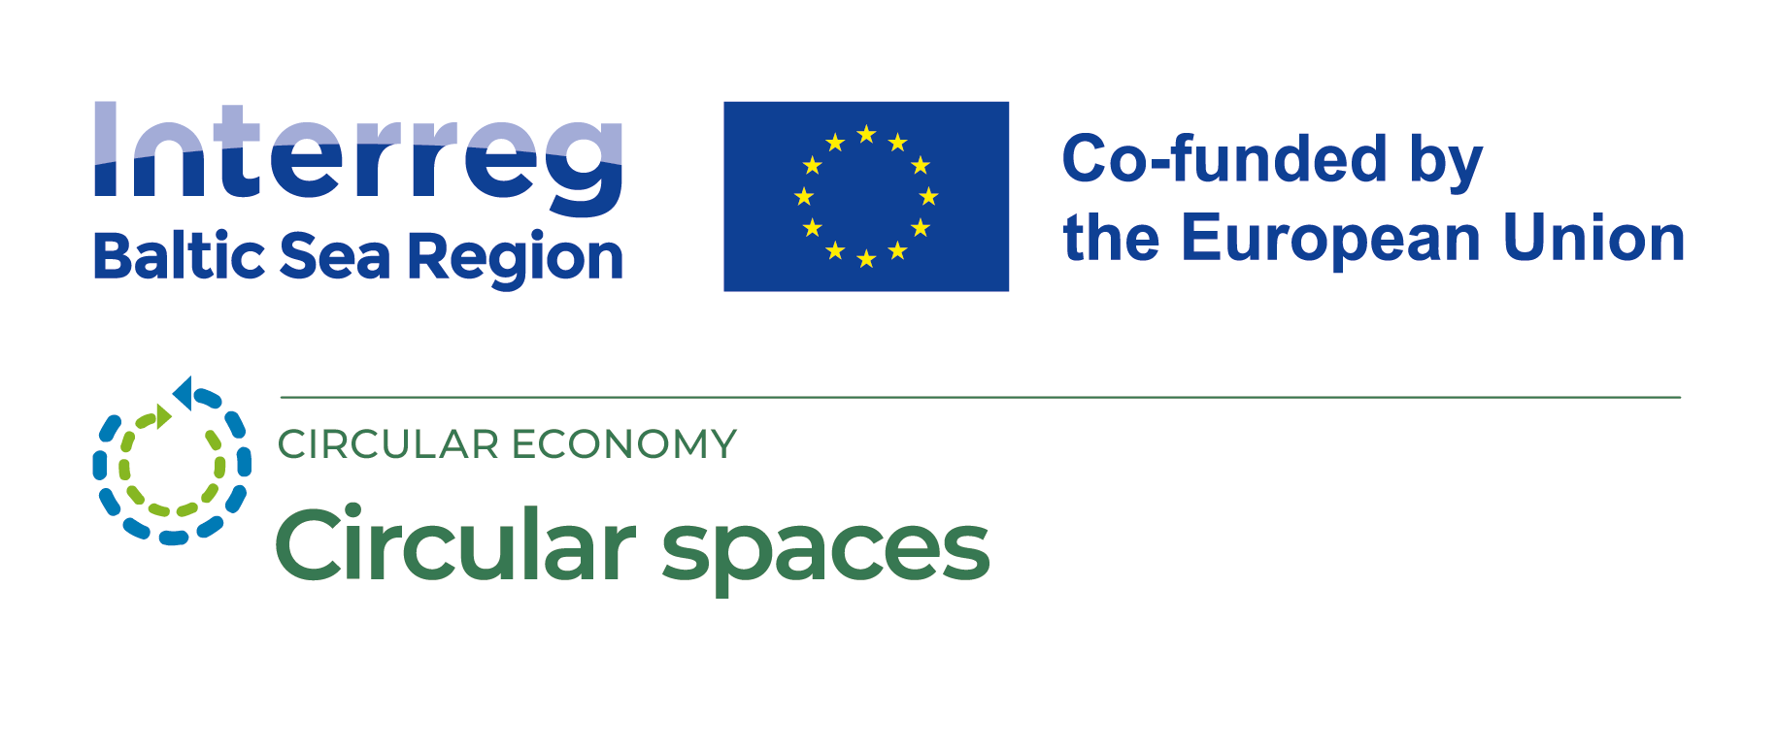
Waste as a resource in Circular Economy (CE)

Slide 2
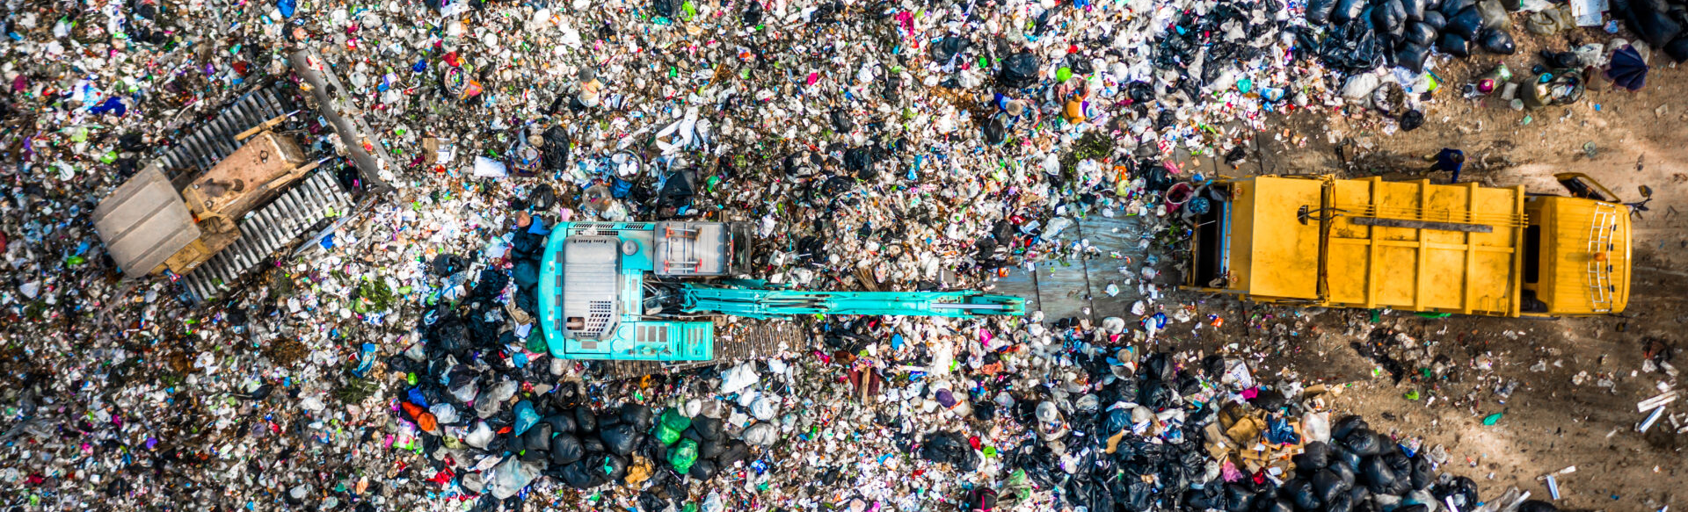
Training outcomes
After completing the training trainees will:
Understand and explain the role of different materials (waste as a resource) in CE.
Understand the main principles for plastic waste use in CE.
Understand the main principles for bioplastic use in CE.
Understand the main principles for steel and metals use in CE.
Understand the main principles for wood, pulp and paper use in CE.
Understand the main principles for glass use in CE.
Find out about Critical Materials and their role in CE.
©Pixabay
Notes:
Efforts to use the potential of waste as resources by putting in place circular design incentives that promote sustainable resource use and improve resource productivity in the long term require a good understanding of the resource basis of the economy, supported with high-quality information on material flows in waste stream. The selection and engineering of materials is a critical component in the development of a circular economy model. The selection and engineering of materials is a critical component in the development of a circular economy model. The redesign of both consumer commodity goods and advanced products may not only require engineering feats in terms of advanced structures but also the implementation of safer and more facile recycled materials (especially from waste). Which material groups (from the waste streams) play an important role in circular design solutions, and what are their properties or development trends, is revealed in this training module. Products must be designed to enable complete recycling of materials and novel synthesis strategies free from toxic precursors or by-products to regenerate new raw materials. The training material also provides information - on which materials in Europe are considered Critical and how to avoid them in circular economy business models or circular design projects.

Slide 3
Training Plan
Introduction | Introduction topic - Role of waste as a resource in CE
Main part | Technical and organic materials in waste Plastic waste in CE (structure of plastic waste, different types of plastic and its recyclability properties, pollution prevention and eliminating possibilities) Bioplastics in CE (types, modifications, labeling and potential in CE) Steel and metals in CE (types and potential in CE) Wood, pulp and paper in CE (types, labelling and potential in CE) Glass in CE (types, labelling and potential in CE) Critical materials and their role in CE (what is “critical material” impact and possibilities to eliminate) What are eco-materials? (Definition of superior properties of eco-materials)
Conclusion | Practical Recommendations and Tips - Selection of low-impact materials as resources (from waste) in Circular Economy How to choose: Cleaner materials, Renewable materials, Lower energy content materials, Recycled materials, Recyclable materials, Materials with positive social impact, i.e., generating local income, Reduction of materials usage.

Slide 4
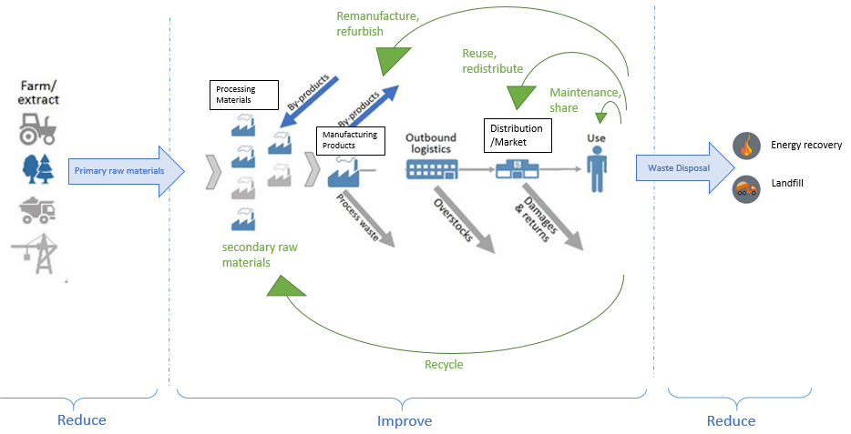
Introduction – Role of waste as a resource in CE
Conceptual scheme of the components of a circular economy (Circular Economy: a smart way of using materials, materialflows.net)
©Pixabay
Notes:
The circular economy pursues a harmonious intergrowth and sustainable development of both the economic and the social system without harming the natural ecosystem. By improving the productivity of materials and products (as shown in the graph below), not only the extraction of virgin resources but also the generation of waste can be reduced.
An increase in material productivity is achieved by elaborating various looping opportunities within the life cycle of materials. These loops are not thought to be run through only once by materials and products, but to be repetitive as often as possible. The further a material is processed along the supply chain, the bigger the looping can become for reusing the materials. However, the tighter the circle, the faster materials return to consumption and the less resources are required. A tight circle of sharing or reusing products among consumers, for example, does not need new materials and requires less energy than the bigger loop of recycling those products. In a circular economy, materials circulate in two separate cycles: the bio-cycle and the techno-cycle. The distinction between these cycles helps to understand how materials can be used in a long-lasting and high-quality way. A general rule of thumb is: the less process steps needed for a material’s reuse, the higher the quality of the remaining material will be.

Slide 5
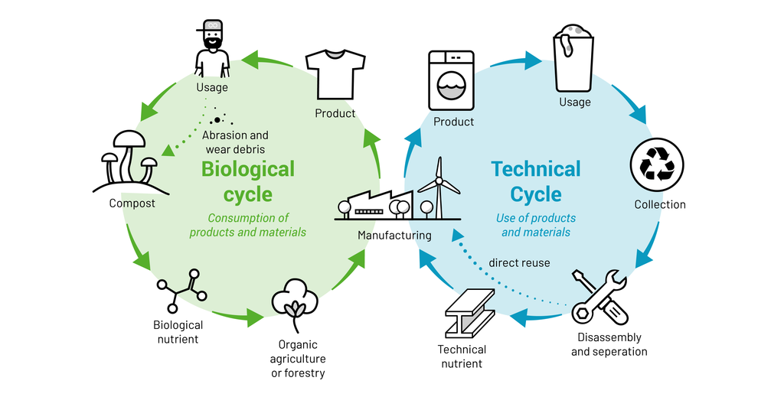
Technical and organic materials
Cradle to Cradle concept by M. Braungart and W. McDonough
Notes:
Organic materials follow a different reuse process than technical materials. Technical materials are also called synthetic materials. Because of this difference in the reuse process, it is important that after use, organic and technical materials can be properly separated from each other after use.
Technical materials such as fossil fuels, plastics and metals have limited availability and cannot be easily recreated. In the techno-cycle it is important that stocks of such finite materials are properly managed. In a circular economy, these materials are only used instead of being consumed. After use, materials are recovered from residual flows at their original value.
Organic materials such as wood, food and water can be incorporated into the ecosystem and re-generated through biological processes. In the biocycle it is important to let the ecosystem do its work as well as possible. Consumption may take place during this cycle (fertilization, food, water) as long as the streams are not contaminated with toxic substances and ecosystems are not overloaded. Renewable organic raw materials can then be regenerated (Ellen MacArthur Foundation, 2015a).

Slide 6
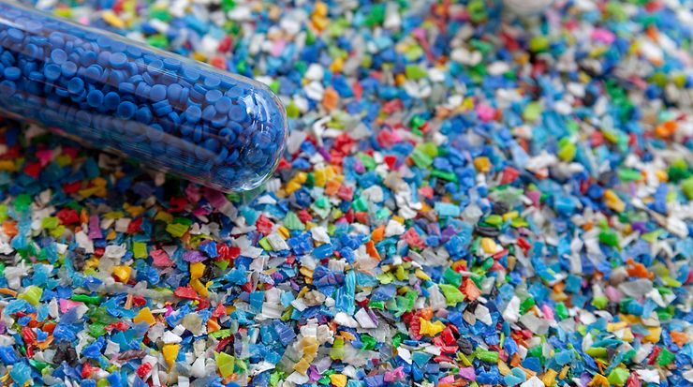
Plastic in Circular Economy

Slide 7
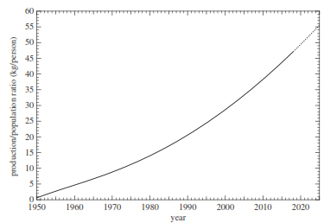
Plastic in Circular Economy
Normalized global total plastics production per person as a function of year. The dashed line represents a polynomial extrapolation of both production and population figures (Bucknall, 2020).
Notes:
The use of plastics in modern society is ubiquitous. Is it in fact remarkably difficult to find anything we use or interact with on a daily basis that is not made of or contains one or more types of plastic. With increased knowledge has come a greater utilization and exploitation of these plastics. Consider the annual production of plastics per capita. The global population has increased from about 2.5 billion in 1950 to 7.7 billion people today, i.e., a threefold increase. By comparison, the normalized plastics production, i.e., the mass produced per capita per year averaged across the global population, shows that there has been an almost 50-fold increase in the mass of plastics per capita generated over this period.
In the context of plastics, achieving a circular economy presents enormous challenges, not least because our current approaches to plastic production, usage and fate generally do not meet most, if any, of the principles of a circular economy. A case in point is the dominance of fossil fuels as plastics feedstocks, which clearly contradicts a key principle of circular economy of only using renewable resources. Other contradictions can be seen with the current fate of plastics after use, i.e., their end-of-life. Even with the rise in recycling practices over recent years, most end-of-life plastics are currently either still sent to landﬁll or increasingly incinerated for energy recovery, both practices that not only damage the environment in different ways, but also represent an enormous loss of a valuable resource. To achieve a circular economy of plastics, signiﬁcant changes to current practices will need to be employed that include new and sustainable approaches to eco-design, reuse, repair and maintenance, leasing and sharing, recycling, and chemical conversion, quite apart from the necessary social and economic changes that will be required (Bucknall, 2020).

Slide 8
Plastic in Circular Economy
The global population has increased from about 2.5 billion in 1950 to 7.7 billion people today, i.e., a threefold increase.
By comparison, the normalized plastics production, i.e., the mass produced per capita per year averaged across the global population, shows that there has been an almost 50-fold increase in the mass of plastics per capita generated over this period.
Even with the rise in recycling practices over recent years, most end-of-life plastics are currently either still sent to landﬁll or increasingly incinerated for energy recovery, both practices that not only damage the environment in different ways, but also represent an enormous loss of a valuable resource.
Notes:
The use of plastics in modern society is ubiquitous. Is it in fact remarkably difficult to find anything we use or interact with on a daily basis that is not made of or contains one or more types of plastic. With increased knowledge has come a greater utilization and exploitation of these plastics. Consider the annual production of plastics per capita. The global population has increased from about 2.5 billion in 1950 to 7.7 billion people today, i.e., a threefold increase. By comparison, the normalized plastics production, i.e., the mass produced per capita per year averaged across the global population, shows that there has been an almost 50-fold increase in the mass of plastics per capita generated over this period.
In the context of plastics, achieving a circular economy presents enormous challenges, not least because our current approaches to plastic production, usage and fate generally do not meet most, if any, of the principles of a circular economy. A case in point is the dominance of fossil fuels as plastics feedstocks, which clearly contradicts a key principle of circular economy of only using renewable resources. Other contradictions can be seen with the current fate of plastics after use, i.e., their end-of-life. Even with the rise in recycling practices over recent years, most end-of-life plastics are currently either still sent to landﬁll or increasingly incinerated for energy recovery, both practices that not only damage the environment in different ways, but also represent an enormous loss of a valuable resource. To achieve a circular economy of plastics, signiﬁcant changes to current practices will need to be employed that include new and sustainable approaches to eco-design, reuse, repair and maintenance, leasing and sharing, recycling, and chemical conversion, quite apart from the necessary social and economic changes that will be required (Bucknall, 2020).

Slide 9
Plastic in Circular Economy
Notes:
Applications of plastics can be grouped together into different sectors of use as shown in ﬁgure. While these usage data represent EU 28, NO and CH countries, they are similar to all developed nations. As can be seen, the largest sector of use for plastics accounting for approximately 40% of annual global production is in packaging. Although a huge range of plastics are known, with hundreds listed in materials databases, the vast volume of plastics that are used are limited to a small number. As shown in ﬁgure, over 80% of all plastics used are polyethylene (low-density, LDPE and high-density, HDPE), polypropylene (PP), polystyrene (PS and EPS), poly(vinyl chloride) (PVC), and poly(ethylene terephthalate) (PET). For most of the era of modern synthetic plastics, their fate has largely been one of a linear economy, i.e., produce–use–discard. As discussed above, this short-sighted attitude has led to the global issues we are now facing. If fully implemented, a circular plastics economy would not only maintain use of plastics for a vast range of applications without having to use a different, potentially more expensive, or less optimal material, but also reduce the harm the loss of plastics are causing to the environment. The question therefore is, can a circular plastic economy be implemented and, if so, what are the hurdles to achieving it?

Slide 10
Eliminate the plastics we don’t need
The vision for a circular economy for plastic has six key points:
1. Elimination of problematic or unnecessary plastic packaging through redesign, innovation, and new delivery models is a priority
2. Reuse models are applied where relevant, reducing the need for single-use packaging
3. All plastic packaging is 100% reusable, recyclable, or compostable
4. All plastic packaging is reused, recycled, or composted in practice
5. The use of plastic is fully decoupled from the consumption of finite resources
6. All plastic packaging is free of hazardous chemicals, and the health, safety, and rights of all people involved are respected.
Notes:
Plastic brings many benefits. At the same time, there are some problematic items on the market that need to be eliminated to achieve a circular economy, and sometimes, plastic packaging can be avoided altogether while maintaining utility.
While improving recycling is crucial, we cannot recycle our way out of the plastic issues we currently face. Wherever relevant, reuse business models should be explored as a preferred solution (or ‘inner loop’ in circular economy terms), reducing the need for single-use plastic packaging. Reuse models, which provide an economically attractive opportunity for at least 20% of plastic packaging, need to be implemented in practice and at scale. Innovate to ensure that the plastics we do need are reusable, recyclable, or compostable. This requires a combination of redesign and innovation in business models, materials, packaging design, and reprocessing technologies. Compostable plastic packaging is not a blanket solution, but rather one for specific, targeted applications, because an effective collection and composting infrastructure is essential but often not in place. Circulate all the plastic items we use to keep them in the economy and out of the environment. No plastic should end up in the environment. Landfill, incineration, and waste-to-energy are not long-term solutions that support a circular economy. Governments are essential in setting up effective collection infrastructure, facilitating the establishment of related self-sustaining funding mechanisms, and providing an enabling regulatory and policy landscape. Businesses producing and/or selling packaging have a responsibility beyond the design and use of their packaging, which includes contributing towards it being collected and reused, recycled, or composted in practice.

Slide 11
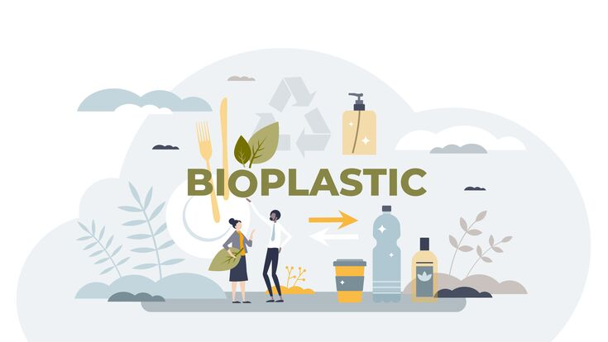
Bioplastic in Circular Economy
Notes:
Bioplastics — typically plastics manufactured from bio-based polymers — stand to contribute to more sustainable commercial plastic life cycles as part of a circular economy, in which virgin polymers are made from renewable or recycled raw materials. Carbon-neutral energy is used for production and products are reused or recycled at their end of life (EOL) (Rosenboom, Langer & Traverso, 2022). Compared with fossil-based plastics, bio-based plastics can have a lower carbon footprint and exhibit advantageous material properties; moreover, they can be compatible with existing recycling streams and some offer biodegradation as an EOL scenario if performed in controlled or predictable environments. However, these benefits can have trade-offs, including negative agricultural impacts, competition with food production, unclear EOL management and higher costs. Emerging chemical and biological methods can enable the ‘upcycling’ of increasing volumes of heterogeneous plastic and bioplastic waste into higher-quality materials.

Slide 12
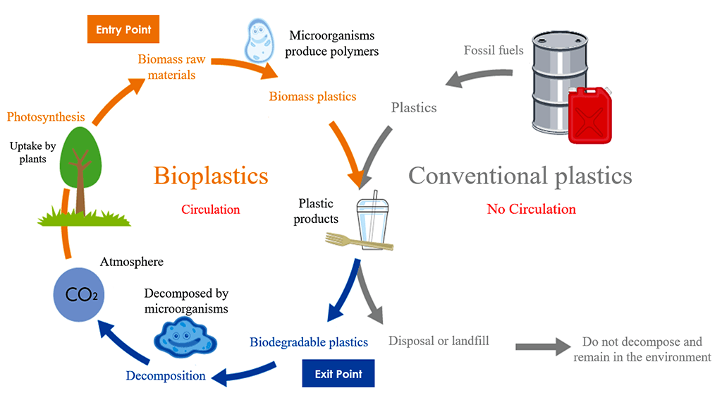
Bioplastic in Circular Economy
Bioplastic cycle. There are two types of bioplastics, biomass plastics and biodegradable plastics. Plastics made from biomass are called biomass plastics. Plastics that can be decomposed by microorganisms after use are called biodegradable plastics. If biodegradable plastics comprising biomass can be developed, plastic substances can circulate from entry to exit through the cycle, further reducing their impact on the environment.
Notes:
The plastics industry has traditionally been based on linear life cycles (grey arrows): crude oil is cracked and refined into monomers and polymer products using fossil energy, which, at their end of life, are either disposed of (~80%) with potential environmental leakage, incinerated (~10%) or, in the minority of cases (10% globally), mechanically recycled into lower-grade products, which also end up landfilled (World Economic Forum, 2016). In a ‘circular plastic economy’ (green arrows), plastic waste becomes raw material for a recycling process at its end of life, and all production and recycling processes are supplied with renewable energy 21,47,62 (Bucknall, 2020). Renewable resources (lignocellulosic biomass and pyrolysis oils) are the starting materials for polymer products, which all have a defined circular end-of-life scenario. CO2 generated through bioplastic incineration (blue arrow), aerobic composting or incineration of CH4 from anaerobic composting is a net-zero addition to the carbon cycle, as it is captured by photosynthesis into new biomass. Advanced recycling routes enable upcycling plastic waste: polymers with functional backbones (such as polyesters or polyamides) can be depolymerized biologically or chemically, and the subsequent monomers are polymerized into tailored high-quality or virgin-quality products (Coates & Getzler, 2020). Polymers with non-functional backbones such as polyolefins (including polyethylene (PE), bio-based PE, polypropylene (PP) and polystyrene) are better suited for cracking into hydrocarbon oil and gas by thermolysis and can then follow a similar upcycling path (Sharuddin et al., 2016).

Slide 13
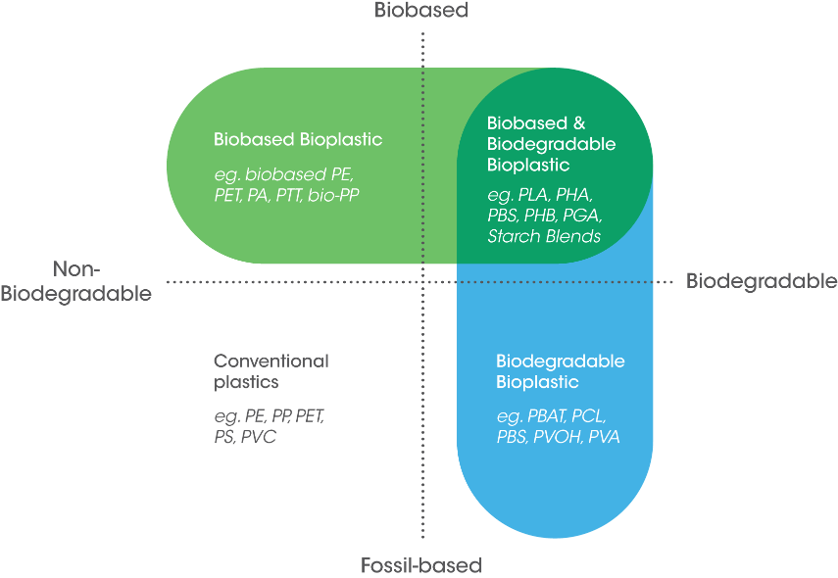
Types of bioplastic
Notes:
Among the different types of bioplastics, biodegradable plastics are classified into different categories according to their origin and their compostability properties.
The term bioplastic should preferrably be avoided as it is a general term that can refer to materials that are either bio-based (related to how the material is sourced — wholly or partly from biomass), biodegradable (related to whether a material can be broken down into carbon dioxide, water, and biomass by the natural action of microorganisms), or both. Because not all bio-based plastics are biodegradable, and some biodegradable plastics are fossil-based (for example, PBAT), the term bioplastic can be confusing.
Bioplastics are a large family of different materials Bioplastics are not just one single material. They comprise of a whole family of materials with different properties and applications. According to European Bioplastics, a plastic material is defined as a bioplastic if it is either biobased, biodegradable, or features both properties.
Biobased The term ‘biobased’ means that the material or product is (partly) derived from biomass or biowaste. Biomass used for bioplastics stems from e.g. corn, sugarcane or cellulose. Bioplastics can also be produced by microbes or based on CO2 or methane.
Biodegradable Biodegradation is a chemical process during which microorganisms that are available in the environment convert materials into natural substances such as water, carbon dioxide, and compost (artificial additives are not needed). The process of biodegradation depends on the surrounding environmental conditions (e.g. location or temperature), on the material and on the application.
‘Biobased’ does not equal ‘biodegradable’ The property of biodegradation does not depend on the resource basis of a material but is rather linked to its chemical structure. In other words, 100 percent biobased plastics may be non-biodegradable, and 100 percent fossil based plastics can biodegrade.

Slide 14
Types of bioplastic
Bioplastics are a large family of different materials According to European Bioplastics, a plastic material is defined as a bioplastic if it is either biobased, biodegradable, or features both properties.
Biobased The term ‘biobased’ means that the material or product is (partly) derived from biomass or biowaste. Biomass used for bioplastics stems from e.g. corn, sugarcane or cellulose. Bioplastics can also be produced by microbes or based on CO2 or methane.
Biodegradable Biodegradation is a chemical process during which microorganisms that are available in the environment convert materials into natural substances such as water, carbon dioxide, and compost (artificial additives are not needed). The process of biodegradation depends on the surrounding environmental conditions (e.g. location or temperature), on the material and on the application.
‘Biobased’ does not equal ‘biodegradable’ The property of biodegradation does not depend on the resource basis of a material but is rather linked to its chemical structure. In other words, 100 percent biobased plastics may be non-biodegradable, and 100 percent fossil-based plastics can biodegrade.
Notes:
Among the different types of bioplastics, biodegradable plastics are classified into different categories according to their origin and their compostability properties.
The term bioplastic should preferrably be avoided as it is a general term that can refer to materials that are either bio-based (related to how the material is sourced — wholly or partly from biomass), biodegradable (related to whether a material can be broken down into carbon dioxide, water, and biomass by the natural action of microorganisms), or both. Because not all bio-based plastics are biodegradable, and some biodegradable plastics are fossil-based (for example, PBAT), the term bioplastic can be confusing.
Bioplastics are a large family of different materials Bioplastics are not just one single material. They comprise of a whole family of materials with different properties and applications. According to European Bioplastics, a plastic material is defined as a bioplastic if it is either biobased, biodegradable, or features both properties.
Biobased The term ‘biobased’ means that the material or product is (partly) derived from biomass or biowaste. Biomass used for bioplastics stems from e.g. corn, sugarcane or cellulose. Bioplastics can also be produced by microbes or based on CO2 or methane.
Biodegradable Biodegradation is a chemical process during which microorganisms that are available in the environment convert materials into natural substances such as water, carbon dioxide, and compost (artificial additives are not needed). The process of biodegradation depends on the surrounding environmental conditions (e.g. location or temperature), on the material and on the application.
‘Biobased’ does not equal ‘biodegradable’ The property of biodegradation does not depend on the resource basis of a material but is rather linked to its chemical structure. In other words, 100 percent biobased plastics may be non-biodegradable, and 100 percent fossil based plastics can biodegrade.

Slide 15
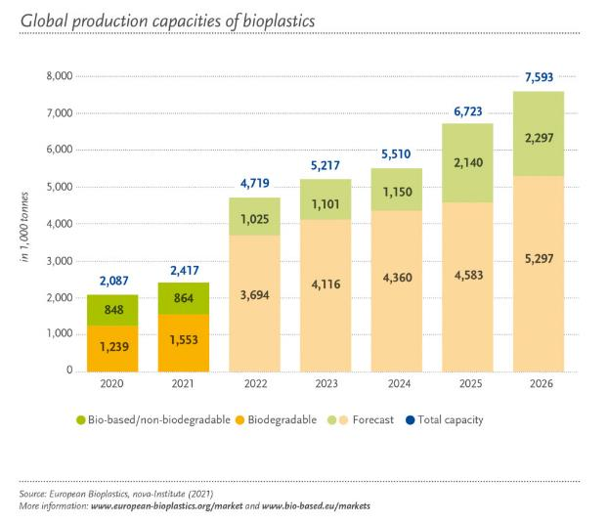
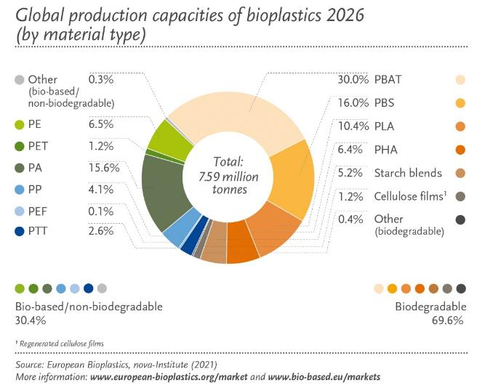
Global production capacities of bioplastic

Slide 16
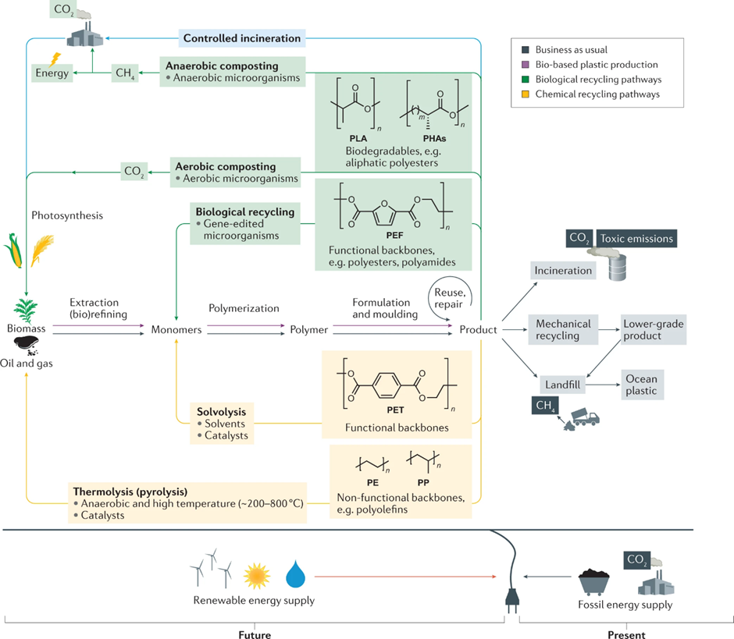
The circular plastic economy. (Rosenboom, JG., et al., 2022)
Notes:
Today, almost every monomer required to produce drop-in polymers — that is, chemically equivalent replacements for fossil-derived polymers — can be obtained from biomass. Additionally, biomass can support the synthesis of novel polymers that are not easily derived from fossil resources. The methods for processing biomass to obtain vinyl monomers, carboxylic acids, alcohols, amides and rubbers have been extensively reviewed (Harmsen et al., 2014).

Slide 17
‘Custom’ compostability/biodegradability labels
Examples of different biodegradability labelling (Rosenboom, JG., et al.2022)
Notes:
The ‘home’ compost label (panel k on figure) has seen increased use but is not based on a legislative standard. This label was proposed by TÜV Austria as a modification of EN 13432, with tests performed at 20–30 °C over time frames that are twice as long as those in the original tests. Similarly, TÜV Austria has developed further labels and certification procedures for different environments in which plastics may end up (panels l–n of figure). New bioplastic testing standards are under review, such as prEN 17427 (2020) by the European Committee for Standardization (CEN), which focuses on tests aimed to inform home compostability specifically for plastic bags.
Panel a reprinted, with permission, from ASTM D7611/D7611M-20 Standard Practice for Coding Plastic Manufactured Articles for Resin Identification, copyright ASTM International, 100 Barr Harbour Drive, West Conshohocken, PA 19428, USA. A copy of the complete standard may be obtained from ASTM International, www.astm.org. Panel b copyright Der Grüne Punkt – Duales System Deutschland GmbH. Panel c copyright OPRL Ltd. Panels d and e reprinted with permission from DIN CERTCO, www.dincertco.de. Panels f, h and k–n copyright TÜV AUSTRIA Group. Panel g copyright Department of Agriculture’s BioPreferred program based on third-party analysis. Panel i copyright European Bioplastics e.V. Panel j courtesy of the Biodegradable Products Institute.
Biodegradation is no ‘silver bullet’ to curb plastic pollution and typically ranks as the least desired fate of bioplastics, especially in anaerobic landfill scenarios without gas capture. Industrial anaerobic digestion offers a potential route for CH4 and energy recovery. True and fast biodegradation without releasing toxic chemicals may prove useful in settings where there are no other forms of recycling, but more research on the impact of microplastics as intermediates is required. Besides recycling, behavioral changes towards using less plastic, and the strict usage of renewable energy for polymer and plastic production, remain essential strategies to mitigate plastic waste and carbon emissions.

Slide 18
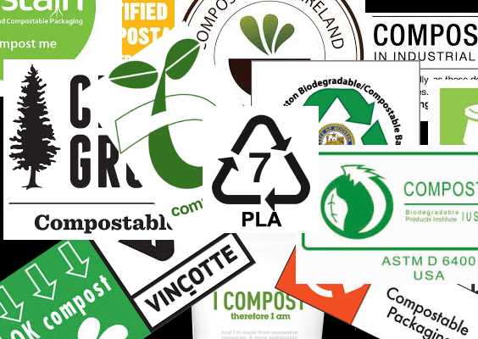
Labelling bioplastics
Identification labels
Recycling-oriented labels
Bio-based content labels
Industrial compostability labels
‘Custom’ compostability/ biodegradability labels
Notes:
Plastic products are often labelled to indicate their chemical composition, whether they can be recycled, are bio-based and/or can be biodegraded and under which conditions. Consumers and converters are currently faced with various labels for bioplastics based on different industrial testing standards, some of which are referenced by major legislators, including the United Nations, the European Union (EU) or the US government. Some of these standards, particularly those certifying biodegradation established around 2000, are currently under investigation, with the aim of revision and harmonization. It is important to understand the basis for these certifications and what the agencies behind them are.
Identification labels
The most common labels on plastic products are the plastic resin identification codes (examples from ASTM D7611/D7611M-20 in panel a of figure 6), which identify the polymer but provide no information on the recyclability. The older version of these labels — the ‘chasing arrows’ — still appears on products, and many consumers still falsely believe that products with these labels are recyclable, which may cause ‘wishcycling’ and lead to consumers placing non-recyclable items in recycling bins. In the USA, only products labelled ‘1’ (polyethylene terephthalate (PETE)) or ‘2’ (high-density polyethylene) have a viable market and are, therefore, recycled. Environmental organizations such as Greenpeace as well as some US states, such as California and New York, favor laws to prevent companies from using recycling symbols for non-recyclable products, and instead aim to use extended producer responsibility (EPR) laws to foster the design of recyclable materials. Bioplastics such as polylactic acid are currently labelled as ‘7’ (other) and are typically not recycled.
Recycling-oriented labels
The ‘green dot’ symbol (panel b of figure) used in the EU indicates that the producer has paid an EPR fee that is intended to fund collection and recycling programs, but not that the product can be recycled. The on-pack recycling label (‘OPRL’) used in the UK (panel c of figure) indicates whether consumers should place individual plastic packaging components into trash or recycling bins, based on the nationwide probability that the component is successfully collected, sorted and reprocessed into a new product with a viable market. The German certification body DIN CERTCO has established new labels to certify the recyclability of a plastic product based on the polymer and existing infrastructure to recycle the latter (panel d of figure). Similarly, new labels to certify the recycled content are being proposed. The US-based How2Recycle label aims to provide more information on the recyclability of individual packaging parts.
Bio-based content labels
The labels shown in panels e–g of figure certify the bio-based carbon content in plastic products. The DIN biobased (panel e) and OK biobased (panel f) labels are granted by DIN CERTCO and the Austrian technical service company TÜV Austria, respectively. The US Department of Agriculture’s BioPreferred program issues a label based on third-party analysis (panel g) and, in Japan, labels are issued by the Japan BioPlastics Association (JBPA). All these labels follow standards such as EN 16640 (Europe), ISO 16620 (international) and ASTM D6866 (USA).
Industrial compostability labels
The ‘OK compost’ (panel h of figure) and ‘seedling’ (panel I) labels used in the EU and the ‘BPI compostable’ (panel j) label used in the USA have become more prevalent in recent years, yet, consumers have to understand the need for industrial capacity to biodegrade. The ‘industrial’ sub-label is based on four tests specified in the standards EN 13432 and ASTM D6400: biodegradation (90% of material is converted into CO₂ in inoculum derived from compost at 58 °C after 6 months), disintegration (90% of material is smaller than 2 mm after 3 months at 40–70 °C, depending on the standard), ecotoxicity (90% of regular plant growth in soil with plastic present) and the heavy metal content must not exceed a certain threshold.

Slide 19
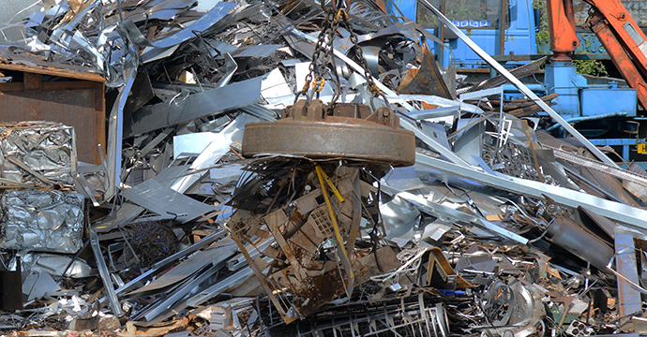
Steel and metals in CE
Notes:
Steel has excellent circular economy credentials both as a material which is strong, durable, versatile and recyclable and, as a structural framing system, which is lightweight, flexible, adaptable and reusable. One of the key benefits of steel is that it can be designed to meet the specific strength, durability, and end-of-life recycling requirements of almost any application. The combination of strength, recyclability, availability, versatility and affordability makes steel unique.
A circular economy promotes longer product lives. The longer a product lasts the lesser raw materials are needed to be sourced. Product durability contributes to reducing the depletion of raw materials. Maintaining products at their highest utility and value for as long as possible is a key component of the circular economy. Putting it simply, the longer a product lasts the lesser raw materials are needed to be sourced and processed and less waste is generated. Steel products are inherently durable meaning not only that they last a long time but also that several steels can be reused after their first life.
Steel also facilitates its own longevity. Steel-framed buildings can be easily adapted if the configuration of the structure needs to be changed. The building can be taken apart and rebuilt with minimal disruption to local communities and the environment. Strong, durable exterior steel structures can accommodate multiple internal reconfigurations to suit changing needs. Warehouses or industrial buildings made with steel can be easily converted into modern living or working spaces. This extends the useful life of the building (and the life of steel it contains) to save resources and reduce costs.

Slide 20
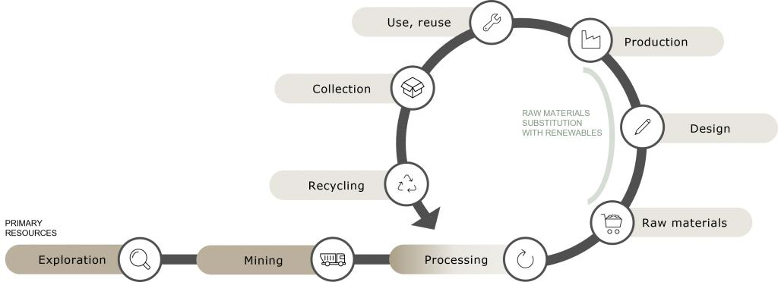
Steel and metals in CE
Recycling enables the creation of new goods with a far smaller carbon footprint than by extracting virgin resources; therefore, it is vital to change present practices.
Notes:
Extending the life of the products is another key aspect of the circular economy. In theory, all new steel can be made from recycled steel. However, this is not practically feasible due to the long life of steel products, given the strength and durability of steel. Around 75 % of steel products ever made are still in use today. Buildings and other structures made from steel can last from 40 to 100 years or longer if proper maintenance is carried out.
Extending the life of the products can be achieved by making the products which are both flexible and adaptable to change so that they can last longer and greater value can be extracted from the materials and resources used to produce them. The pace of change in all walks of life has never been greater. Changing work patterns, new building services and information technologies, changing demographics and new legislation are all putting new and different demands on steel products. Sustainable products should be flexible to change of use and adaptable to future needs and requirements whether they are regulatory or market driven.
Large, heavy structural steel components need planning for end-of-life management. However, with steel scrap having value, the incentive to recover and recycle these components is high and more cost effective than paying for them to be placed in landfill sites.

Slide 21
Steel and metals in CE
In theory, all new steel can be made from recycled steel.
Around 75 % of steel products ever made are still in use today.
Buildings and other structures made from steel can last from 40 to 100 years or longer if proper maintenance is carried out.
Large, heavy structural steel components need planning for end-of-life management.

Slide 22
Steel and metals in CE
Tesfaye, F., Hamuyuni, J., Iloeje, C.O. et al. Technology Metals in the Circular Economy of Cities. JOM 74, 596–598 (2022)
Notes:
Metal materials found in bulk parts are typically easier to recover and valorize. The processing steps required at high temperatures facilitate elimination of organic or polymeric contamination (Veasey, 1997), but the presence of ceramics as anticorrosion coatings or as friction controllers may again affect the final mix purity. The very large bulk of produced metal parts will be made of stainless steel, copper and its alloys, as well as aluminum and titanium. Metals are typically much easier to recycle compared to polymeric or ceramic materials due to the broad range of metal grades used and available in engineering and manufacturing. The recycling of aluminum or stainless steel are examples of this ability to recycle metals despite the need for chemical treatments to reduce or remove oxides and the energy penalty arising from heat treatments required for melting and ingots generation. The recyclability of metals is also not as challenging as polymeric materials, which can only be recycled so many times without degrading the molecular structure of the polymer (depolymerizing or over-polymerizing for instance). Most metals, unless again oxidized or contaminated during their operation as a product or recycling, may be recast nearly indefinitely. Separating metals from alloys is rarely done since the composition of the materials developed may be adjusted based on elemental analysis of the recovered materials. However, the recovery of solid metal from composite materials represents a key challenge since it is energy-demanding, whilst the sorting of metals at the source is equally difficult, with the exception of ferromagnetic material extraction from non-ferromagnetic materials, which is well mastered (Zhan & Xu, 2009). The sorting of metals such as aluminum or copper from titanium, becoming increasingly used in high value structural materials, is very challenging and must involve selective separative steps; such metallurgical, electrochemical or physical approaches have been well developed and work at scale (Ali, 2018). Thus, metals do not represent a key challenge and valorization is nonetheless dependent on energy inputs required to deconstruct alloys into single metallic species.

Slide 23
Processing of Metals in Makerspace
Common Ferrous Metals:
Alloy Steel – such as stainless steel and core-ten.
Carbon Steel – commonly used in fabrication.
Mild Steel or Carbon Steel is manufactured in two ways:
Hot Rolled – Typically used for making larger structural members, it is cheaper but less dimensionally stable.
Cold Rolled – Very dimensionally consistent, it has sharper corners and cleaner finish quality. Typically used for detailed applications and furniture.
Common Non-Ferrous Metals:
Aluminium
Brass
Copper
Titanium
Gold
Silver
Notes:
Choosing the right metal
To choose the right material for your project, it is essential to understand the basic properties of workable metals. Metals can be split into two categories; Ferrous (those which contain iron), and non-ferrous (those which do not contain iron).
Ferrous metals
This group is characterised by its tensile strength and durability; making it popular for structural applications. Its iron content makes it both magnetic (with the exception of stainless steel) and susceptible to oxidisation, better known as rust.
Non-ferrous metals
This group is characterised by its malleability, making it easy to work with. Non-ferrous metals do not contain any iron and therefore are not magnetic and do not corrode through oxidisation (rust). Many non-ferrous metals are alloys, meaning that they are a mix of different metals; for example, brass, which is a mix of copper and zinc. Different ratios of these mixes create different working qualities which can be matched with a specific project or application.

Slide 24
Which metals can be welded?
Mild Steel (Hot/Cold Rolled)
Comes in a large selection of dimensions and profiles.
Typically requires minimal preparation if the material is new.
Large pieces can be cut to length by the supplier where needed.
Ideal for structural components or details which are hidden.
The best choice if you have bends in your design.
Cost effective and easy to work with.
Easy to clean and finish.
It will oxidise (rust) if left unfinished, so this is a good choice if you plan to powder-coat or paint the component.
Can be welded with MIG or TIG
Stainless Steel (304 and 316)
Comes in a limited selection of dimensions and profiles.
Requires minimal prep.
Ideal for components which can be seen, or where a raw metal finish is desired.
Does not oxidise, ideal for outdoor applications.
Harder and more challenging to work than mild steel.
More susceptible to distortion when heated.
More expensive than mild steel.
More challenging to weld.
Can be Tig or Mig welded.
Aluminium
Difficult to weld
Titanium
Difficult to weld
Notes:
Not all metals can be machined or welded using the same tools or processes. Currently, the Maker Spaces have the capabilities to machine and weld ferrous metals, such as carbon steel (mild steel) and stainless steel. It is possible to cut, grind and machine any other metal, including non-ferrous metals, however, the process for welding these are currently not available. Consult with a Maker Spaces technician if you have questions about materials.

Slide 25
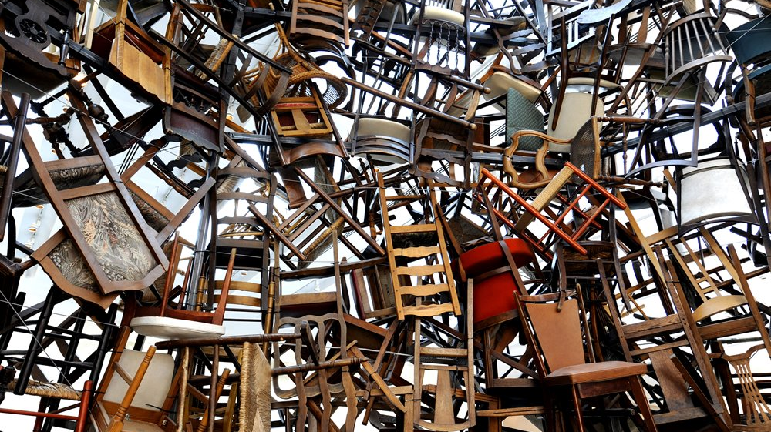
Wood, pulp and paper in CE

Slide 26
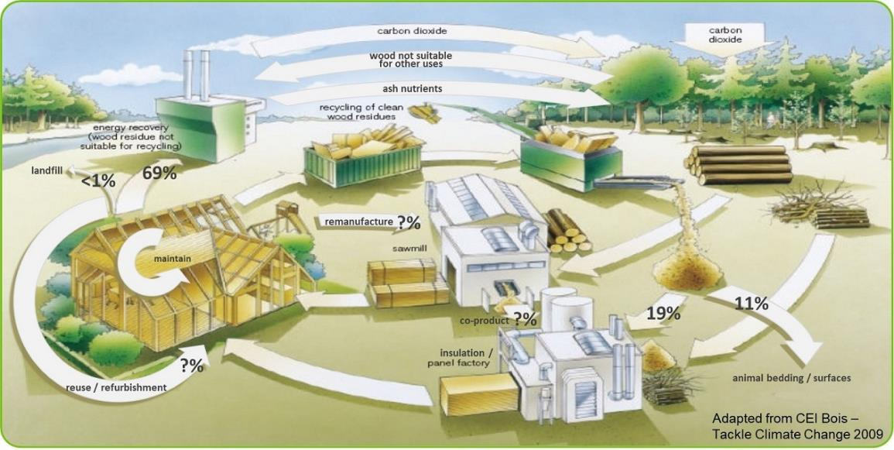
Timber in CE
Notes:
Timber is a biological nutrient and therefore follows the biological cycle, with the possibility of some ‘cascading’ recycling (down-cycling). As can be seen by the CEI Bois diagram from 2009, which shows waste timber and by-products from the processing industry being reused for panel production and energy recovery, the timber industry has been promoting what could be termed a semi-circular business model years. However, when you look at the numbers, it is clear that more could be done with the timber that has been extracted. The Wood Recyclers Association estimates that 4.5 million tonnes of wood waste was generated in 2018. Of this 877,000 tonnes (19%) was recycled and used for panel board manufacture and 500,000 tonnes (11%) used for animal bedding, equine surfaces, and other recycling purposes. 2.1 million tonnes (47%) went to UK biomass and 313,000 tonnes (7%) was exported for biomass. We know from the Environment Agency waste interrogator data that less than 1% of ‘waste’ timber ends up in landfill. This leaves approximately 665,000 tonnes (15%) unaccounted for, which is likely to have ended up in the ‘refuse derived fuel’ element of waste from materials recovery facilities (MRFs) that is either used in the UK or exported for use as a fuel in energy production.
With ever-increasing energy and resources going into timber production generally, and in particular engineered timber products, should designers look at how these products could be developed to follow the technical cycle, at least initially, and aim to:
maintain timber products in place for longer,
refurbish and reuse timber components,
look at how certain components could be remanufactured?
In addition the timber industry must ensure that it becomes more self-sufficient in its timber production, with the UK being second only to China as the largest net importer of timber and timber products, with more than 60% of our timber requirements being sourced from elsewhere.

Slide 27
Timber in CE
With ever-increasing energy and resources going into timber production generally, and engineered timber products, should designers look at how these products could be developed to follow the technical cycle, at least initially, and aim to:
maintain timber products in place for longer,
refurbish and reuse timber components,
look at how certain components could be remanufactured.

Slide 28
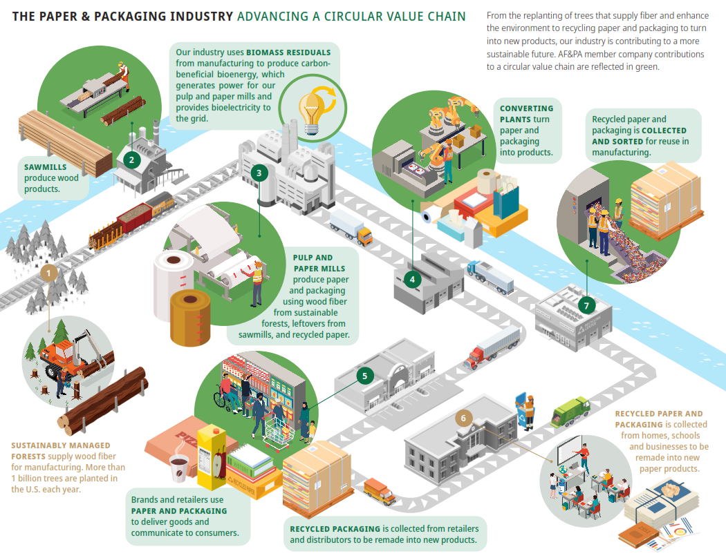
Wood and paper in CE
Source: The American Forest & Paper Association (AF&PA)
Notes:
The Forest Products Industry & the Circular Economy
The forest products industry is inherently circular in its supply chain. Trees are replanted to supply fiber and enhance the environment. And paper and packaging are recycled to make new products. This is how our industry is contributing to a more sustainable future.
Let’s break it down:
It starts with sustainably managed forests that supply wood fiber for manufacturing. Most forests in the U.S. are privately owned by small landowners. More than 1 billion trees are planted in the U.S. each year.
Sawmills use sustainably harvested wood to make wood products.
Wood fiber from sawmills is also used, often with recycled paper, to manufacture paper and packaging. Converting mills turn this paper into products.
The paper and packaging industry uses renewable biomass energy residuals – left over wood fiber and other manufacturing materials – to power mills.
Paper-based packaging is a sustainable option that allows brands to deliver products safely and communicate with consumers. After use, packaging is collected and sent back to mills to be recycled.
In the United States, 94% of the people have access to community recycling programs for paper. And 79% of Americans have access to residential-curbside programs, making it efficient and effective to recycle paper at home.
Many of our member companies own and operate material recovery facilities and collection programs.
As this process comes full circle, the recycled paper is sorted and fed back into our manufacturing process to make new products.

Slide 29
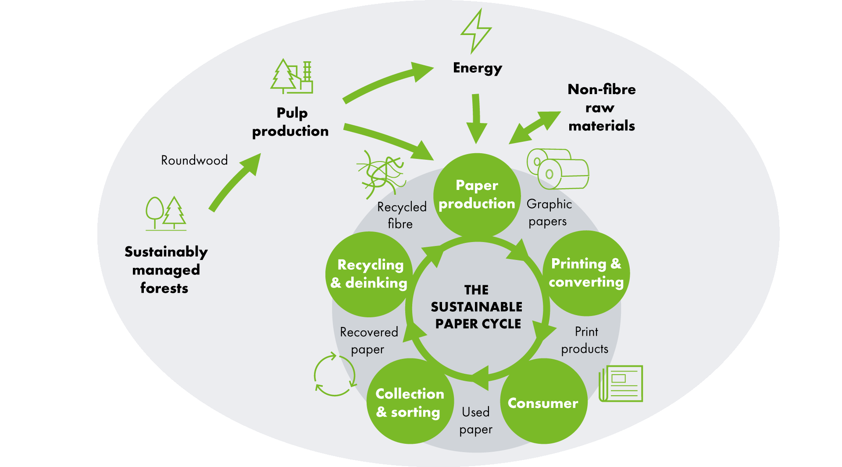
Paper in CE
Notes:
Sustainably managed forests
The foundation of a sustainable paper cycle is the use of wood from sustainably managed forests, where after trees are felled they are replaced with seedlings that eventually grow into mature trees, ensuring that the forest is constantly renewed. Such carefully and skilfully managed forests can ensure that tree growth exceeds the rate of extraction, enhances the long-term storage of carbon, and protects biodiversity to maintain forest health. And it of course provides a source of renewable raw material. 100% of the virgin wood fibre we use in our products meets the criteria for wood from sustainably managed forests. UPM uses the two leading global forest certification schemes, FSC and PEFC, to demonstrate the sustainability of our forest sources. Our goal is 100% of virgin fibre from certified sources by 2030 (currently 80%).
Pulp production
Pulping is the process of breaking down solid wood into the individual cellulose fibres that will be used to make paper. Different types of paper require different types of pulp. Fresh pulp (sometimes called Virgin pulp) is produced from pulp wood in one of two basic ways. The first is by mechanical grinding of pulpwood to produce mechanical pulp. This sort of pulp is used mainly for papers which have a short life span such as catalogue papers and newspapers. The second is by cooking the wood with chemicals to dissolve the material which binds fibres together in wood. This produces chemical pulp, usually referred to as Wood Free pulp. This type of pulp is normally used for papers with a longer life span, such as office papers and high-quality marketing material. At UPM we produce and use both mechanical and chemical virgin pulp.
Paper production
The basic principles of papermaking have remained almost unchanged for two thousand years. Fibres are distributed evenly in water and the water is drained, leaving the fibres bonded together. Today, we utilise the most advanced technology, not only to make paper, but also to ensure that the process utilises raw materials in the most sustainable way, with minimal impact on the environment at every stage from resources to recycling. Papermaking today requires more technology than a jumbo jet. The paper machine is as wide as a two-lane highway and operates 24 hours a day, seven days a week, almost all year long. The three main resources used in papermaking are water, energy and cellulose fibres. Sustainably managed forests provide the cellulose fibres. Lakes and rivers provide the water. Much of the energy used is generated from by-products and side-streams created by the pulp and papermaking processes themselves.
Printing and converting
Printing and converting are important stages in the paper life cycle because they can influence how easily a product can be recycled after use. Printing and converting processes can change the characteristics of the paper in a way which may then hinder their recycling. For instance, the use of water-based inks, and extensive use of foil printing, or laminates.
Consumer
The reader plays a crucial role in maintaining a sustainable paper cycle, because without their conscientious actions after use, paper would never be recycled.
Collection and sorting
One basic rule in using recovered paper is that you can only make a high-quality product from high quality raw material. So if you want to recycle used paper into graphic papers, then you need to sort out the higher quality use paper from lower quality packaging. Only light-coloured recovered papers (newsprint, magazines, advertising materials) are suitable as a raw material for our graphic paper products. Collection and sorting of used paper is also needed in order to remove and separate other valuable recyclable materials such as glass, metals and plastic.
Recycling and deinking
Recovered paper needs to be de-inked before the cellulose fibres in it can be reused in papermaking. This process needs some chemicals and a certain amount of energy and water, and removes the inks, fillers and coatings from the paper to leave clean fibres. The by-product resulting from this process can be used as a fuel to generate energy for the mill, and in many cases the fillers and coating removed find reuse in the cement or construction industry, or even back in the papermaking process itself. It’s important to remember that some cellulose fibres are also lost during the deinking process and so the use of virgin fibres will always be necessary to maintain the paper cycle.

Slide 30
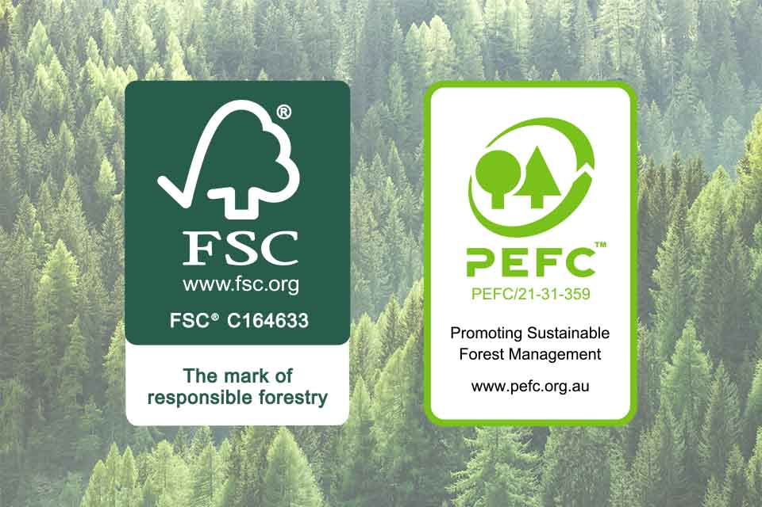
FSC® (Forest Stewardship Council) and PEFC™ (the Programme for the Endorsement of Forest Certification) labels
Notes:
Paper packaging fits into the circular economy model seamlessly. Its raw material, wood fiber, is a renewable, natural and sustainable resource. Paper packaging is easily collected and recycled, ensuring these valuable fibers are used time and time again.
Well-designed, efficiently produced, appropriately used and responsibly disposed-of packaging provides multiple benefits. It is essential to prevent product damage and can help extend a product’s life. It helps improve efficiency in the supply chain and provides safe and convenient access to goods. Packaging communicates vital information to the customer whilst providing a great ‘unboxing experience’ to those receiving gifts or luxury items. However, poor material choices are damaging to both brands and the planet.
Paper packaging utilizes an exceptional amount of recycled material , but paper fibers cannot be recycled indefinitely, so there will always be a need for fresh/virgin wood fiber from sustainable sources to enter the cycle. Certification is important to communicate and demonstrate to stakeholders and final wood-product consumers the sustainability of forest management and its products.
The most common forest certification schemes in Europe are FSC® (Forest Stewardship Council) and PEFC™ (the Programme for the Endorsement of Forest Certification)

Slide 31
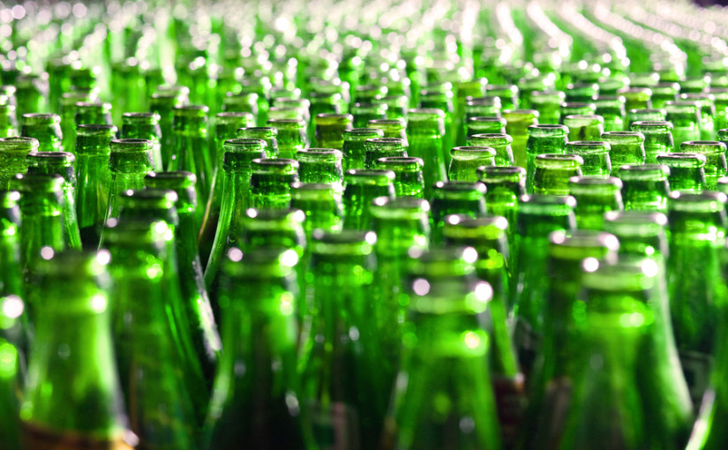
Glass in CE

Slide 32
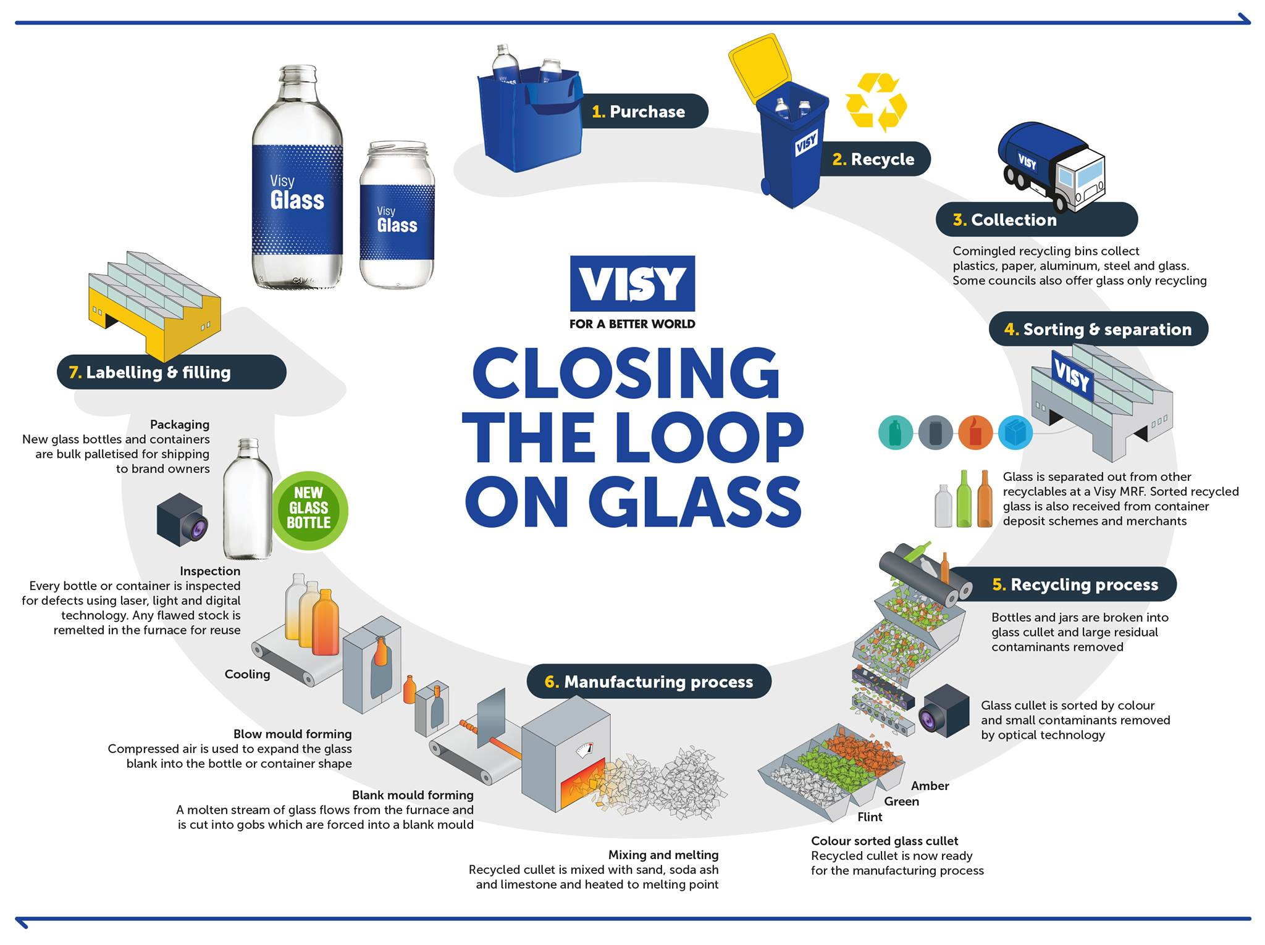
Circularity of Glass
Notes:
Glass stands out as one of the best examples of the closed loop production model because it is one of the most effectively recycled materials in Europe (67% on average). This is not only because of its natural characteristics - it is 100% and infinitely recyclable - but also because of well-established separate collection schemes. More can be done however. Increasing recycled glass brings major benefits to the environment because when recycled glass is used, fewer raw materials are extracted, less waste is generated, less energy is used and less CO₂ is emitted.
Once produced, glass is one of those rare materials that can be 100% and infinitely recycled in a bottle-to-bottle loop without any loss of quality: recycled glass is not waste, but a precious resource the industry requires to replace virgin raw materials. Glass recycling has many benefits: more than 70% of all post-consumer glass packaging is recycled in the EU, thus keeping valuable resources out of landfills. One ton of recycled glass saves 1.2 tons of virgin raw materials and cuts CO2 emissions by 60%. The container glass manufacturing model fits perfectly with the EU’s ambition to build a circular economy.

Slide 33
Circularity of Glass
Once produced, glass is one of those rare materials that can be 100% and infinitely recycled in a bottle-to-bottle loop without any loss of quality: recycled glass is not waste, but a precious resource the industry requires to replace virgin raw materials.
Glass recycling has many benefits: more than 70% of all post-consumer glass packaging is recycled in the EU, thus keeping valuable resources out of landfills.
One ton of recycled glass saves 1.2 tons of virgin raw materials and cuts CO2 emissions by 60%.
The container glass manufacturing model fits perfectly with the EU’s ambition to build a circular economy.

Slide 34
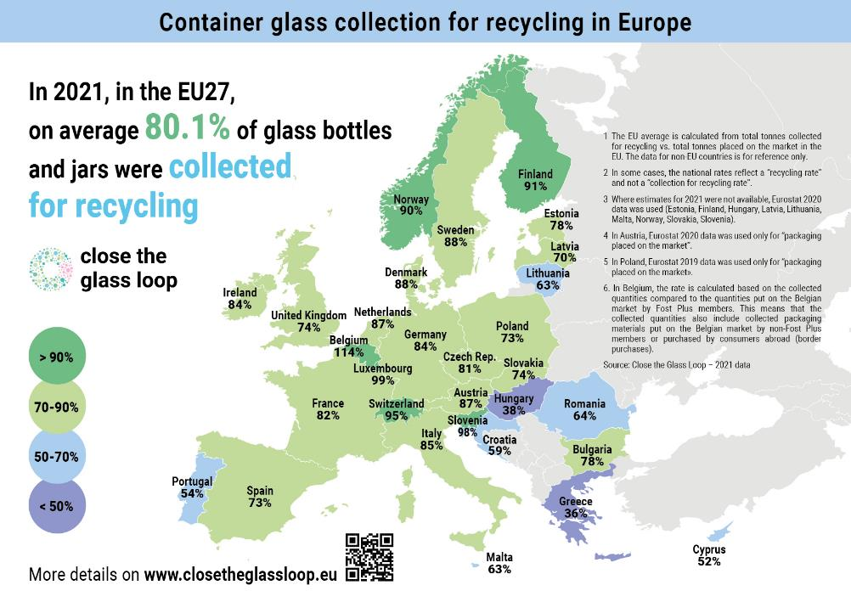
Collection and Recycling
Notes:
It is 100% recyclable, again and again.
Recycling means the economy can continue to flourish in a sustainable way, by reusing supplies and creating jobs to remake and resell products that we all rely on as consumers. In fact, most of Europe’s glass is already recycled (recycling rates are at 80% and rising in Europe!) – but with your help, we can reach 100%.
It’s reusable and refillable.
In addition to its recyclability properties, glass can be reused and refilled without losing quality. Bottles can be used up to 50 times before recycling and remelting them into new containers at the end of their lives – closing the loop on a complete circular economy.
It is good for the environment.
Recycling saves energy, natural resources, and substantially lowers carbon emissions. As cullet requires less energy to be melted and shaped, every tonne of cullet used saves 670 kg of CO2!
Glass’s inherent properties make it an ideal fit for the EU’s circular economy ambitions. Not only can glass be reused up to 50 times; it can also be endlessly recycled in a closed bottle-to-bottle loop, meaning a used glass bottle never has to be waste. Made from all natural resources, glass is impermeable, virtually inert, and always food safe – no matter how many times it is recycled.

Slide 35
Glass in CE
To close the loop and achieve a complete circular economy for glass packaging in Europe, the European container glass industry calls on the European Institutions to consider the following points as essentials for a Circular Economy:
• Multiple recycling of a permanent material is the best option for resource efficiency.
• Separate collection and a ban on backfilling for recyclable materials are key to ensure that the best quality recycles are re-introduced into the production process.
• Manufacturing industries, such as glass packaging which produce sustainable products, create jobs and bring added value to Europe, and need to be supported as they already are successful examples of a European Circular Economy.

Slide 36
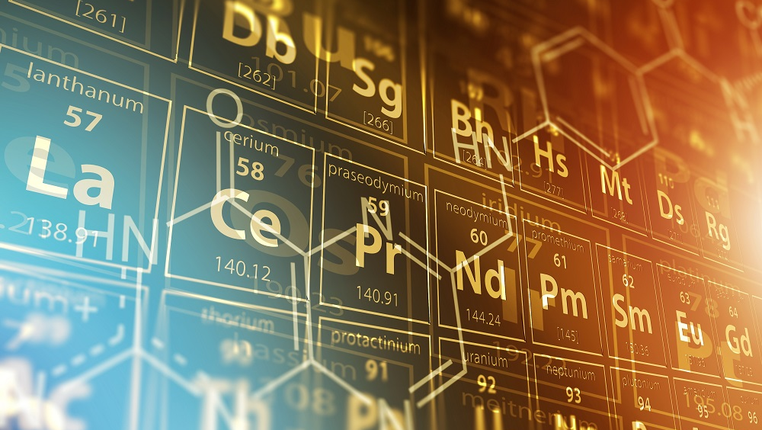
Critical materials

Slide 37
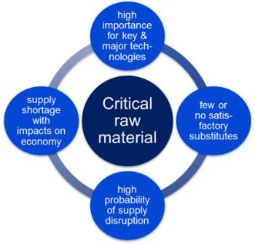
Critical materials
Critical materials are fundamental to both advanced and clean technologies. Access to a secure supply of these materials is key to maintaining quality of life, geopolitical and economic stability and is necessary for the transition to a climate-neutral global economy.
The 2020 EU list contains 30 materials as compared to 14 materials in 2011, 20 materials in 2014 and 27 materials in 2017. Currently, 26 materials remain on the list.
2020 EU Critical Raw Materials
Antimony | Hafnium | Phosphorus
Baryte | Heavy Rare Earth Elements | Scandium
Beryllium | Light Rare Earth Elements | Silicon metal
Bismuth | Indium | Tantalum
Borate | Magnesium | Tungsten
Cobalt | Natural Graphite | Vanadium
Coking Coal | Natural Rubber | Bauxite
Fluorspar | Niobium | Lithium
Gallium | Platinum Group Metals | Titanium
Germanium | Phosphate rock | Strontium
Notes:
The EU is aiming to ensure a secure and sustainable supply of critical raw materials for Europe’s industry.
EUROPE FACES DEPENDENCIES ON KEY CRITICAL RAW MATERIALS
The EU is heavily dependent on critical raw materials from a number of third countries. Our dependency, combined with the growing global demand due to the shift towards a digital and green economy makes supply chains vulnerable.
There is a great demand for metals and minerals in today´s society. In Europe, we consume about a quarter of the world´s raw materials but produce only three percent. This means a large dependency on imports. According to the EU, European production of raw materials needs to increase.
The EU has listed 34 minerals and metals as critical and/or of strategic importance for European society and welfare. These critical raw materials (CRMs) constitute ingredients in key technologies necessary for securing the green transition, digitalisation, space industry and defence capabilities. They are critical because of their economic importance in relation to the risk of supply interruption (the supply risk).
The latest list, which was determined in 2023, also includes a group of 16 so-called strategic raw materials (SRMs) of even greater priority. Two metals in this group are not classified as critical, only as strategic: copper and nickel. Their global production is sufficiently diversified not to have a high supply risk, but they are considered to be so fundamental, above all for electrification, as to be included in the strategic classification.
WHAT ARE WE DOING?
The European Critical Raw Materials Act aims to strengthen EU’s critical raw materials capacities along all stages of the value chain. It aims to increase our resilience by reducing dependencies, increasing preparedness and promoting supply chain sustainability and circularity.
List of Critical Raw Materials
It identifies raw materials which are important for the whole European economy and face a high risk of supply disruption.
List of Strategic Raw Materials
It identifies a list of raw materials characterised by high strategic importance and projected global supply/demand imbalances.

Slide 38
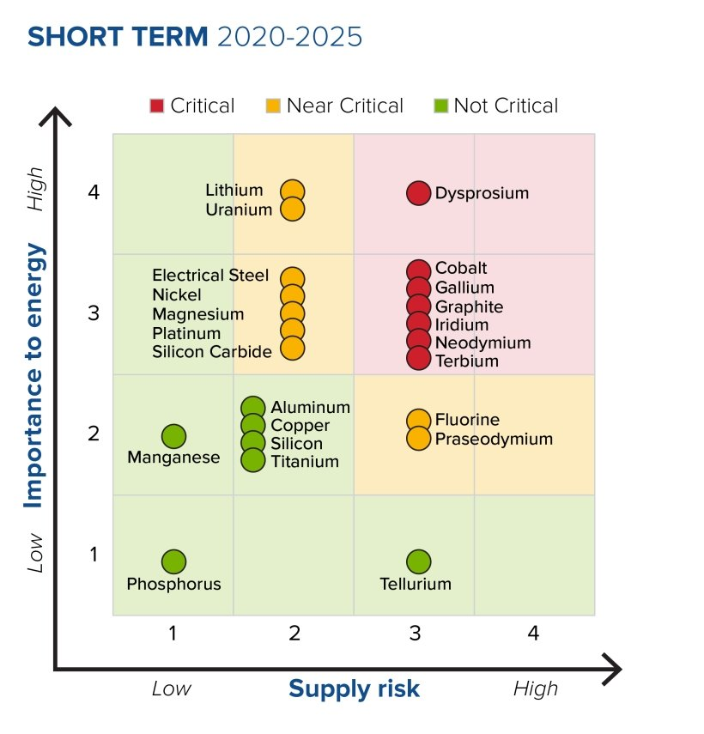
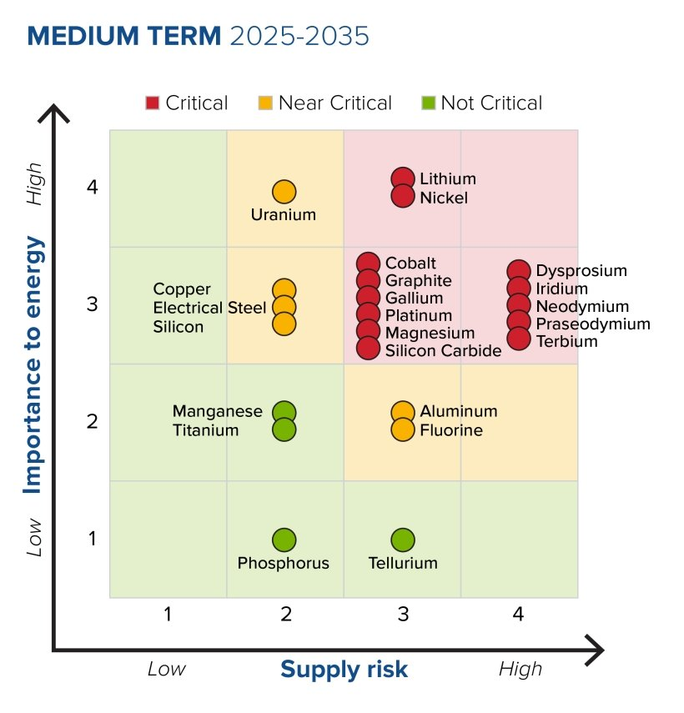
Short-term (2020–2025) and Medium-term (2025–2035) U.S. criticality matrix
Source: U.S. Geological Survey, 2022
Notes:
This list is based on the assessment described in the U.S. Department of Energy's (DOE's) most recent critical materials assessment, the 2023 DOE Critical Materials Assessment. The results of the assessment are shown in the criticality matrices below. The Final 2023 Critical Materials List includes all materials that were assessed as “critical”
or “near critical” in either the short or medium term – with the exception of uranium.
This list includes critical materials for energy, as determined by the Secretary of Energy, as well as those critical minerals on the 2022 final list published by the Secretary of Interior, acting through the director of the U.S. Geological Survey. The Final 2023 Critical Materials List includes the following:
Critical materials for energy (“the electric eighteen”): aluminum, cobalt, copper, dysprosium, electrical steel, fluorine, gallium, iridium, lithium, magnesium, natural graphite, neodymium, nickel, platinum, praseodymium, silicon, silicon carbide and terbium.
Critical minerals: The Secretary of the Interior, acting through the director of the U.S. Geological Survey, published a 2022 final list of critical minerals that includes the following 50 minerals: “Aluminum, antimony, arsenic, barite, beryllium, bismuth, cerium, cesium, chromium, cobalt, dysprosium, erbium, europium, fluorspar, gadolinium, gallium, germanium, graphite, hafnium, holmium, indium, iridium, lanthanum, lithium, lutetium, magnesium, manganese, neodymium, nickel, niobium, palladium, platinum, praseodymium, rhodium, rubidium, ruthenium, samarium, scandium, tantalum, tellurium, terbium, thulium, tin, titanium, tungsten, vanadium, ytterbium, yttrium, zinc, and zirconium.”

Slide 39
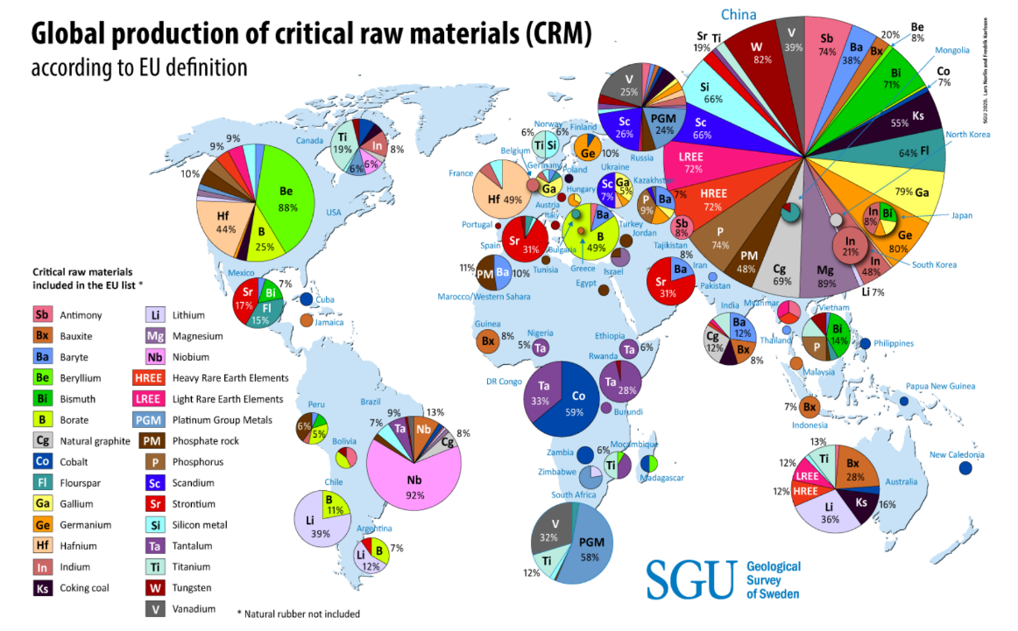
Source: Geological Survey of Sweden SCRREEN2/EU.
Notes:
How to read the map?
Each circle shows the total production of various critical minerals and metals for each country, calculated as percentage by weight. The percentages show the share of world production for a certain substance (the total areas of the pie charts for a certain substance together make up 100 percent, again based on weight). For example, Brazil produces 92 percent of the world's niobium. The map also shows that China completely dominates the global production of critical raw materials even if they do not produce all of these. Note that this map applies only to critical metals and minerals. Thus, for example, Sweden is not included, otherwise a major producer within the EU of iron ore, precious metals and base metals.
Source: SCRREEN2/EU.

Slide 40
Critical materials
Integration of the roles of the key stakeholders at all stages of the cradle-to-cradle cycle:
primary metals producers of both base and rarer metals;
product designers to optimize critical material use and recyclability into the design phase;
retailers and local government to provide the facilities for collection and separation to provide the raw materials for recycling;
consumers to cooperate in separation and return programs for EoL goods;
governments to provide an appropriate societal and legislative framework to deliver high rates of recycling (e.g., Extended Producer Responsibility schemes, effective collection and sorting and public education);
recyclers applying best available techniques (BAT) to recover critical materials from separated waste streams.
Notes:
The circular economy for critical minerals does not just denote ‘recycling.’ The principle of waste reduction should occur throughout the entire supply chain, and many circular economy practices for critical minerals arise well before a product reaches end-of-life.
For example, at the primary production stage, mines that typically focus on base metals have the opportunity to extract lesser known ‘critical minerals’ from their waste as by-products. This reduces the amount of waste rock and the number of new mines needed for critical minerals.
Mineral wastes, such as tailings, are rich sources of critical minerals that, in comparison to primary sources, have been pre-processed, offering an easy to access, low-cost option to secure critical minerals. However, adding new technologies to extract by-products to a company’s operations for critical minerals may not immediately compensate for additional costs, therefore, it needs encouragement and support from government.
At the midstream stage, when mined materials are transformed into the compounds needed by manufacturers, there are many circular economy opportunities. Instead of being wasted, offcuts from the manufacturing process can be remanufactured. This is also where recycled materials can be reintroduced into the supply chain as secondary feedstock.
When advanced high-tech products like batteries, solar panels, mobile phones, and computer hard drives reach their end-of-life, these items can be processed to recover minerals and materials and sold back to the manufacturing sector as secondary feedstock. This reduces the pressure on primary inputs and supports the circular economy.
Consumers also have an essential role to play. Demand for critical minerals will continue to increase as the population grows and more people look forward to higher living standards. For example, there will always be an element of waste in buying new mobile phones and discarding not-quite-outdated phones each year. People who are serious about the tenets of a circular economy should remember the principles of repair and reuse and recognize that hefty consumerism is ultimately fueling our increasing need for critical minerals.
As the volume of end-of-life high-tech technologies and the critical minerals contained therein are relatively small, recovery and recycling efforts are nascent. A vicious circle arises when companies are unable to invest in a recycling plant because the feedstock is small and unreliable. Products are not being collected for recycling because there are not enough recycling plants for these niche materials. With the demand for advanced technologies expected to increase over the coming decades, governments now have opportunities to work with industry and consumers to foster a circular economy approach for critical materials.
Recycling for critical metals needs to be seen as a system which begins with collecting, sorting and dismantling, pre-processing to separate components containing valuable metals, and upgrading relevant fractions before final metallurgical processing.

Slide 41
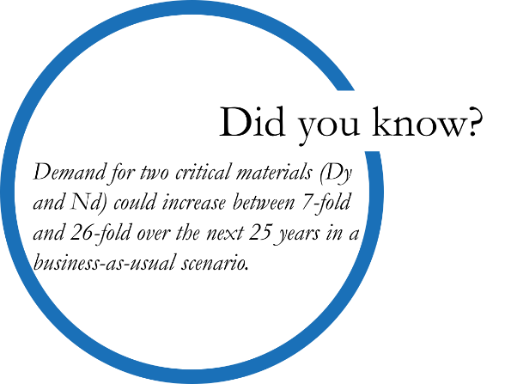
Critical materials
Seven conditions (Hagelüken (2014)) for effective recycling:
1. Technical recyclability from the source.
2. Accessibility of the source components (e.g., automotive catalysts, car battery, personal computer, mobile phone, motors).
3. Economic viability, whether by the inherent value of the extractive material or the fiscal environment established by regulation.
4. Collection mechanisms to ensure the product is available for recycling.
5. Entry into the recycling chain rather than loss due to export or improper disposal (for instance mislabeling of electronic goods as for reuse and export thereby bypassing waste export regulations).
6. Optimal technical and organizational set-up adapted to the particular product type.
7. Sufficient capacity to handle the potential supply.

Slide 42
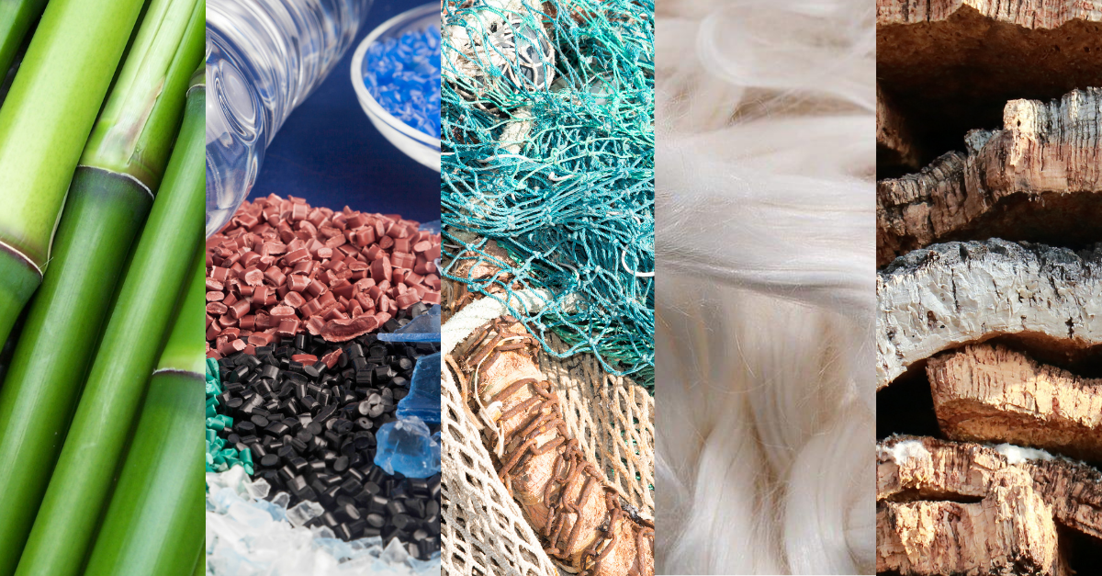
What are eco-materials?
Notes:
Eco-materials are defined as those materials that enhance environmental improvement throughout the whole life cycle, while maintaining accountable performance (Halada & Yamamoto, 2001). Eco-materials play a key role in material science and technology to minimize environmental impacts, enhance the recyclability of materials, and to increase energy and material efficiency. In North America and Europe, eco-materials are often called ‘environmentally-friendly materials’ or ‘environmentally preferable’ materials.

Slide 43
Eco-materials
Definition of superior properties of eco-materials:
Energy saving ability to reduce total life cycle energy consumption of a system or device.
Resource saving ability to reduce the total life cycle material consumption of a system or device.
Reusability to allow the reuse of collected products as similar functions.
Recyclability to allow the use of collected product of material as a raw material.
Structural reliability to be used on the basis of its reliable mechanical properties.
Chemical stability to be used over the long term without chemical degradation.
Biological safety ability to be used without causing negative effects to the ecological system.
Substitutability to be used as an alternative to ‘bad’ materials.
Amenity to ensure the comfort of working environment
Cleanability to separate, fix, remove and detoxify a pollutant for the environmental treatment process.

Slide 44
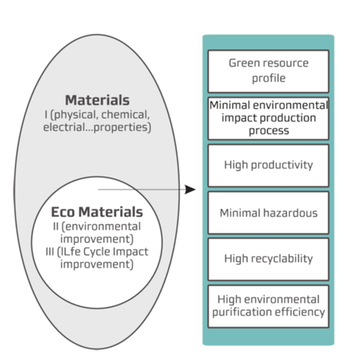
Eco-materials
Eco-materials are those that can contribute to reduction of environmental burden through their life cycles.
In other words, any material could be an eco-material as long as it satisfies the pre-requisites (I) and necessary conditions of eco-materials (II and/or III).
The pre-requisites of eco-materials include the optimization of physical and/or chemical properties and best technical performance (I).
Conceptual model of eco-materials within the context of material science (Nguyen, X. H.,T. Honda, et al. (2003)).
Notes:
The necessary conditions are as follows:
• Significant environmental improvements compared to conventional materials (II),
• No tradeoff of environmental load through the whole life cycles, and
• If there is a tradeoff, whole life cycle is environmental
• data must be available to verify the improvement of environmental performance (III).

Slide 45
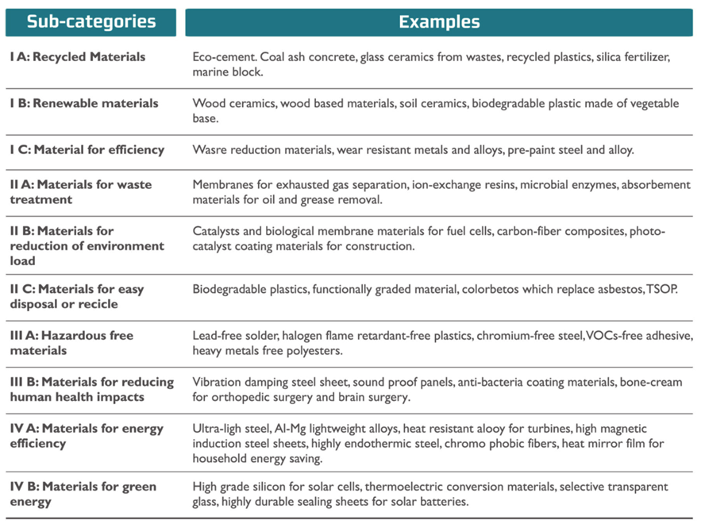
Some examples of eco-materials which are currently commercialized .
Source: (Nguyen, X. H.,T. Honda, et al. (2003))

Slide 46
Practical Recommendations and Tips: Selection of low-impact materials in Circular Design
Notes:
How to choose: Cleaner materials, Renewable materials, Lower energy content materials, Recycled materials, Recyclable materials, Materials with positive social impact, i.e., generating local income, Reduction of materials usage.

Slide 47
How to select: Cleaner materials?
Do not use materials or additives which are prohibited due to their toxicity. These include PCBs (polychlorinated biphenyls), PCTs (polychlorinated terphenyls), lead (in PVC, electronics, dyes, and batteries), cadmium (in dyes and batteries), and mercury (in thermometers, switches, fluorescent tubes).
Avoid materials and additives that deplete the ozone layer such as chlorine, fluorine, bromine, methyl bromide, halons and aerosols, foams, refrigerants, and solvents that contain CFCs.
Avoid the use of summer smog-causing hydrocarbons.
Find alternatives for surface treatment techniques such as hot-dip galvanization, electrolytic zinc plating and electrolytic chromium plating.
Find alternatives for non-ferrous metals such as cop- per, zinc, brass, chromium, and nickel because of the harmful emissions that occur during their production.

Slide 48
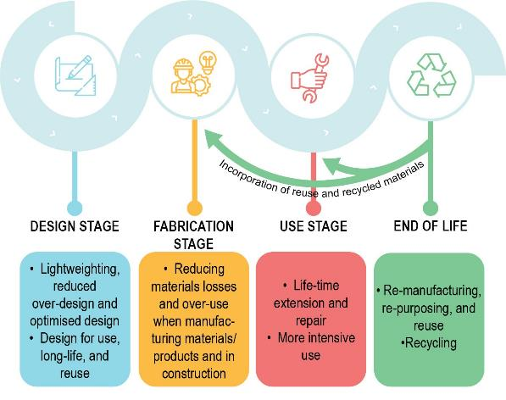
How to select: Renewable materials?
Find alternatives for exhaustible materials.
Lower energy content materials?
Avoid energy-intensive materials such as aluminum in products with a short lifetime.
Avoid raw materials produced from intensive agriculture.

Slide 49
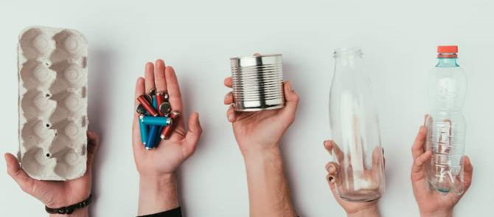
How to select: Recycled materials?
Use recycled materials wherever possible, to increase the market demand for recycled materials.
Use secondary metals such as secondary aluminum and copper instead of their virgin (primary) equivalents.
Use recycled plastics for the inner parts of products which have only a supportive function and do not require a high mechanical, hygienic or tolerance quality.
When hygiene is important (as in coffee cups and some packaging) a laminate can be applied, the center of which is made from recycled plastic, covered with or surrounded by virgin plastic.
Make use of the unique features (such as variations in color and texture) of recycled materials in the design process.

Slide 50
How to select: Recyclable materials?
Select just one type of material for the product as a whole and for the various sub-assemblies.
When this is not possible, select mutually compatible materials.
Avoid materials which are difficult to separate such as compound materials, laminates, fillers, fire retardants and fiberglass reinforcements.
Preferably use recyclable materials for which a market already exists.
Avoid the use of polluting elements such as stickers, which interfere with recycling.

Slide 51
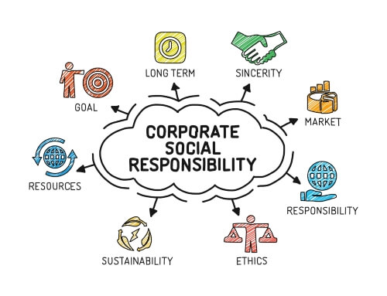
How to select: Materials with positive social impact, i.e., generating local income?
Make use of materials supplied by local producers.
Stimulate arrangements for recycling of materials by local companies which can substitute (part of) the raw materials of the company.

Slide 52
How to select: Reduction of materials usage ?
Reduction in weight
Aim for rigidity through construction techniques such as reinforcement ribs rather than ‘over dimensioning’ the product.
Aim to express quality through good design rather than over dimensioning the product.
Reduction in (transport) volume
Aim at reducing the amount of space required for transport and storage by decreasing the product’s size and total volume.
Make the product foldable and/or suitable for nesting.
Consider transporting the product in loose components that can be nested, leaving the final assembly up to a third party or even the end user.

Slide 53
External resources:
https://www.circulardesignguide.com/post/material-selection
https://www.c2ccertified.org/assets/uploads/Herman_Miller_Journal_Of_Industrial_Ecology.pdf
http://www.planningnotepad.com/2013/01/sustainability-design-3-redesigning.html
https://blogs.helsinki.fi/inventionsforcirculareconomy/circular-economy/biological-and-technical-cycles/
https://simplicable.com/new/upcycling-vs-downcycling
https://www.conserve-energy-future.com/recyclingmaterial.php
https://www.goodstartpackaging.com/biodegradable-vs-compostable-what-is-the-difference/
https://www.ecoenclose.com/blog/8-things-to-know-about-compost-facilities-and-6-tips-to-be-a-responsible-composter/
https://www.geeksforgeeks.org/biodegradable-and-non-biodegradable-materials/
©Pixabay

Slide 54
References:
Bucknall DG. 2020 Plastics as a materials system in a circular economy. Phil.Trans.R.Soc.A378: 20190268. http://dx.doi.org/10.1098/rsta.2019.0268
Hagelüken, Christian. (2014). Recycling of (Critical) metals. Critical Metals Handbook. 41-69.
PlasticsEurope. 2018 Plastics - the Facts 2018. PlasticsEurope - Association of Plastics
Manufacturers. See https://www.plasticseurope.org/en/resources/publications/619plastics-facts-2018.
Rosenboom, JG., Langer, R. & Traverso, G. Bioplastics for a circular economy. Nat Rev Mater 7, 117–137 (2022). https://doi.org/10.1038/s41578-021-00407-8
World Economic Forum, Ellen MacArthur Foundation & McKinsey & Company. The new plastics economy: rethinking the future of plastics (2016). Report on the envisioned shift from linear to circular plastic economies, addressing strategies such as bioplastics, advanced recycling and extended producer responsibility.
Coates, G. W. & Getzler, Y. D. Y. L. Chemical recycling to monomer for an ideal, circular polymer economy. Nat. Rev. Mater. 5, 501–516 (2020).
Anuar Sharuddin, S. D., Abnisa, F., Wan Daud, W. M. A. & Aroua, M. K. A review on pyrolysis of plastic wastes. Energy Convers. Manag. 115, 308–326 (2016).
Harmsen, P. F. H., Hackmann, M. M. & Bos, H. L. Green building blocks for bio-based plastics. Biofuel. Bioprod. Biorefin. 8, 306–324 (2014). Comprehensive account of synthetic monomers and how to derive them from renewable resources.
Veasey TJ (1997) An overview of metals recycling by physical separation methods. Proceedings of the Institution of Mechanical Engineers, Part E: Journal of Process Mechanical Engineering 211(1):61–64
Zhan L, Xu Z (2009) Separating and Recycling Metals from Mixed Metallic Particles of Crushed Electronic Wastes by Vacuum Metallurgy. Environmental Science & Technology 43(18):7074–7078
Ali UM (2018) Electrochemical Separation and Purification of Metals from WEEE. LAP Lambert Academic Publishing
COMMUNICATION FROM THE COMMISSION TO THE EUROPEAN PARLIAMENT, THE COUNCIL, THE EUROPEAN ECONOMIC AND SOCIAL COMMITTEE AND THE COMMITTEE OF THE REGIONS Critical Raw Materials Resilience: Charting a Path towards greater Security and Sustainability COM/2020/474 final

Slide 55
slides with training material
©Pixabay

