Slide 1
The Circular Bioeconomy
What is it?

Slide 2
Learning Goals
The difference between the linear and cicular bioeconomy
Main production steps in biorefineries
Use of biogas and residual products from biorefineries
Sustainable strategies for the transition to a more bio-based economy

Slide 3
The term bio economy definition:
Bioeconomy is an economy where materials, chemicals and energy originate from renewable bio-based raw materials.

Slide 4

The concept of linear economy definition:
Linear economy is an economy that extracts natural resources, produces, distributes, consumes and then eventually turns into waste.
Manufacturing
Use
Waste

Slide 5

The concept of circular economy definition:
In a circular economy, resources stay within society's cycle instead of becoming waste
Manufacturing
Recycling
Use

Slide 6
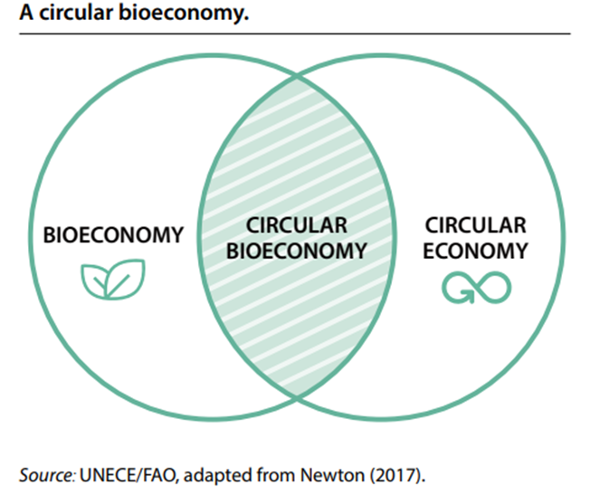

Slide 7
”Summary of the concept of Bioeconomy"
https://www.youtube.com/watch?v=hx-jZmE-2_U
Notes:
3,47 min

Slide 8

Why a Circular Bio Economy ?
(school task )
Discussion in small groups
- Give examples of circular systems
-What do we have to gain from increasing the use of biocircular systems?

Slide 9
Some examples of the circular bioeconomy's positive impact on the environment
Save 2.5 billion CO2 equivalents/year in the EU
Biogas from stable manure – an important source of energy that mitigates the climate impact of greenhouse gases
Renewable ethanol - reduces greenhouse gas emissions by 77% compared to with fossil fuels
Biodiesel can achieve significant reductions in emissions in the range of 50%-90% compared to conventional diesel

Slide 10
Terms and statements - match the correct term with the correct statement…. (Write the term number in front of the correct statement)
1. Circular bioeconomy |  | The amount of greenhouse gases released into the environment by an activity, group, process, or individual, usually measured in kilograms of carbon dioxide.
2. Blue bioeconomy |  | A refinery that converts biomass to energy and other beneficial by-products (such as chemicals).
3. Biogas |  | A renewable type of fuel derived from plants and animals such as vegetable fats or grease to be used in diesel engines.
4. Biobased |  | Closing the loop and recycling, repurposing biological resources.
5. Biometan (RNG) |  | Based on biological materials, especially agriculture or forest resources.
6. Emissions |  | A type of charcoal made from biomass, that is used to improve nutrition in the soil.
7. Bioreffinery |  | Fertilizer of biological origin, which contains live microorganisms.
8. Biomass |  | Also known as renewable natural gas is a biogas that has been upgraded to a quality similar to fossil natural gas and has a methane concentration of 90% or higher. It is obtained by removing CO2 and other impurities from biogas.
9. Biofertilizer |  | Product made from a renewable plant source as opposed to petroleum.
10. Biochar |  | An economic term related to the exploitation, preservation, and regeneration of the marine environment.
11. Bioplastics |  | Plant material, vegetation or agricultural waste used as a fuel or energy source.
12. Biodiesel |  | A substance discharged into the air, usually by an internal combustion engine
13.Carbon footprint |  | A mixture of methane and carbon dioxide, produced by bacterial degradation of organic matter, and used as fuel.
Notes:
Print or copy the task for the students - review the correct answer on the next slide

Slide 11
Terms/Dictionary
Circular bioeconomy: closing the loop and recycling, repurposing biological resources.
Bio-based: based on biological materials, especially agriculture or forest resources.
Biofertilizer: fertilizer of biological origin, which contains live microorganisms.
Biochar: a type of charcoal made from biomass, that is used to improve nutrition in the soil.
Biodiesel: a renewable type of fuel derived from plants and animals such as vegetable fats or grease to be used in diesel engines.
Bioplastics: product made from a renewable plant source as opposed to petroleum.
Blue bioeconomy: an economic term related to the exploitation, preservation, and regeneration of the marine environment.
Biomass: plant material, vegetation or agricultural waste used as a fuel or energy source.
Carbon footprint: the amount of greenhouse gases released into the environment by an activity, group, process, or individual, usually measured in kilograms of carbon dioxide.
Carbon dioxide equivalents:is a way of indicating how large a greenhouse effect an emission of a gas has in comparison with emissions of the same amount of carbon dioxide
Emissions: a substance discharged into the air, usually by an internal combustion engine.
Biogas: a mixture of methane and carbon dioxide, produced by bacterial degradation of organic matter, and used as fuel.
Bio-methane (RNG) – also known as renewable natural gas is a biogas that has been upgraded to a quality similar to fossil natural gas and has a methane concentration of 90% or higher. It is obtained by removing CO2 and other impurities from biogas.
Bioreffinery: a refinery that converts biomass to energy and other beneficial by-products (such as chemicals).

Slide 12
Why biorefining?
Use of organic materials for the production of products and energy
Environmentally friendly use of plants ,algae and waste
Chemical, thermal and physical processing

Slide 13
Examples of biorefineries
Protein extraction
Seaweed biorefinery
Biogas production
Biorefineries are facilities for the production of products from biomass

Slide 14
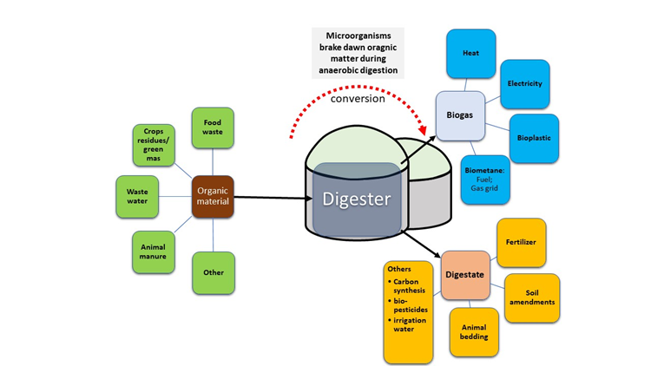
BIOGAS

Slide 15
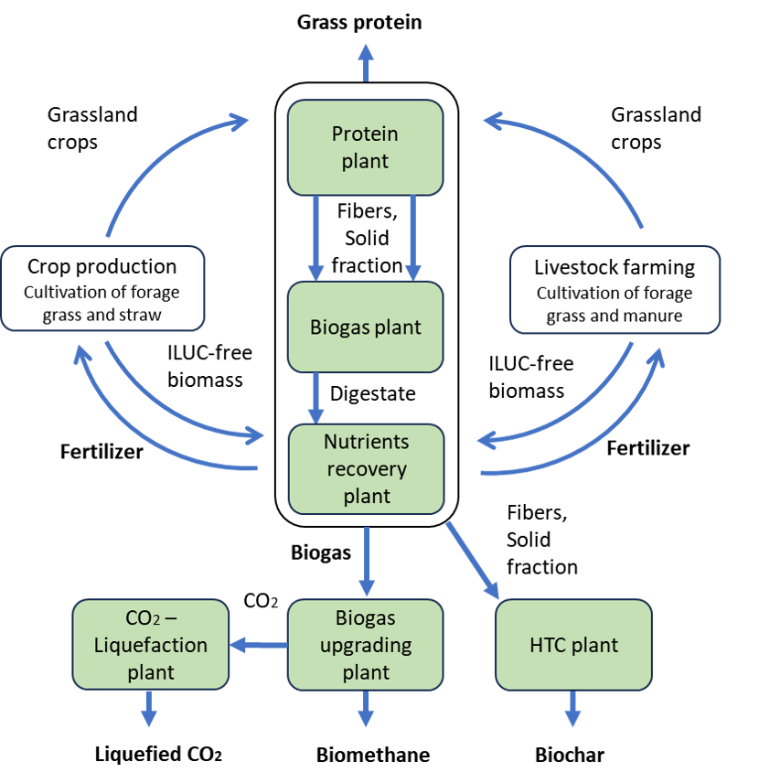
Refinery forage crops
Notes:
Hydrothermal carbonization (HTC) is a technology by which a wet biomass can be processed into a higher value material. The process involves heating the wet biomass for a few hours to 200-250°C under high pressure to avoid boiling.

Slide 16
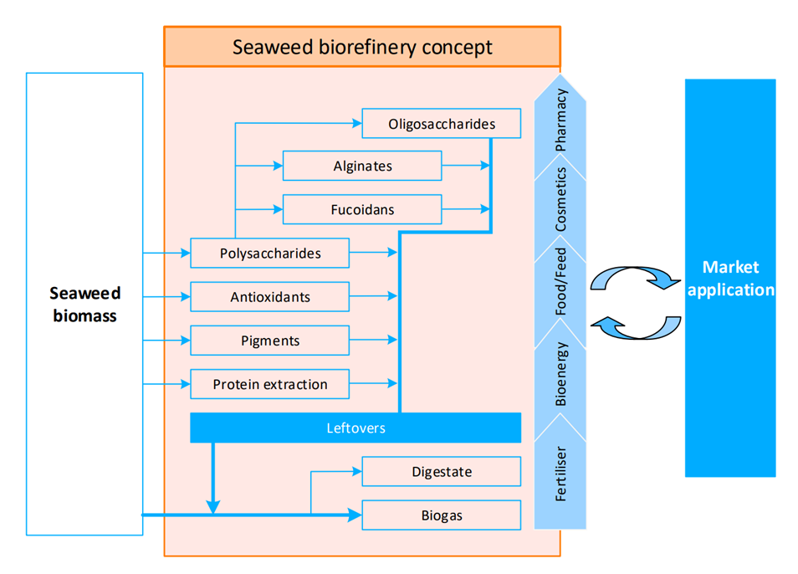

Slide 17
Areas of use for Biogas and residue
Biogas
Thermal energy (heat),
Fuel
Electricity​
Bioplastic
Residue
Fertilizer
Animalbedding
Soilamendments
Pros :
Renewable resource that reduces dependence on non-sustainable alternatives
Efficient use of organic waste
Cons :
Dependence on sufficient access to raw materials
High costs and investments in infrastructure

Slide 18
Areas of use for extracted protein
Protein juice
High-quality protein for high-performance ruminants and monogastrics animals
Pos:
Reduces dependence on imported protein feed (soy)
Possibility for crop farms to include forage plants in the crop rotation
Cons :
High costs for investments
Dependent on availability of high-quality grass and clover
Press cake (residual)
Feed for low-performing animals,
Biogas production
Biochar production
Textile Fibers

Slide 19
Pyrolysis process and products
Process
Biochar
Heating bio mass –
Up to 500-600 °C without oxygen,
Ämnet sönderfaller utan förbränning
Vid pyrolys avgår gaser och en återstod i fast eller flytande form
Carbon sequestration
Soil improvement
Energy production
Biogas and Bioil
Heating
Power generation
Fuel
Syngas
As above, also as a raw material in the chemical industry

Slide 20
Sustainable strategies for the transition to a more bio-based economy
Great need for knowledge – broad educational activities
General reduction of consumption – for a sustainable future
Using renewable resources – a natural resource that depletes more slowly than it is replenished
Efficient material flows – especially with regard to carbon.
Make optimal use of production waste
Use degradable products
Implement effective collection systems
Notes:
A bio-based economy contributes to more sustainable methods and to reducing climate change.
This is done with everything from very simple technology – such as reusing production waste as resources in the manufacture of new products – to advanced technology – such as producing new materials, for example bioplastics, from components from the original biomass. The aim is always to achieve the most efficient material flows possible, especially with regard to carbon
A renewable resource is a natural resource that depletes more slowly than it is replenished. The resource must have ways to recover to be called renewable. However, they can become non-renewable if they are used to a greater extent than nature's ability to regenerate them.
A CIRCULAR bioeconomy can contribute to more sustainable practices and to reducing climate change. This can be done with everything from very simple technology – such as reusing production waste as resources in the manufacture of new products – to very advanced technology – such as producing new materials, for example bioplastics, from components from the original biomass. The aim is always to achieve the most efficient material flows possible, especially with regard to carbon.

Slide 21
The Paris Agreement
A treaty combating climate change. It aims to limit global temperature rise to well below 2°C above pre-industrial levels. Every signatory country works toward agreed-upon goals. For example, Sweden pledge to become carbon-neutral (have net-0 emissions) by 2045. Finland is one of Europe’s most ambitious countries, wanting to achieve climate neutrality by 2035. (Ministry of Foreign Affairs in Finland). Almost the entire world is working towards achieving climate neutrality by 2050

Slide 22
“How wonderful it is that nobody need wait a single moment before starting to improve the world”
~ anne Frank

