Slide 1
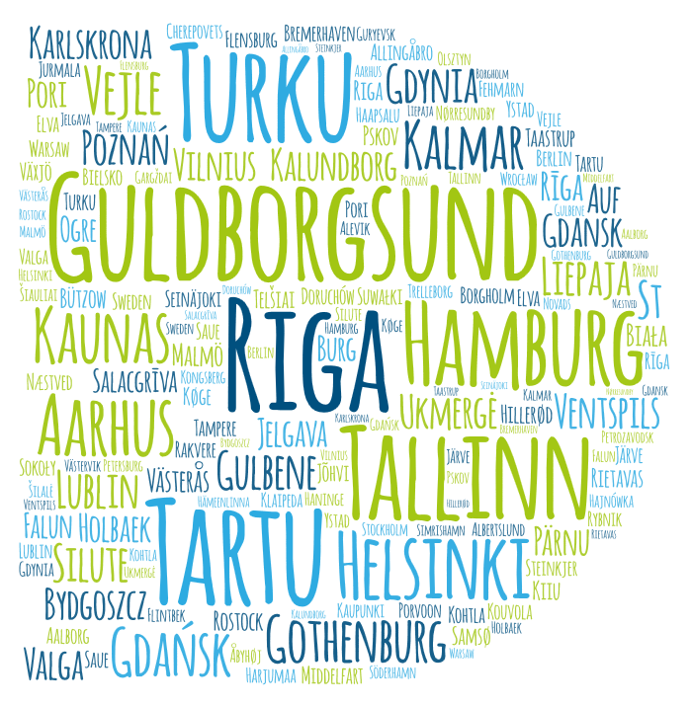
Interreg Baltic Sea Region
in facts: local public authorities
wordart.com (Amatic)
Local public authorities
in projects

Slide 2
Interreg Baltic Sea Region
in facts: local public authorities
Local public authorities
by country
Over 170 local public authorities from 10 countries
out of 1500+ partners in projects
Share of
local public authorities
among all partners
from the country
Number of
local public authorities
by country

Slide 3
Interreg Baltic Sea Region
in facts: local public authorities
Local public authorities involved in
Innovation Natural Resources Transport projects
64 projects with local public authorities
123 projects in total
3
15
Local public authorities are mostly involved in innovation, urban mobility and clear waters
10
6
15
25
10
21
1
5
5
7
5
10
5
9
3
3
3
6
2
6
6
6
More information at:
projects.interreg-baltic.eu

Slide 4
Interreg Baltic Sea Region
in facts: local public authorities
Share of local public authorities among all project partners
by call
16.7
%
12.8
%
Involvement
of local public authorities
in projects
increased
7.5 %
First call
(2016-2019)
Second call (2017-2020)
Third call (2019-2021)

Slide 5
Interreg Baltic Sea Region
in facts: local public authorities
Projects driven by
local public authorities
5+ local
public authorities
in the project
BaltCity Prevention
Baltic Game Industry
NOAH
LUCIA
WATERDRIVE
BSR electric
NSB CoRe
More than
20 projects
are driven by
local public authorities
BIC
BIS
CircularPP
Restart BSR
BEST
BSR Water
IWAMA
MARELITT Baltic
NonHazCity 2
Healthy Boost
Act Now
NonHazCity
cities.multimodal
Green SAM
SUMBA
Project lead partner is a local public
authority

